Slide 1
Goals. Students will be able to:
Identify who the Aztec were.
Summarize important characteristics of Tenochitlan, the Aztec capital.
Describe the role warfare played in Aztec life.

Slide 2
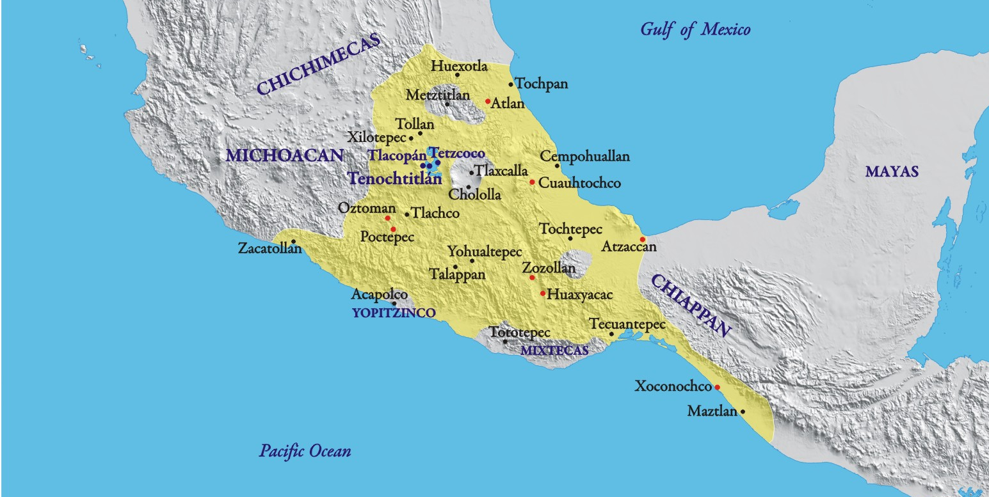
Aztecs
An empire centered on three allied cities: Tenochtitlan (the preeminent), Texcoco, and Tlacopan. Rebelled against the Azcapotzalco Empire.

Slide 3
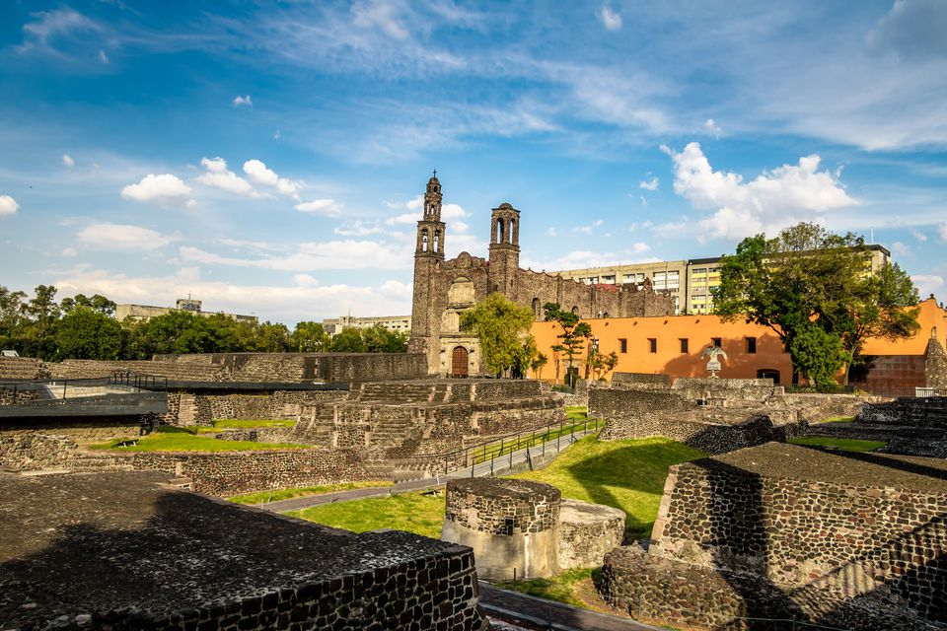
Aztecs
Mexico City is built on Tenochtitlan.
When Spanish arrived in AD 1519:
Between 200,000 and 300,000 people. Five times the population as London.
Notes:
Main market could hold 60,000 people at one time.
Could buy chocolate, vanilla, cigarettes, tools for carpentry and other trades, ceramics, and luxury items made of gold, silver, jade, turquoise, and feathers.
Slavery was common.

Slide 4
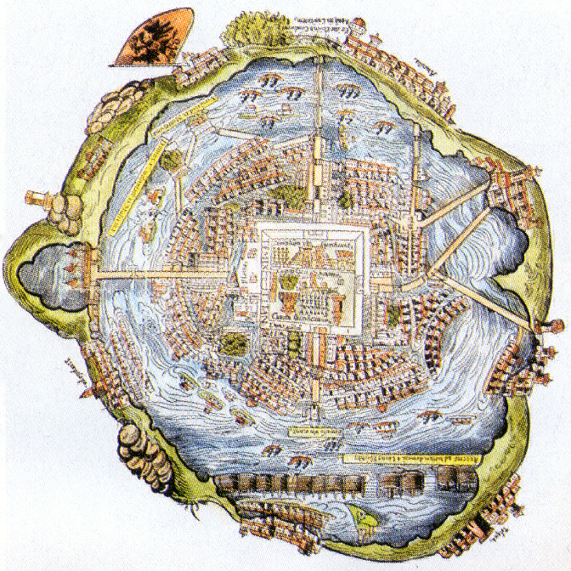
Tenochtitlan
A city built for defense
Built on an island that was connected to shore via bridges. The bridges had collapsible sections. Gates also secured the entrances.

Slide 5
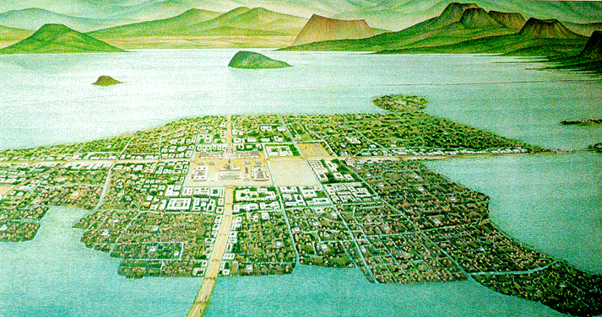
Tenochtitlan surrounded by Lake Texcoco

Slide 6
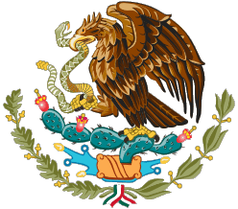
Tenochtitlan
City founded in AD 1325
Legend of eagle eating a snake while perched on a cactus.
Before this, the Aztecs were a wandering tribe of basically mercenaries.
Craft barrios (calpullis) organized the town.
Center of town had public buildings.
Included two zoos. One for birds of prey, the other for other animals including mammals, reptiles, and other birds.

Slide 7
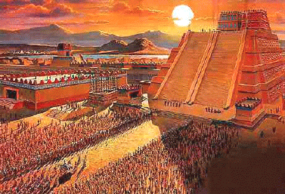
Public Buildings
Templo Mayor—Great Pyramid
60 m tall (197 ft). Dedicated to Smoking Mirror (Huitzilopohtli), the god of war and sun, and Tlaloc (god of rain and fertility).
Tens of thousands of people sacrificed at the temple.
Destroyed during the Spanish conquest in 1521.
tzompantli – Skull rack.
Also 60 m tall

Slide 8
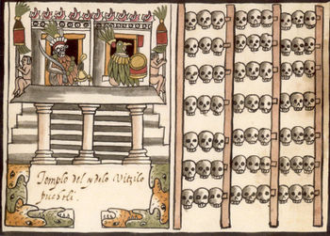
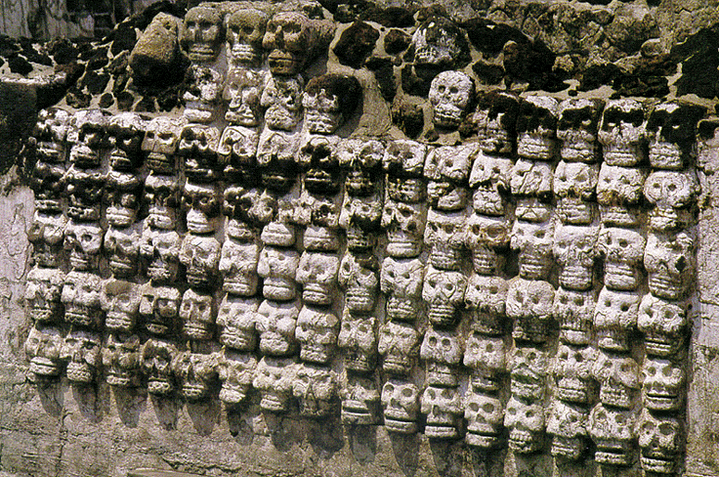
Tzompantli
Wooden skull rack found in many places, but especially associated with the Aztec.
Skulls from war captives who were sacrificed. Also losers of ballgames.

Slide 9
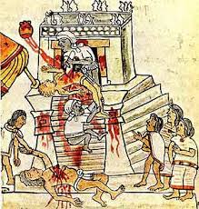
War and Sacrifice
Aztec society was based on warfare. The gods had to be fed through blood, especially human blood. Aztecs took this principle to an extreme.

Slide 10
Aztec society was based on warfare.
Notes:
Rigid class system. Warfare was the only means of social advancement. Eagle Nobles.
Eagle nobles given land and titles.

Slide 11
Flowery War
Warriors who fell in battle went to the paradise of the Sun God.
Head of the military was the Emporer, who was required to wage war.
Handled external relations. Had a counterpart named “Female Snake”, who administered internal policy and administration.
Potchteca—Members of a trading class that acted as spies and traders. Vanguard of the Aztec military.

Slide 12
Passage from a Nahuatl song that was sort of like the national anthem:
The battlefield is the place:
Where one toasts the divine liquor in war,
Where are stained red the divine eagles,
Where the jaguars howl,
Where all kinds of precious stones rain from ornaments,
Where wave headdresses rich with fine plumes,
Where princes are smashed to bits.
There is nothing like death in war,
Nothing like the flowery death
So precious to Him who gives life:
Far off I see it: my heart yearns for it!

Slide 13
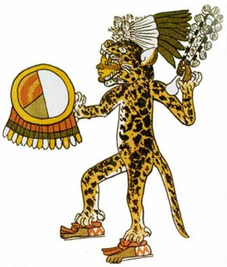
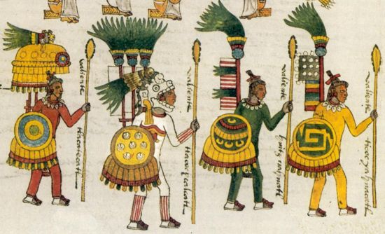
Aztecs fought with sword-clubs called macuahuit and atlatls. The leaders wore very finely adorned feather capes, which made them very identifiable for the Spanish.
Foreign troop acted as bowmen

Slide 14
Death Whistle
https://www.youtube.com/watch?v=I9QuO09z-SI

Slide 15
Raising Children for War
Soon after an Aztec boy was born, a special incantation was recited over him: “The house into which you are born is not your true home. Instead it is a resting place, for you are a warrior. Your mission is to give the sun the blood of enemies to drink, and the feed Tlaltecuhtli [the Earth] with their bodies.”
The boy was then given a miniature shield and four arrows.
In contrast women were given weaving tools. The rites read over them admonished them to remain at home and serve their families well.

Slide 16
Schooling
Universal education.
School started at age 15 and lasted until about 20.
Two types of schools: military academies and seminaries.
Nobles attended seminaries, where they learned religion and astronomy. All government officials had to have attended seminaries.
Priests then received additional training. Like grad school

Slide 17
Schooling
Most people went to military academies.
Males and females were segregated.
Girls joined “the House of Song” and learned songs, dances, and domestic skills.
Males received miliatary training. Included serving as squires during military campaigns.
The master of the school had to approve marriages, in part to ensure that the union would benefit the soldier’s readiness for war.

Slide 18
