Slide 1
General Anthropology Anthro. 1000

Slide 2
Professor:
Todd L. VanPool
Teaching Assistant:
Jeremy Morin

Slide 3
Syllabus
Attend class!!!
No text book, but read the assigned readings
Grading:
Readings, discussions, and online quizzes
Tests
Class Participation

Slide 4
Who did you vote for?
I could not care less.

Slide 5
Goals. Students will be able to:
Define anthropology and differentiate it from other social and behavioral sciences.
Define key concepts including ethnocentrism, cultural relativity, the naturalistic fallacy, the moralistic fallacy, and objectivity.
Define and differentiate five definitions of ‘culture’ that anthropologists use.

Slide 6
What is Anthropology?
Anthropos = man
Logos = study
Anthropology = the study of humans
It differs from other disciplines because of its holism, breadth of research, and the questions it answers. Anthropology studies people and their cultures using a comparative framework.

Slide 7
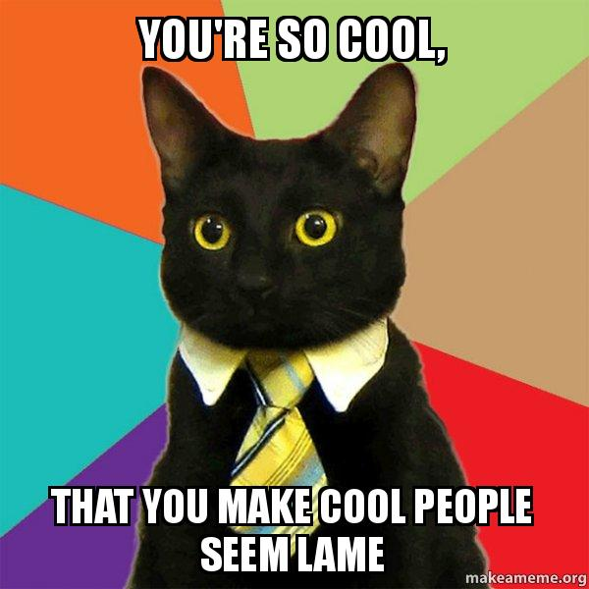

Slide 8
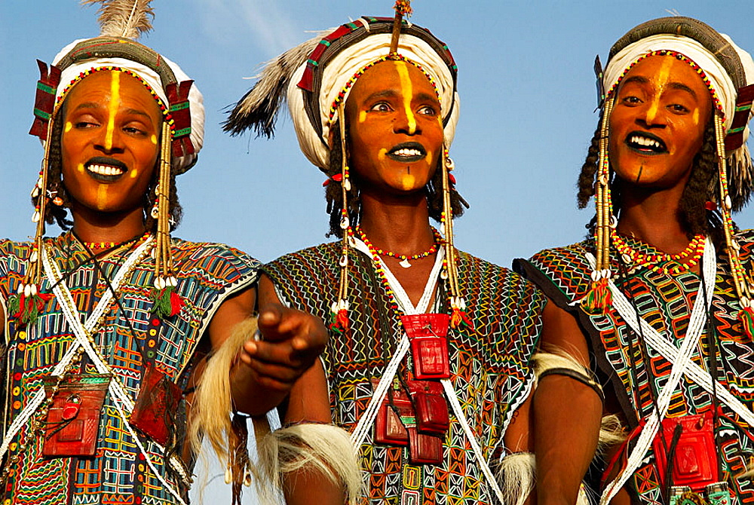
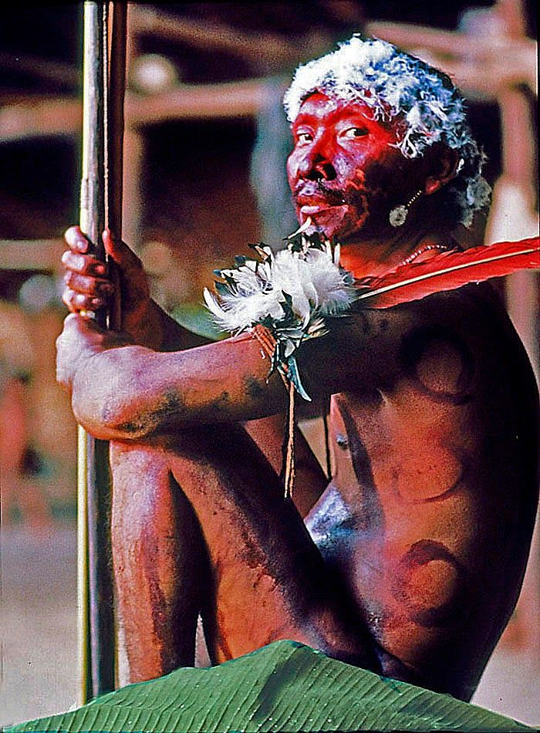
Other People are Cool Too!

Slide 9
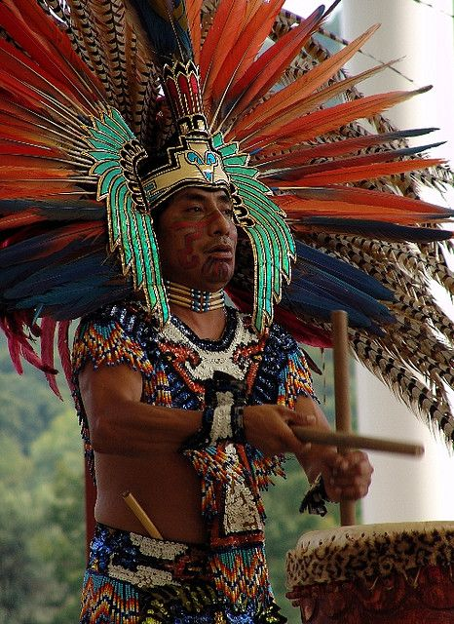
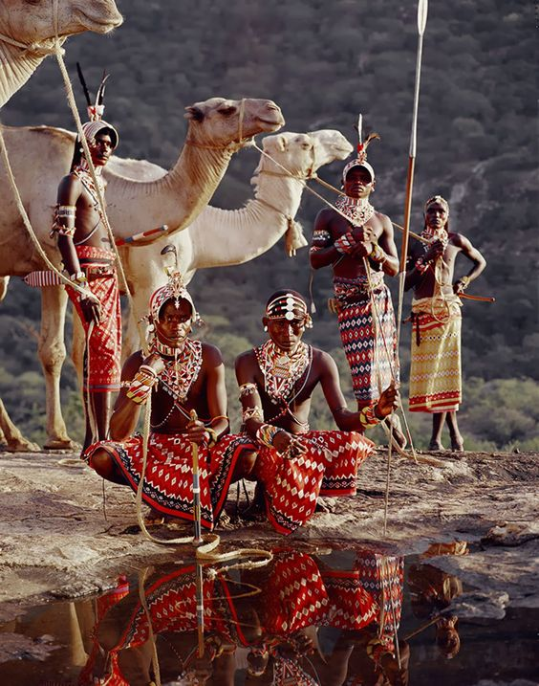
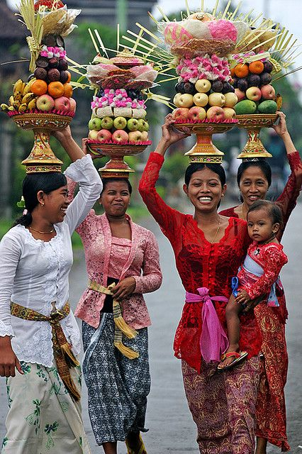
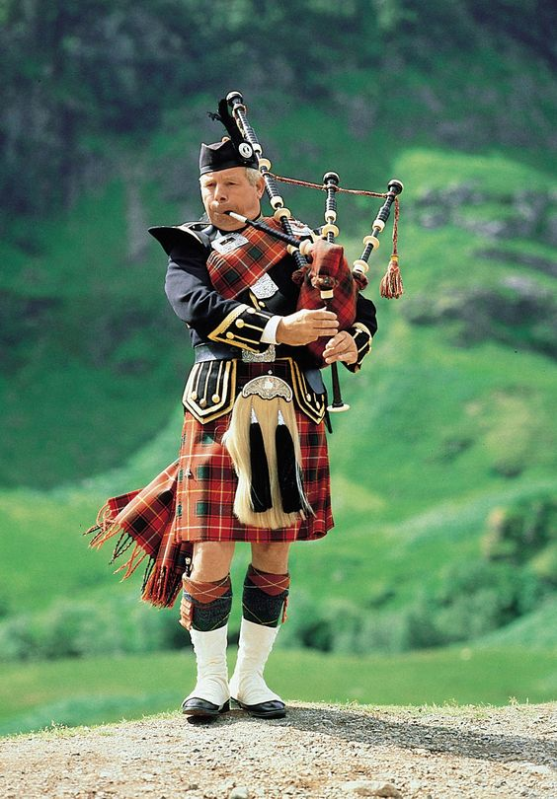
Anthropology is the study of culture. And culture matters!
Want to understand human behavior? The one needs to understand culture. However, Western culture is only one example of (or a cluster of closely related) cultures. More variation. How can we get information from these other cultures?
ANTHROPOLOGY

Slide 10
Anthropology’s subject matter includes the study of engineering, technology, art, music, psychology, physiology, biology, economics, gender, literature, natural history, environmental science, warfare, mathematics, linguistics, religion, philosophy, sociology, demography, cartography, geography, history, medicine, chemistry, agriculture, husbandry, communications, speech, heck, even plumbing, across cultures. Not only that, anthropology can study it over a really long period of time, much longer than is possible for ANY other discipline. In fact, anthropology is the only means of studying the behavior of vast majority of human existence.

Slide 11
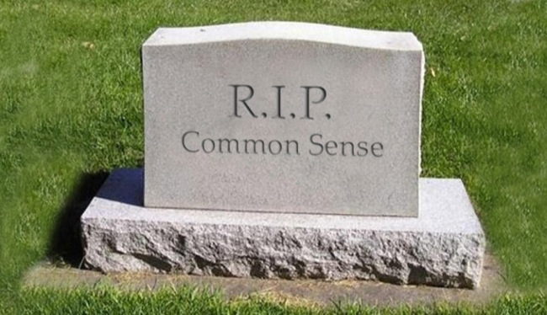
How to Think About Culture: Key Concepts
Must reject common sense.
Common sense is (especially) culturally specific.
Use common sense to evaluate other cultures and they won’t make sense.

Slide 12
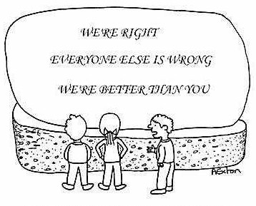
Ethnocentrism: Evaluation of other cultures according to preconceptions originating in the standards and customs of one’s own culture.

Slide 13
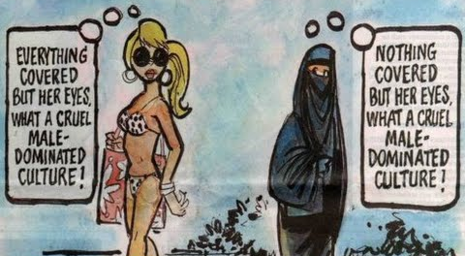
Cultural Relativity:
IS NOT the idea that all cultures are the same or produce the same outcome.
IS the idea that behavior in each culture must be understood within the context of that culture.

Slide 14
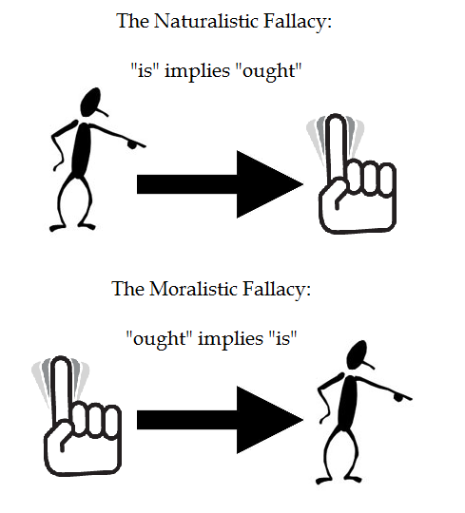
Avoid the Naturalistic Fallacy and the Moralistic Fallacy
Two logical errors:
Naturalistic Fallacy—What ‘is’ determines what ought to be. If people in a culture do activity X, then it is morally right that they engage in activity X.
Moralistic Fallacy—What ought to be is what is. People shouldn’t be androcentric, therefore people in this culture aren’t androcentric.

Slide 15
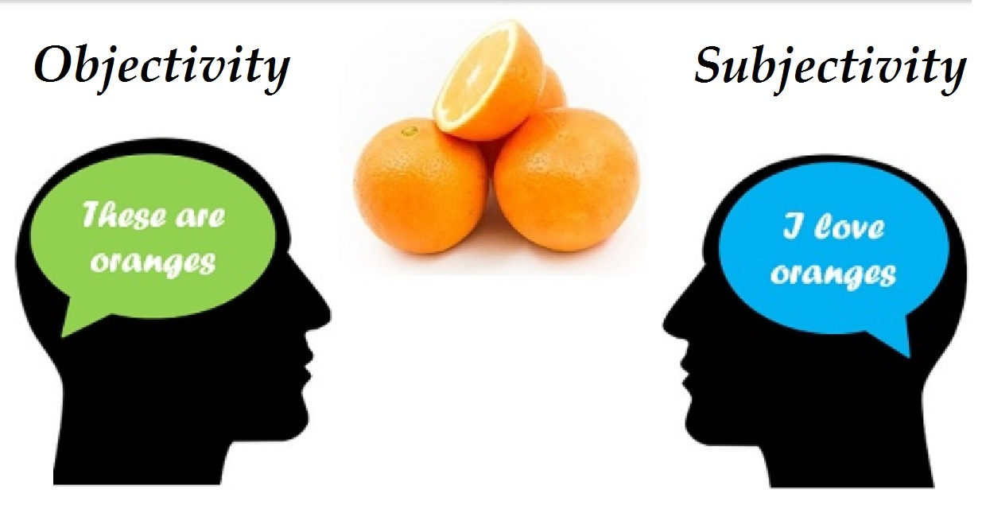
Objectivity
DOES NOT mean free from internal bias or values.
Does mean that it can be evaluated using the same tools and criteria by multiple observers.

Slide 16
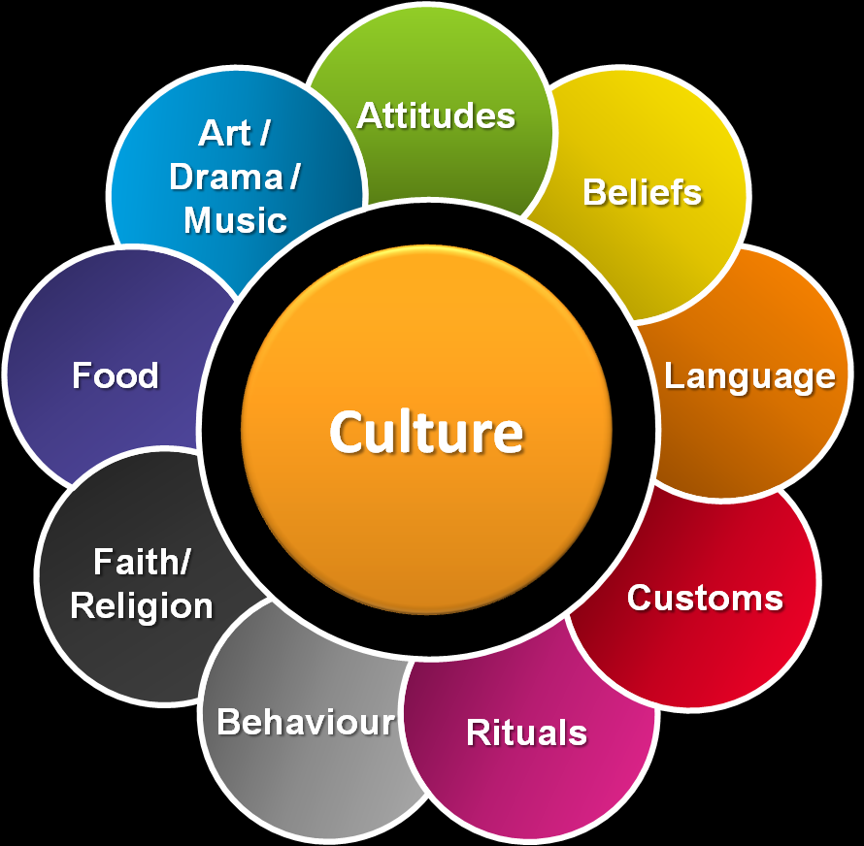
Culture
Anthropology is the study of culture and the biological and environmental factors that affect it. What does ‘culture’ mean?

Slide 17
Culture: many different definitions have been proposed.
Oldest and most common is from Edward Tylor (late 1800s):
Culture is the complex whole that includes knowledge, belief, art, law, morals, customs, and other habits people acquire as part of a society.

Slide 18
Tylor’s definition still common. Things to think about:
Culture is a group phenomenon. No one has culture. It is instead the pattern typical of the entire group.
Very general and unclear scale. Are, say, ‘Lutherans’ a culture? What about ‘protestants’? How about ‘Christians’? What about Judaism, Christianity, and Islam? The answer might be ‘yes’ OR ‘no’ at a given scale of analysis.

Slide 19
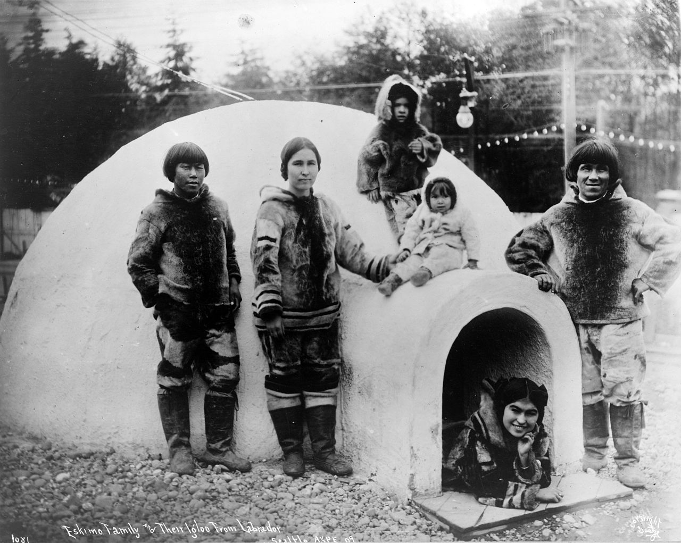
Many recent definitions focus on cultural transmission.
Culture is transmitted behavioral information.

Slide 20
Many recent definitions focus on cultural transmission.
Culture is transmitted behavioral information.
Every living human breaths, but the cultural aspects of breathing would include actors who learn from others how to breath so that it appears they are angry, tired, happy, etc. Thus, breathing has a cultural aspect that can be identified.

Slide 21
Some definitions focus on mental constructs.
Shared culture is shared perceptions of the world, beliefs, and values.
Really problematic in anthropology:
How can we measure/observe mental states?
How closely do they have to be shared to still be considered part of the same culture?

Slide 22
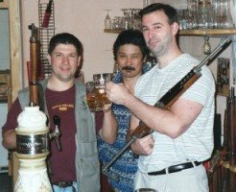
Two additional definitions:
Culture can be used to refer to a specific group (e.g., the Iroquois culture; the beer and shotgun culture). Close correspondence of material culture and behavior.

Slide 23
Culture as the extra-somatic means of adaptation
Extra-somatic means outside of your body.
It’s one’s behavior and the tools one uses to survive and reproduce.
Somatic means of adaptation
Extra-somatic means of adaptation

Slide 24
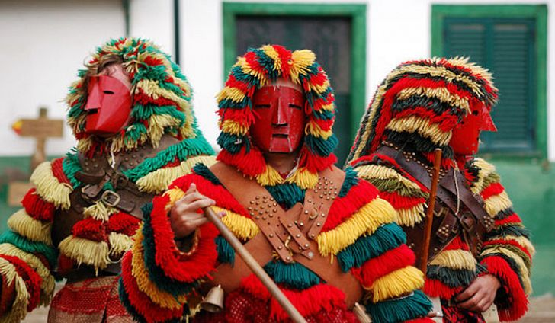
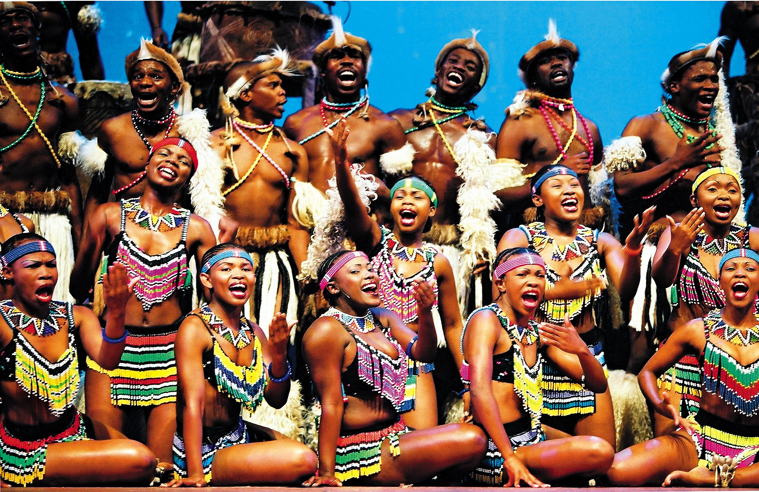
Each definition has been used and continues to be used. When you hear the word ‘Culture’, you need to stop and figure out how the term is being used.
Notes:
Masks from Caretos in the carnival of Podence, Portugal.

Slide 25
