Slide 1
Goals. Students will be able to:
Define archaeology and explain why it is important.
Define the fundamental terms of artifact, feature, and site.
Identify 5 ‘types’ of archaeology.
Identify examples of archaeological research at Mizzou.

Slide 2
The four subfields of Anthropology:
Archaeology
Biological Anthropology
Ethnology/Cultural Anthropology
Linguistics
Notes:
Go through each subfield but end on anthropology

Slide 3
ANTHROPOLOGICAL ARCHAEOLOGY
Archaeology: study of human behavior and cultural patterns and processes through culture’s material remains
Garbage
Burials
Houses
Quarries and fields
Dams
Remains of structures

Slide 4
Archaeology
Artifacts: objects manipulated or manufactured by humans.
Features: a non-portable “structure” made by humans.
Sites: a location of human behavior that produced a substantial number of artifacts/features. Lots of the same artifacts/features, or a bunch of different artifacts and features.

Slide 5
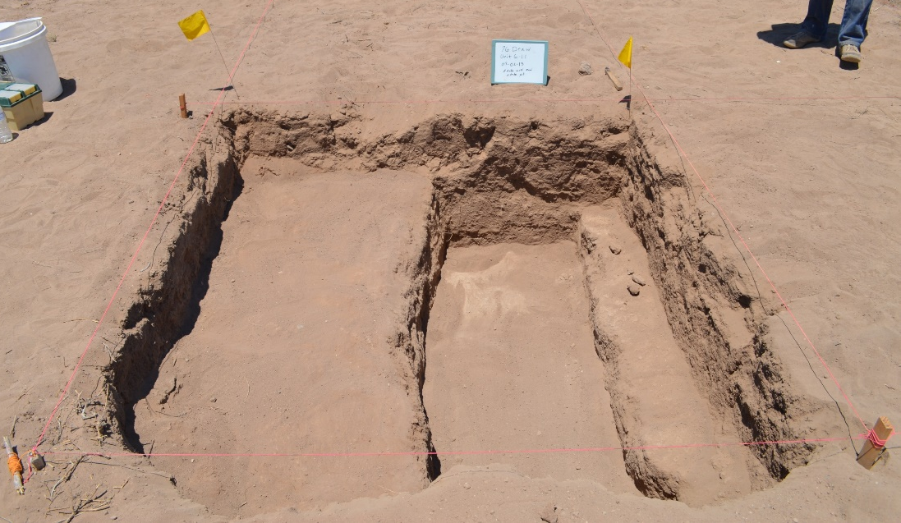
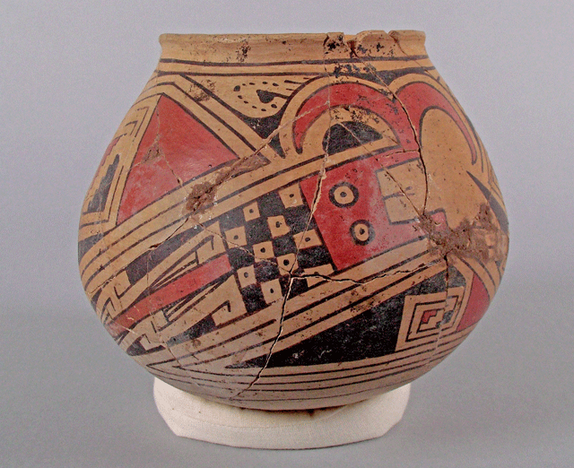
Site
Feature
Artifact
Pit
Floor
Wall

Slide 6
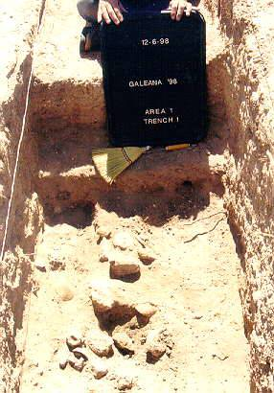
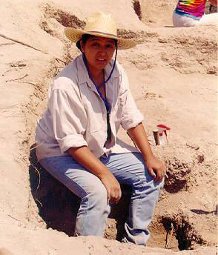
“Types” of archaeology:
Prehistoric Archaeology.
Focuses on people who have no written record.

Slide 7
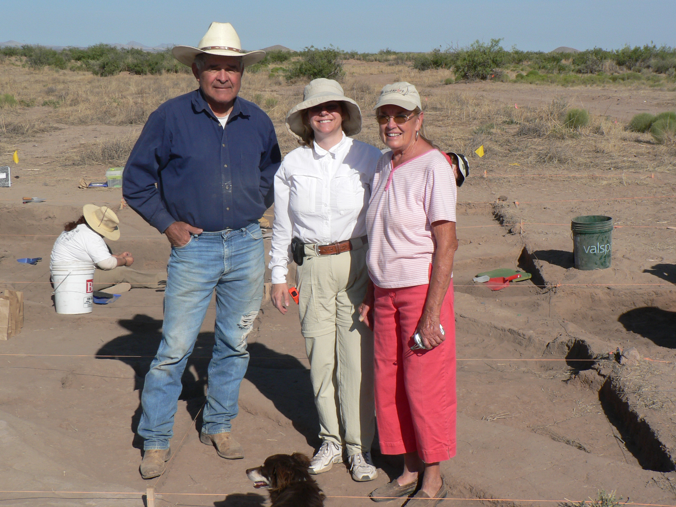

Slide 8
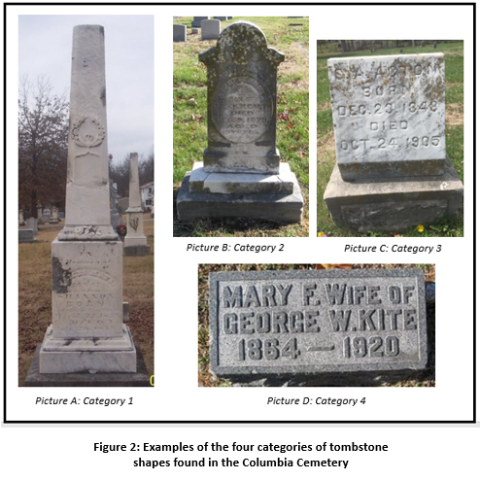
Type 2: Historic Archaeologists study people who do have written records.
Often designed to evaluate historical questions or to test the accuracy of “common historical knowledge.” Subjects can include modern peoples, e.g., “cold war archaeology.”

Slide 9
Type 3: Underwater Archaeology
Conduct prehistoric or historic except they do it under the water.

Slide 10
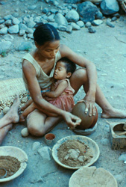
Type 4: Ethnoarchaeology
Examine living/modern groups to understand how specific people make and use artifacts and features.
Atlatl and Dart

Slide 11
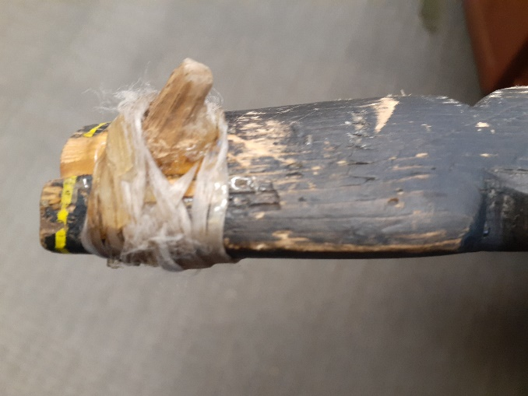

Slide 12
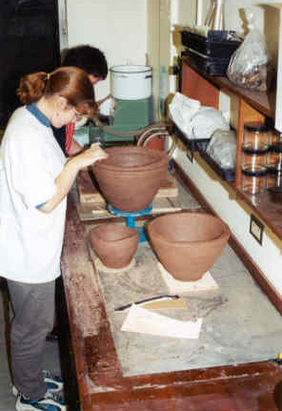
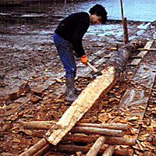
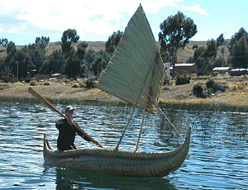
Type 5: Experimental Archaeology
The use of controlled experiments to provide information useful to archaeological study.

Slide 13
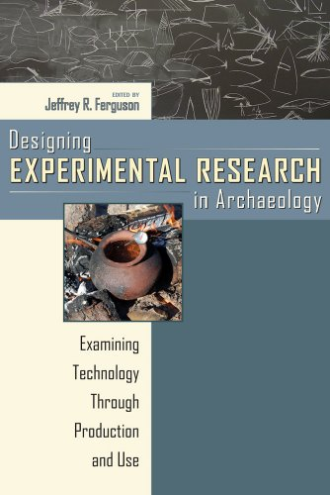

Slide 14
Classical Archaeology is not the same as Anthropological Archaeology
.
Notes:
Study Mediterranean area and emphasize language and art. They are really specialized historical archaeologists who focus on Western cultures such as those from Greece and Rome. Perhaps the main type of archaeology in Europe

Slide 15
