Slide 1
Goals. Students will be able to:
Define biological anthropology
Describe the major approaches to bioanthropology
Identify some members of our department specializing in bioanthropology.
Describe the north European bog bodies and explain why they are an excellent example of biological anthropology.

Slide 2
The four subfields of Anthropology:
Biological Anthropology
Archaeology
Ethnology/Cultural Anthropology
Linguistics
Notes:
Go through each subfield but end on anthropology

Slide 3
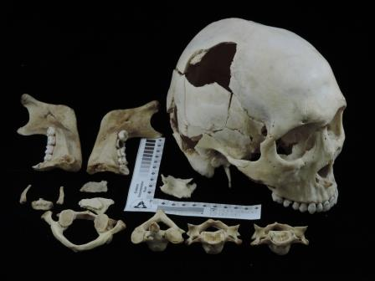
BIOLOGICAL ANTHROPOLOGY
Study of human bodies and mortuary treatments

Slide 4
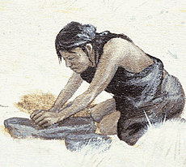
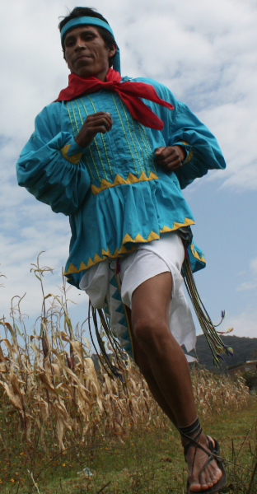
Human Osteology: analysis of skeletal materials to examine life history, ancestry, and adaptation
Notes:
Neanderthals have an unusual distribution of skeletal trauma, with high levels of head trauma and few pelvis and lower limb injuries. In their now classic paper, Berger and Trinkaus (1995) compared these patterns of trauma to both archaeological populations and modern hospital samples, in order to shed light on the types of activity patterns that may have led to the relatively unique anatomical distribution of Neandertal trauma. We revisit this topic using a dramatically expanded comparative sample from the National Electronic Injury Surveillance System (NEISS), which includes 84 sets of trauma data from different sports and activities (n=61,667). When the pattern of injury in these living samples was compared to that of Neandertals, 70 groups were significantly different from Neandertals. Of the 14 activities not statistically significantly different, it was difficult to hypothesize analogous behaviors in Neanderthals. These include activities such as water tubing (p = 0.812), flying disks and boomerang games (p = 0.077), and accidents involving a golf cart (p = 0.126). It is possible that this method of drawing comparisons between patterns of Pleistocene trauma and those of modern sports samples may be problematic due to issues of survivorship and small fossil sample size. Alternatively, it also remains possible injury distribution data provides insufficient resolution to interpret past behaviors, due to the wide variety of specific activity patterns that can generate a single distribution pattern.

Slide 5
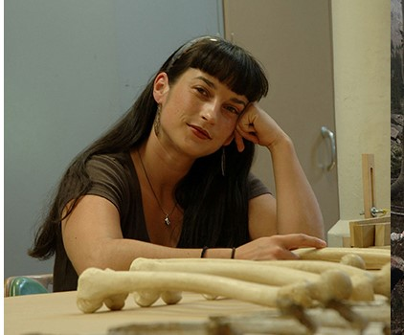
Dr. Libby Cowgill--Human ancestors, especially Neandertals; skeletal analysis and the ways activity is reflected in our bones.
Notes:
Neanderthals have an unusual distribution of skeletal trauma, with high levels of head trauma and few pelvis and lower limb injuries. In their now classic paper, Berger and Trinkaus (1995) compared these patterns of trauma to both archaeological populations and modern hospital samples, in order to shed light on the types of activity patterns that may have led to the relatively unique anatomical distribution of Neandertal trauma. We revisit this topic using a dramatically expanded comparative sample from the National Electronic Injury Surveillance System (NEISS), which includes 84 sets of trauma data from different sports and activities (n=61,667). When the pattern of injury in these living samples was compared to that of Neandertals, 70 groups were significantly different from Neandertals. Of the 14 activities not statistically significantly different, it was difficult to hypothesize analogous behaviors in Neanderthals. These include activities such as water tubing (p = 0.812), flying disks and boomerang games (p = 0.077), and accidents involving a golf cart (p = 0.126). It is possible that this method of drawing comparisons between patterns of Pleistocene trauma and those of modern sports samples may be problematic due to issues of survivorship and small fossil sample size. Alternatively, it also remains possible injury distribution data provides insufficient resolution to interpret past behaviors, due to the wide variety of specific activity patterns that can generate a single distribution pattern.

Slide 6
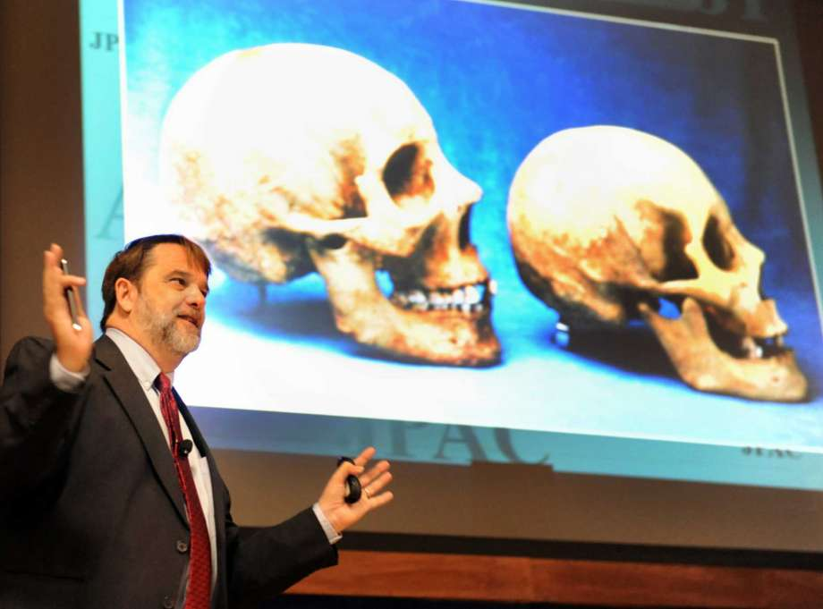
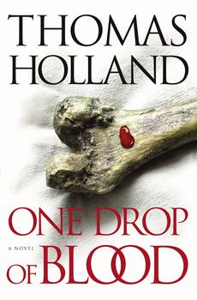
BIOLOGICAL ANTHROPOLOGY
Thomas D. Holland
Earned PhD from MU in 1991.
Worked as the director of the DOD Central Identification Laboratory in Hawaii. Worked to recover and identify US war dead (e.g., unidentified war dead in Korea and Vietnam).

Slide 7
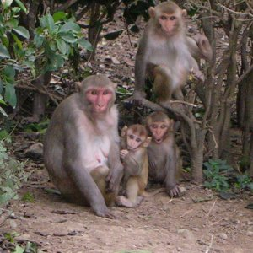
BIOLOGICAL ANTHROPOLOGY
Primatology: study of nonhuman primates to better understand human evolution, life history, and behavior
Dr. Greg Blomquist—ecology and evolution of patterns of growth, reproduction, and life history in primates.

Slide 8
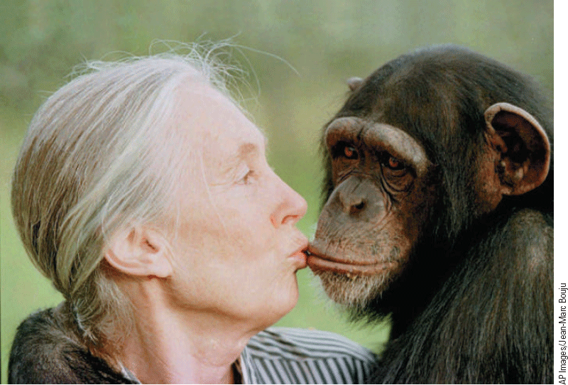
Primatologist Jane Goodall
Jane Goodall: studying chimpanzees to understand our distant ancestors.

Slide 9
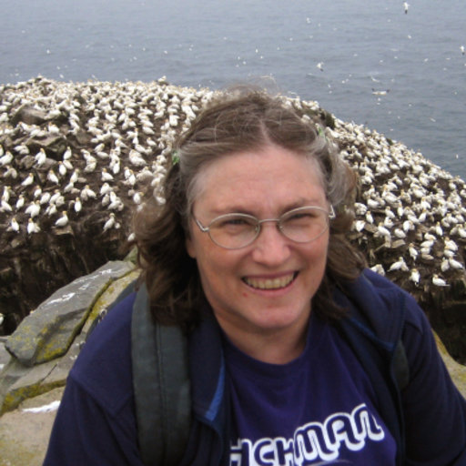
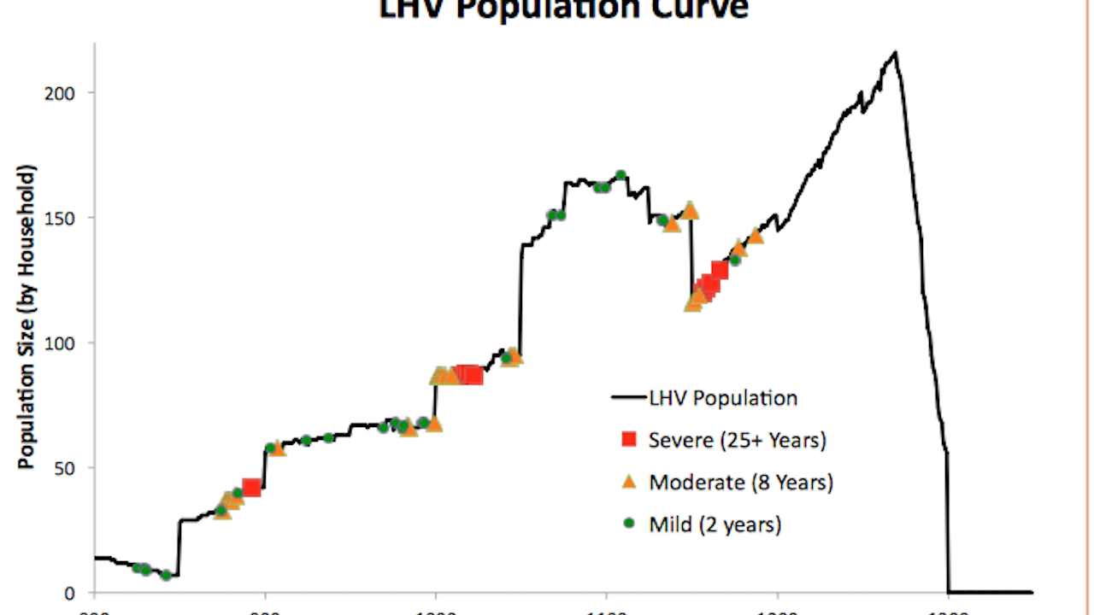
Demography: analysis of data related to birth, death, and so forth to understand factors such as disease, warfare, status, and other factors affecting health
Dr. Lisa Sattenspiel—AAAS Fellow; specializes in infectious disease, especially the 1918 flu; is currently involved in research on COVID-19. Also looking at factors that influenced health here in Columbia (e.g., immunization).

Slide 10
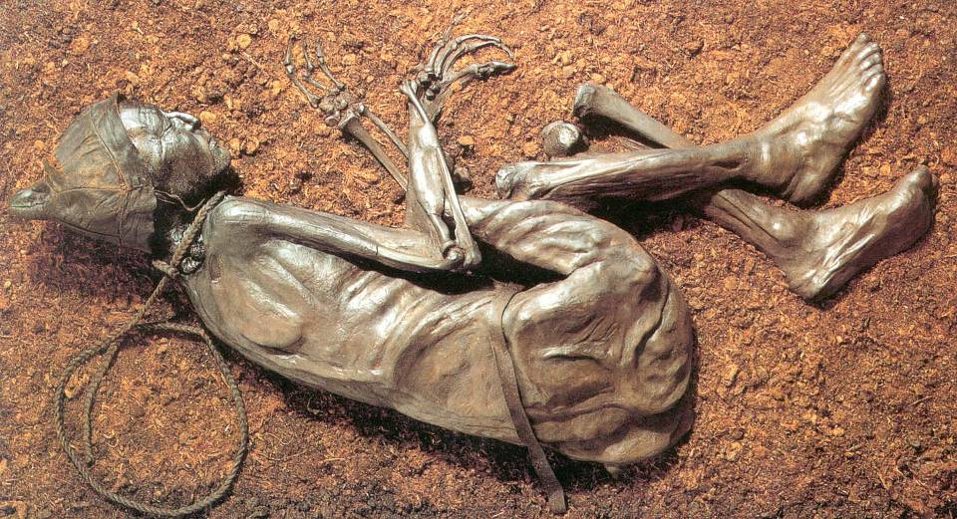
Mortuary Practices: treatment of the dead to understand factors such as class and social organization.

Slide 11
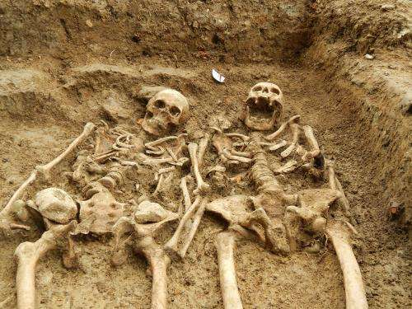
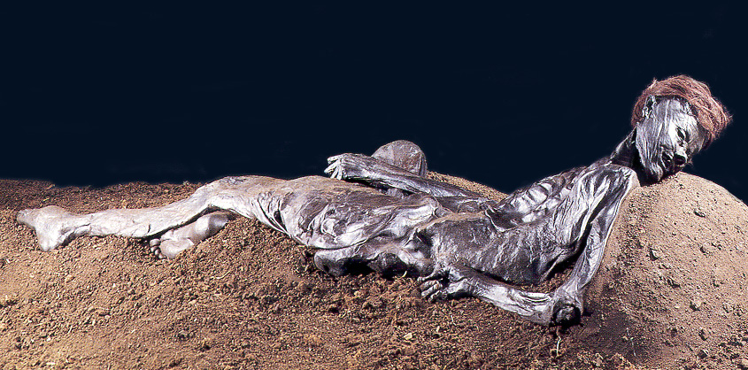
Bog Bodies
Naturally mummified cadavers in pear bogs. Unusual because skin and other soft tissue remain.

Slide 12
Bog Bodies
Preserved because of highly acidic water, cold temperatures, and anaerobic environment. Skin preserves, but bones don’t.
1,000+ have been found.
Most date to the Late Iron Age (~500 BC) of northwestern Europe.
Typically show signs of being killed: stabbing, bludgeoning, hanging, strangled.
Ritually slain, but question of whether this reflects human sacrifice AND/OR capital punishment.

Slide 13
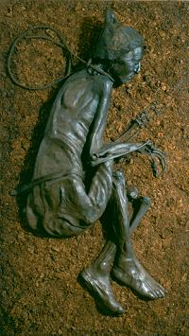
The Tollund Man
Found in 1950 in a Danish peat bog. So well preserved, originally thought to be a murder victim.
Killed sometime around 300 BC. Naked except for a hat and a rope around his neck. Hanged.
Probably around 40 years old. 5’ 3” tall (body probably shrunk).

Slide 14
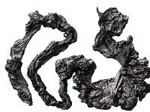
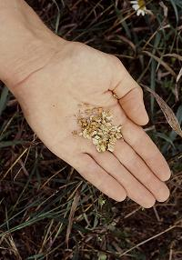
The Tollund Man
Stomach contents: last meal of porridge made of 40 different wild and natural seeds. No meat.
Rye contained a hallucinogenic fungus that also stems bleeding. Perhaps intentionally ingested as part of a religious ceremony.

Slide 15
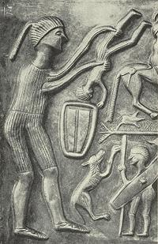
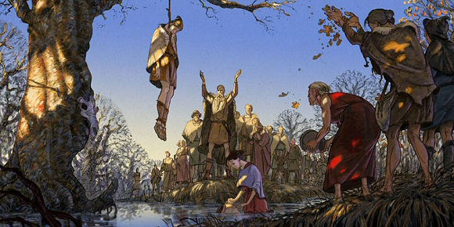
Bog Bodies
Historic and iconographic evidence for ritual drownings and other forms of human sacrifice, as well as capital punishment. Some bodies have entrails partly removed, which could have been part of divination ceremony.

Slide 16
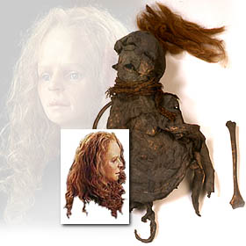
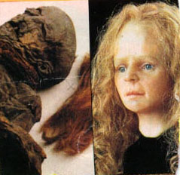
Yde Girl
From the Netherlands. Died between 54 BC and 128 AD.
Suffered from scoliosis, a painful disfigurement of the spine.
Noose and woolen cape. Stabbed in chest as well, but not what killed her.

Slide 17
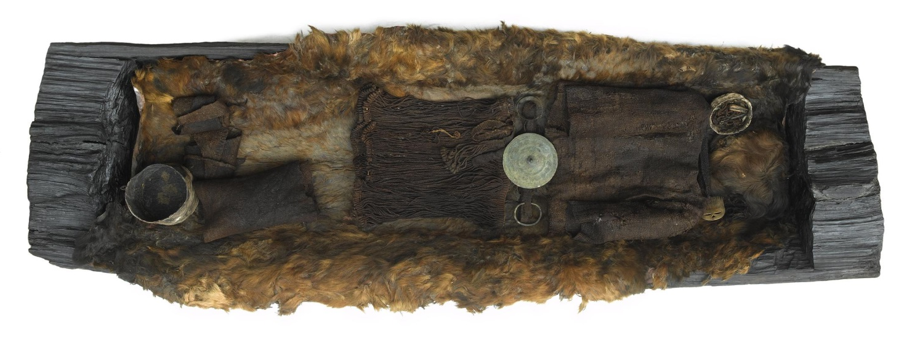
Egtved Girl
Burial in South Jutland, Denmark. Buried in bog, but earlier than most bog bodies. 1400 BC.
~18 year old
Had excellently preserved clothing. String skirt, short sleeved shirt, with a bronze spiked belt disk. Manicured nails. Long blonde hair. Bronze belt plate with swirl (sun symbol?). Bronze arm bands.
Arm Band
Ring

Slide 18
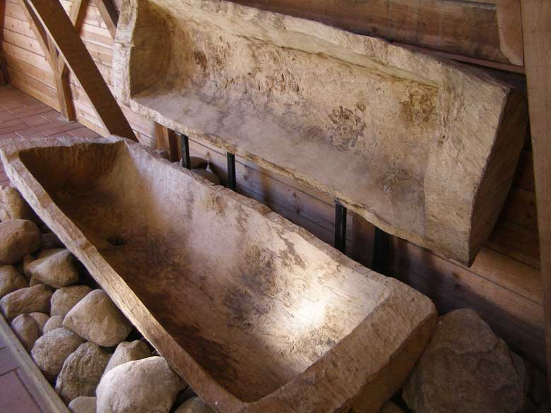
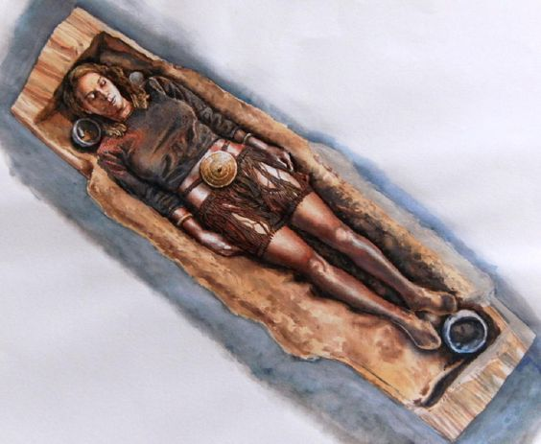
Egtved Girl
Buried on cowhide and covered with a coarse wool blanket.
Buried with cremated 5 to 6 year old. Also beer.

Slide 19
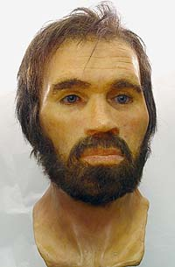
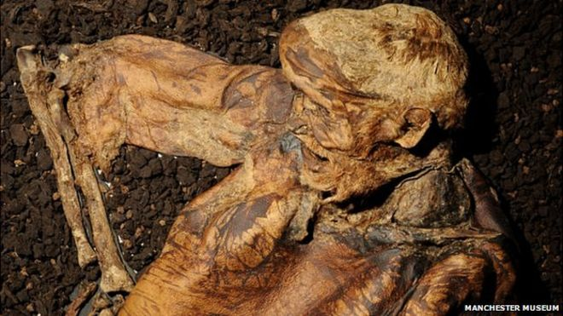
Lindow Man
From England. Deposited sometime around 2000 years ago. At least 27 other bog bodies. Later than bodies from Denmark, the Netherlands, Germany, etc.
Male, mid-20s. In good health.
Strangled, blunt force trauma to head, and throat cut.

Slide 20
