Slide 1
Goals. Students will be able to:
Define anthropological linguistics
Identify the major approaches to anthropological linguistics
Describe the role dialectical differences played in Tohono O’Odham life and social relationships

Slide 2
The four subfields of Anthropology:
Linguistics
Archaeology
Biological Anthropology
Ethnology/Cultural Anthropology
Notes:
Go through each subfield but end on anthropology

Slide 3
LINGUISTIC ANTHROPOLOGY
Linguistic anthropology: study of language and linguistic diversity in time, space, and society

Slide 4
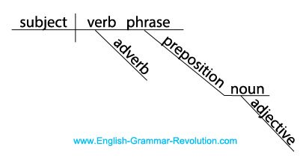
Three types:
Descriptive Linguistics: studies the structure of language

Slide 5
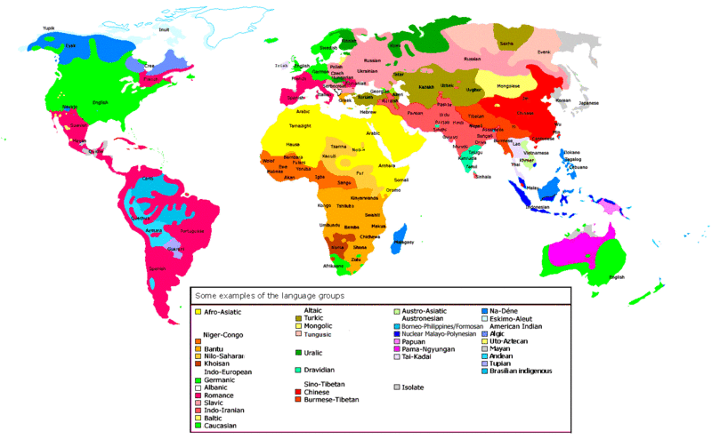
Three types:
Historical Linguistics: studies language distribution and development/change

Slide 6
Relationships Between Languages
Languages descended from common ancestors
Are considered ‘families’
mother and daughter languages
Family trees of languages
show branches and sub-branches
Language ‘isolates’
Are considered sole survivors of ancient families
Languages developed in contact situations

Slide 7
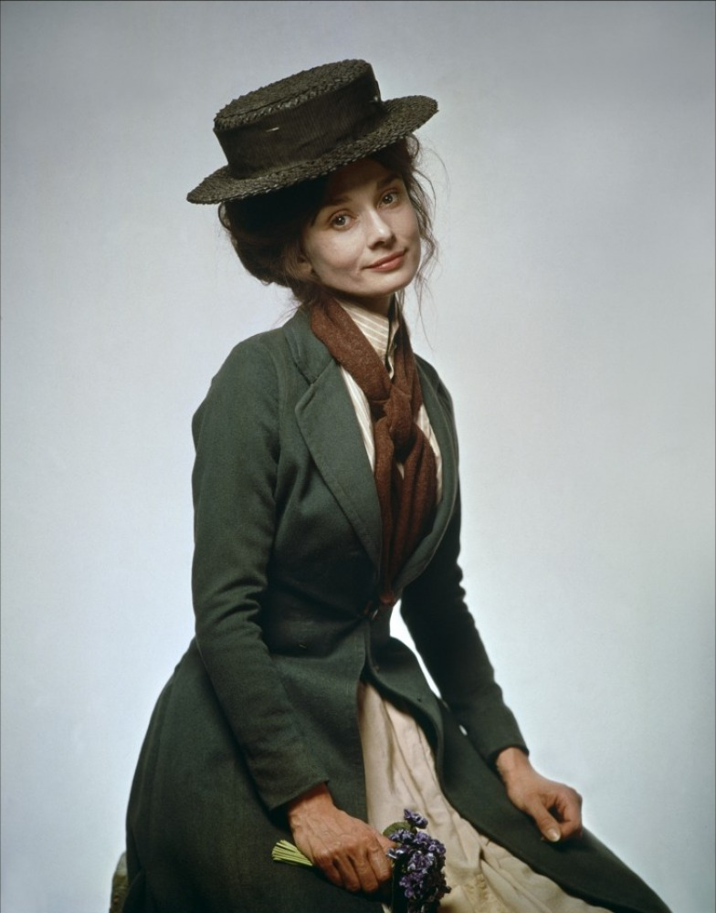
Three types:
Sociocultural linguistics: studies language in society

Slide 8
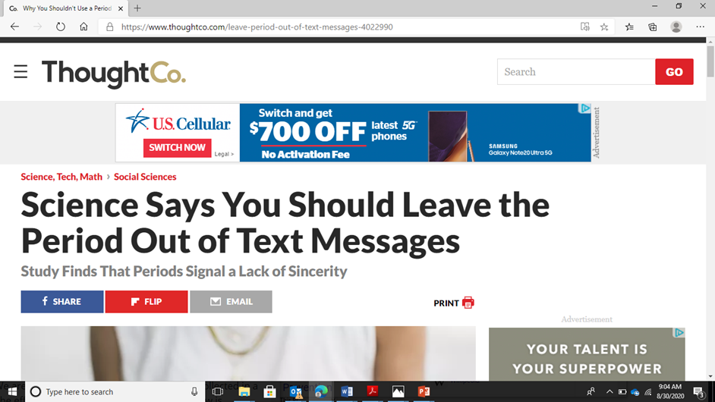
Context Matters

Slide 9
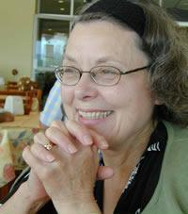
Applied Linguistics
Documenting languages to help preserve them.
Book talks about the Living Tongues Institute for Endangered Languages.
Dr. Louanna Furbee: works to document/preserve Tojolabal Mayan, which is a language spoken by about only 1,000 people now.
Notes:
Greg Anderson

Slide 10
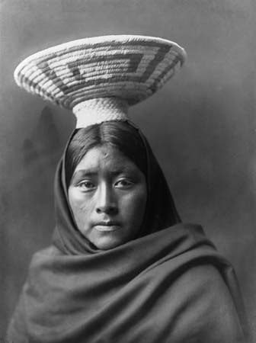
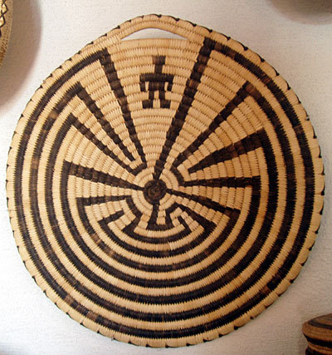

Slide 11
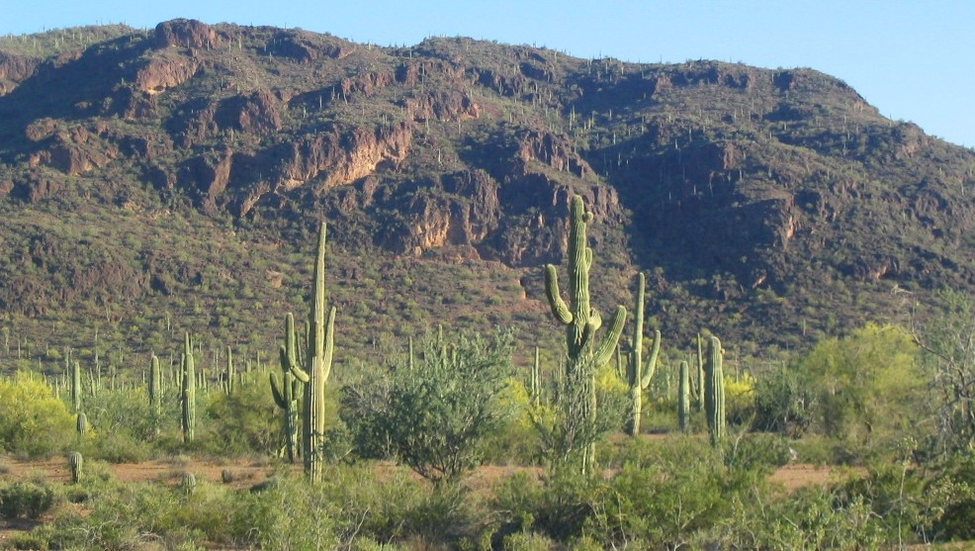
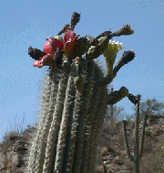
Tohono O'odham Nation

Slide 12
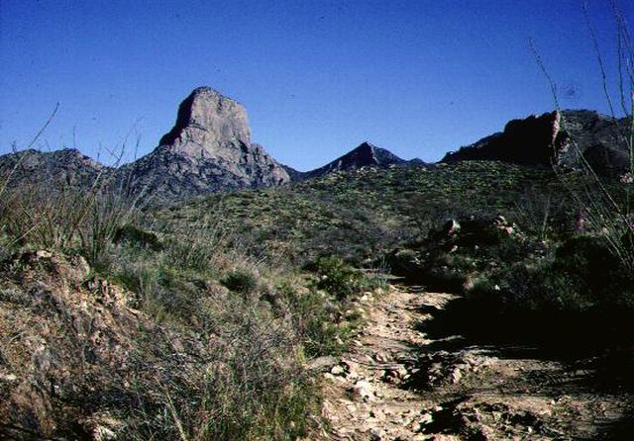

Slide 13
Tohono O'odham
a Uto-Aztecan language of the Tepiman subgroup.
There are 6 distinctive dialects, which can be considered to be either part of the core and part of the periphery.
They tease each other about their dialects.

Slide 14
Two strategies
A "localist" strategy--the speaker behaves as s/he has decided. "I will select a particular kind of person as my model, and I will try to sound as much like that kind of person as I can."
A "distributed" strategy--the speaker decides, "I am not sure what kind of person I want to sound like. I will try to sound like a variety of different kinds of people.”

Slide 15
