Slide 1
Goals. Students will be able to:
Define primatology.
Explain the basic structure of Linnaean taxonomy.
Explain the evolutionary concepts of analogy and homology.
Identify some similarities among primates.

Slide 2
PRIMATOLOGY
Primatology: the study of nonhuman primates—fossils and living apes, monkeys, tarsiers, lemurs, and lorises—including their behavior and social life
Jane Goodall with a chimp

Slide 3
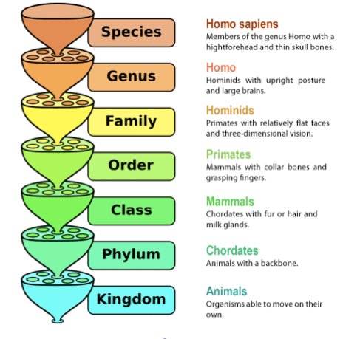
Biological Classification:
Linnaean Taxonomy. Hierarchical classification based on structural similarities (wanted to understand God’s design)
Goes from general to specific.

Slide 4
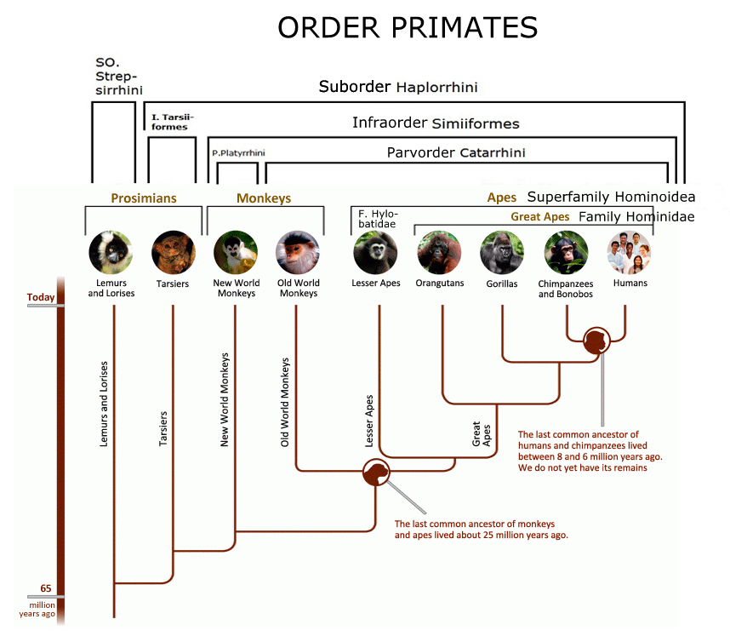
Linneaus noted similarity among humans, monkeys, and apes. He classified them together as primates.
He based his classificatory system on the following criteria:
Body Structure
Body Function
Sequence of bodily development

Slide 5
Humans belong to the order Primates.
Share characteristics with other primates:
Stereoscopic vision
Shorter snouts relative to some animals
Prehensile hands and feet
Distinctly structured brains
Decreased litter size (few offspring with parental investment)
What traits do you think the last shared ancestor of all primates had?

Slide 6
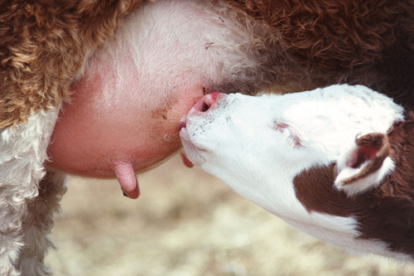
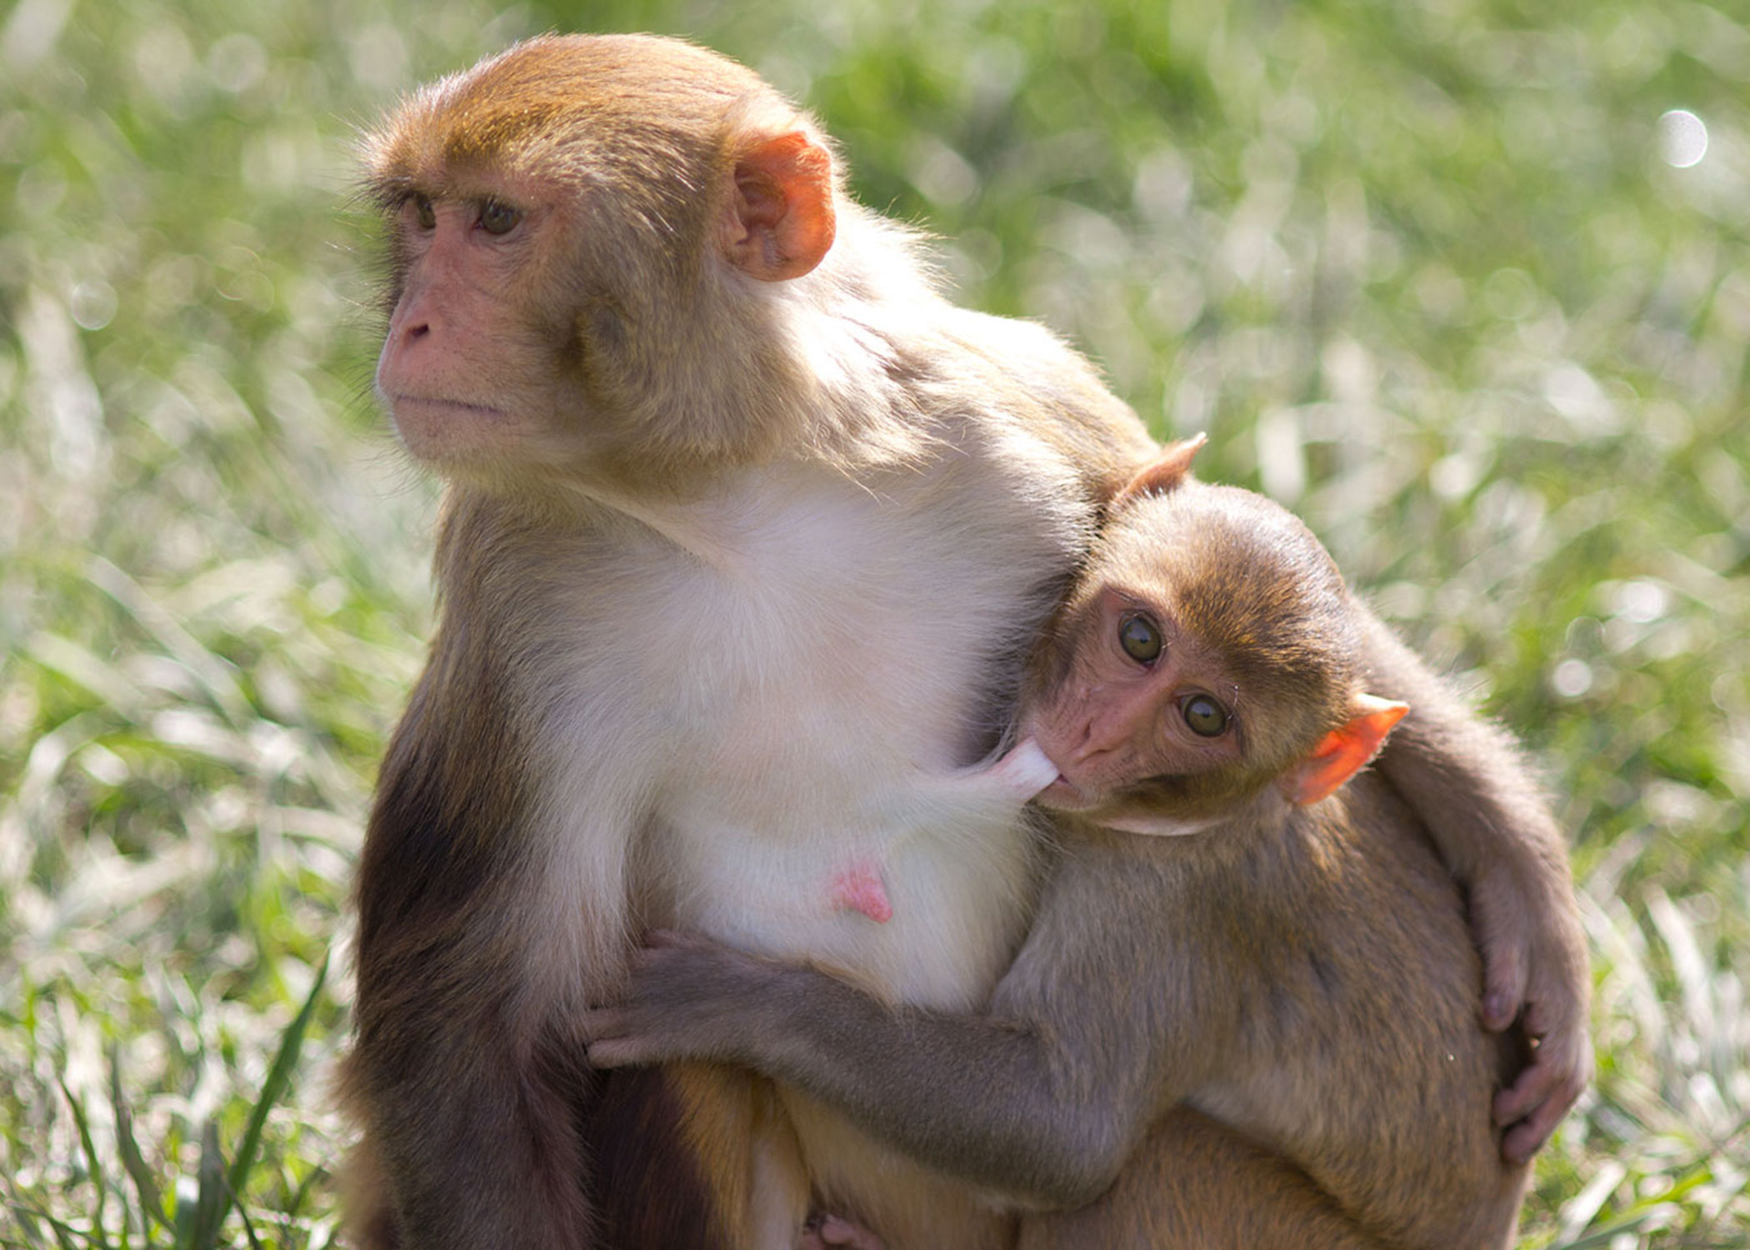
OUR PLACE AMONG PRIMATES
Similarities between humans and apes are evident in anatomy, brain structure, genetics, and biochemistry
Homologies: similarities organisms share because of common ancestry
As mammals, humans are of the class Mammalia and share certain mammalian traits, such as mammary glands

Slide 7
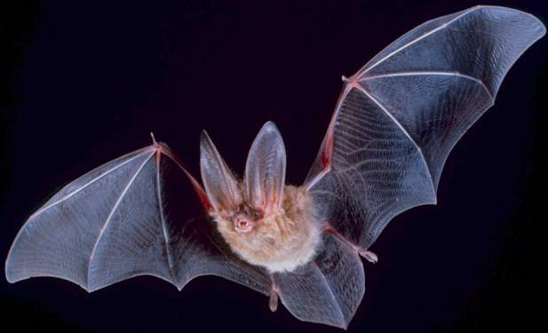
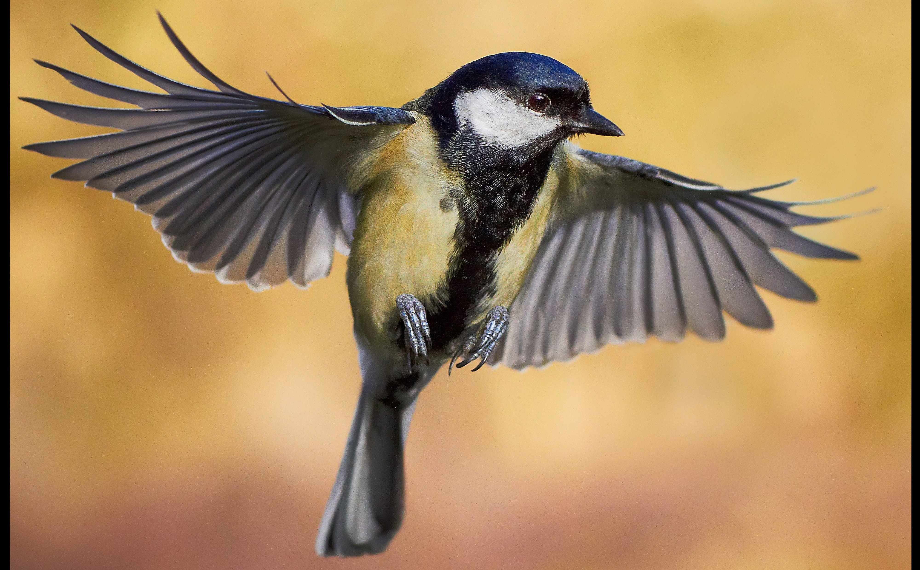
Analogies and Convergent Evolution
Similar traits that can arise if species experience similar selective forces and develop similar adaptations

Slide 8
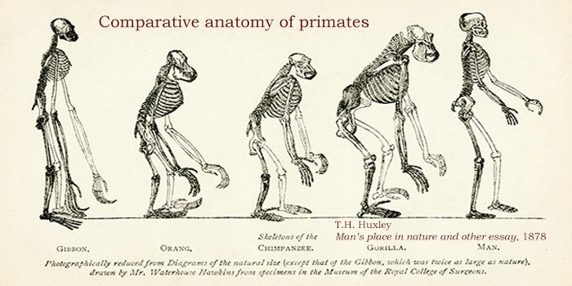
We have us, the end point of our evolution. Want to know the process.
Homologies tell us about the “starting points” for our evolutionary development.
Analogies tell us about the contexts in which particular features might increase fitness.
We can explain why we look like us and other primates look like them.

Slide 9
Humans belong to the order Primates.
Share characteristics with other primates:
Stereoscopic vision
Shorter snouts relative to some animals
Prehensile hands and feet
Distinctly structured brains
Decreased litter size (few offspring with parental investment)
What traits do you think the last shared ancestor of all primates had?

Slide 10
