Slide 1
Goals. Students will be able to:
Define cultural anthropology
Differentiate between ethnology and ethnography
Describe the major approaches to ethnographic study.
Identify some members of our department specializing in cultural anthropology.
Identify and summarize some key feature of Fore culture.
Explain why this study is an example of cultural anthropology.

Slide 2
The four subfields of Anthropology:
Ethnology/Cultural Anthropology
Archaeology
Biological Anthropology
Linguistics
Notes:
Go through each subfield but end on anthropology

Slide 3
CULTURAL ANTHROPOLOGY
Cultural anthropology: comparative, cross-cultural study of human society and culture
Ethnography: fieldwork in a particular cultural setting; provides an account of that community, society, or culture
Ethnology: study of sociocultural differences and similarities; examines, interprets, and analyzes the results of ethnography

Slide 4
Ethnography and Ethnology— Two Dimensions of Cultural Anthropology
ETHNOGRAPHY | ETHNOLOGY
Requires fieldwork to collect data | Uses data collected by a series of researchers
Often descriptive | Usually synthetic
Group/community specific | Comparative/cross-cultural

Slide 5
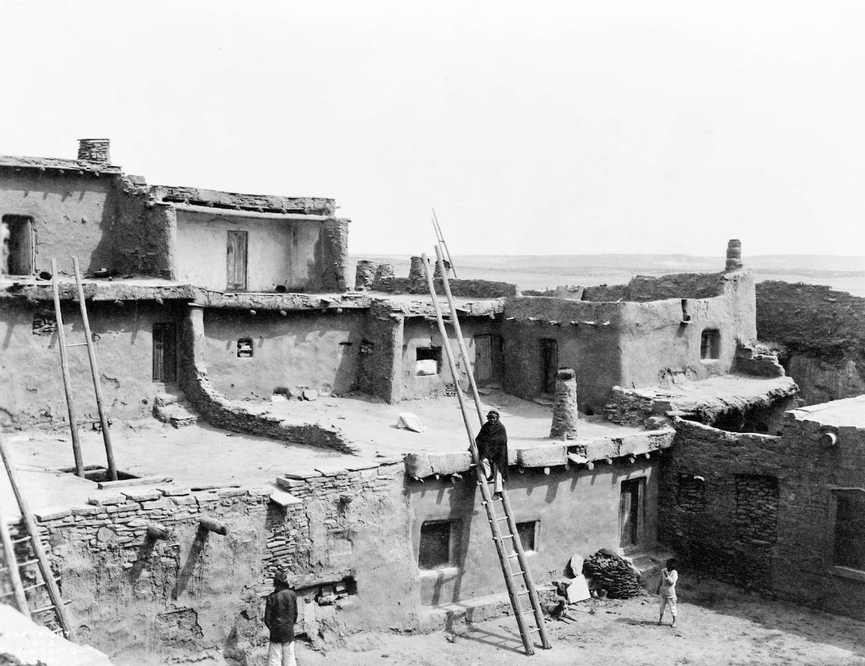
Ethnographic Present
Culture Changes

Slide 6
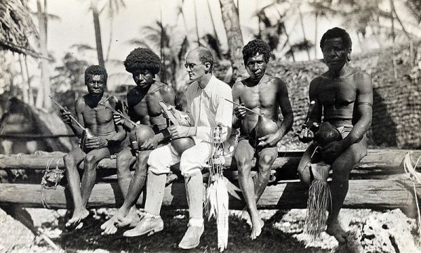
Ethnographic Methods: Participant Observation
The anthropologist joins people as they do things. Combines social participation and personal observation within the community.
Notes:
The primary advantage is that the ethnographer is able to understand the experiences and habits of the research subjects from the participant's point of view. See things the researcher might not have even thought to ask.
Limitations: researcher can influence behavior. Potential bias (e.g., males can go with males).

Slide 7
Ethnographic Methods: Interviews
Dr. Sean Prall—studies the Himba people, pastoralists that live in northern Namibia. Looks at health related factors like sleep and parental investment.
Notes:
Talk to people and get information. Can be informal and spontaneous, but often has a specific series of questions.

Slide 8
Ethnographic Methods: Surveys/Questionnaires
Use opened questions to gain information
Can also use questionnaires with a scale like, ‘1 means strongly support, 5 means strongly disagree.’
Online surveys are becoming increasingly popular. Methodological problems, but it can be an effective way to get cross-cultural data.
Notes:
Can use open-ended questions, can use a scale, can use presence/absence, etc. May even be online, which is increasingly popular.

Slide 9
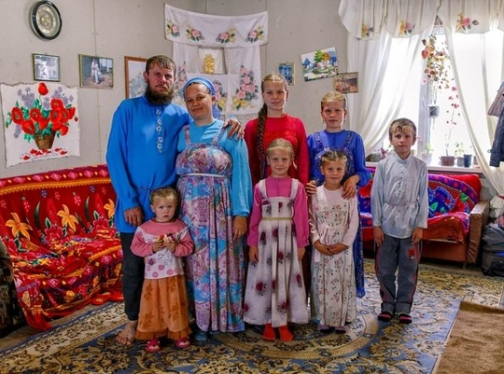

Slide 10
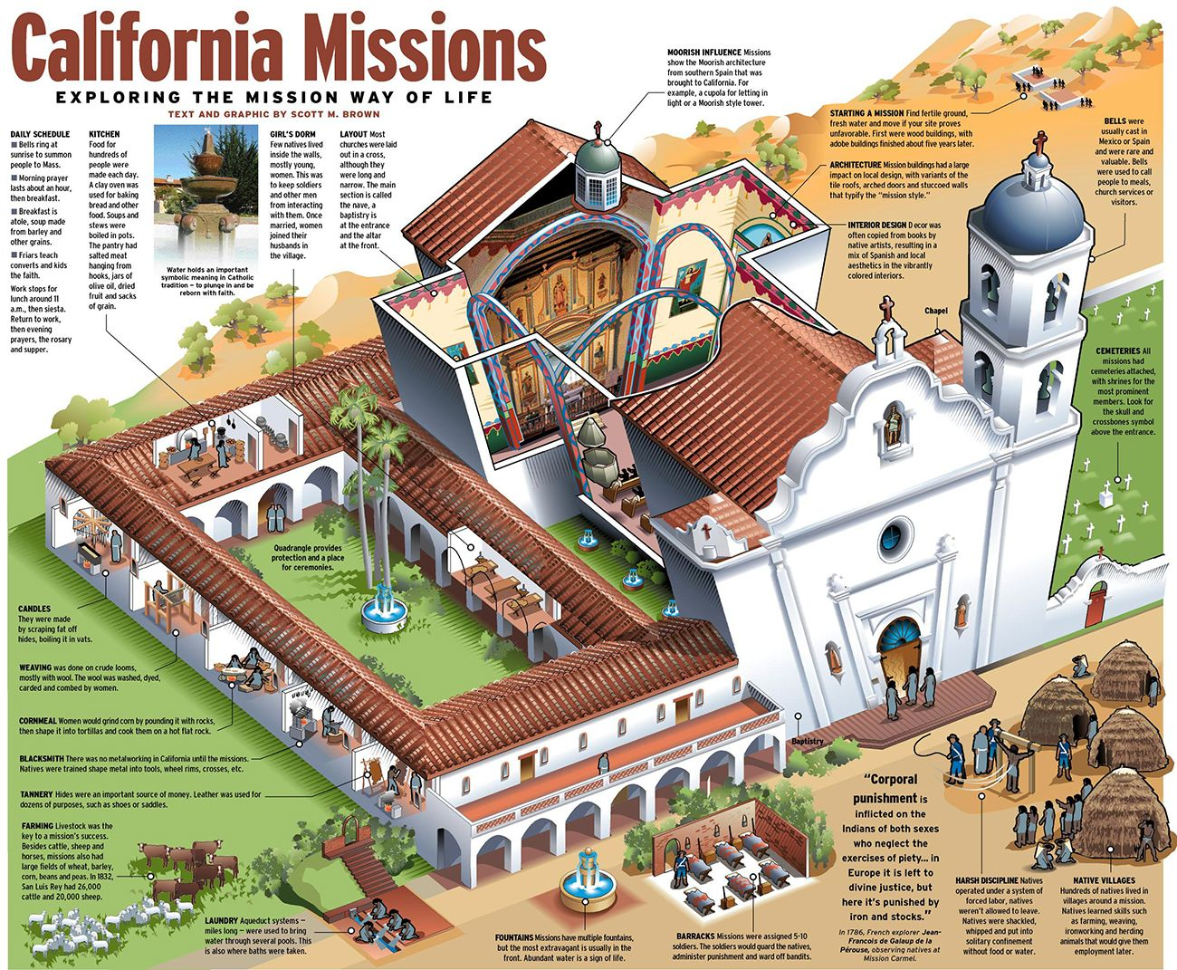
Ethnographic Methods: Archival Research
People’s writing is the source of information, as opposed to their spoken word.

Slide 11
“Types” of Ethnography
Classic ethnography focused on non-Western people (e.g., Dr. Rob Walker’s efforts studying native Brazilian cultures).
Applied ethnology (work ethnology, medical ethnology, anthropology of education, immigrant communities, prisons, etc.)

Slide 12
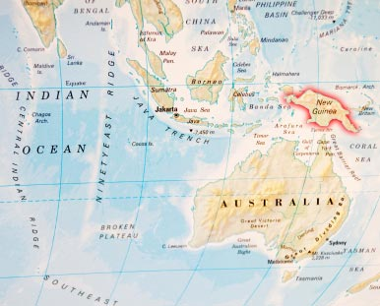
Foré of New Guinea

Slide 13
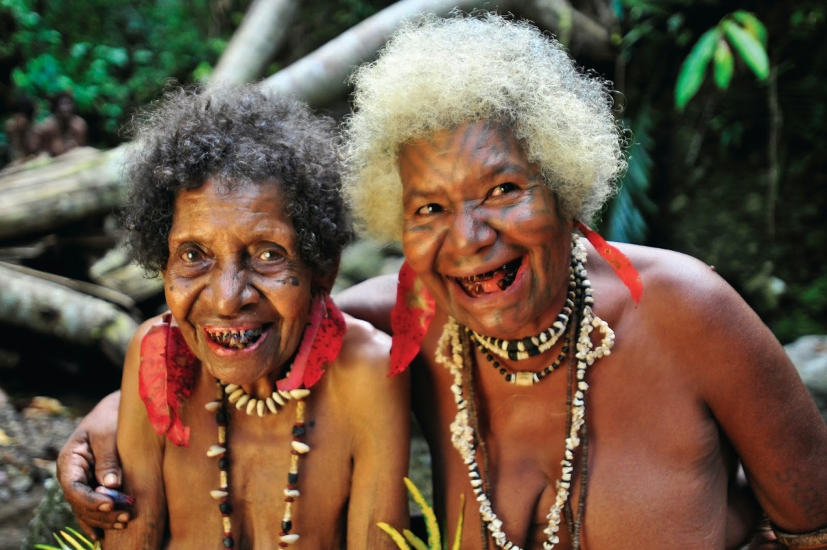
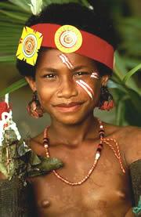
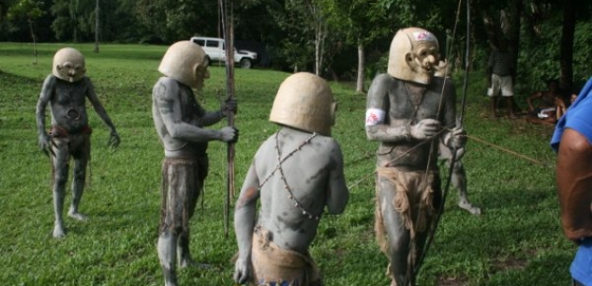

Slide 14
Limited contact prior to late 1940s.
In the 1940s, colonial government sought a village by village census. Sought to improve hygiene, increase road access, and discourage warfare (chronic issue) and sorcery/witchcraft.
By late 1950s, colonial authorities could reliably move through Fore territory. About 12,000 Fore.
Anthropologists came to study and help transition.

Slide 15
Fore
About 12,000 people in 1950s currently about 20,000
Farm using “slash and burn” or “swidden” agriculture.
Cut down overburden, and light it on fire
Ash makes great fertilizer
Through time, the field is “used up”. When this happens, people cut down overburden and make a new field.
Old field is left fallow.

Slide 16
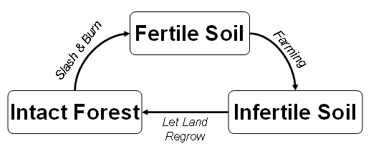

Slide 17
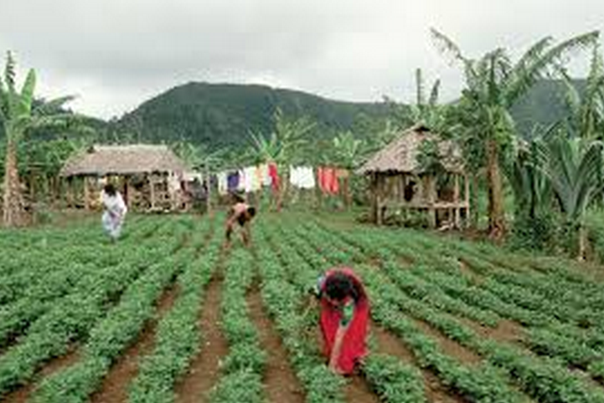
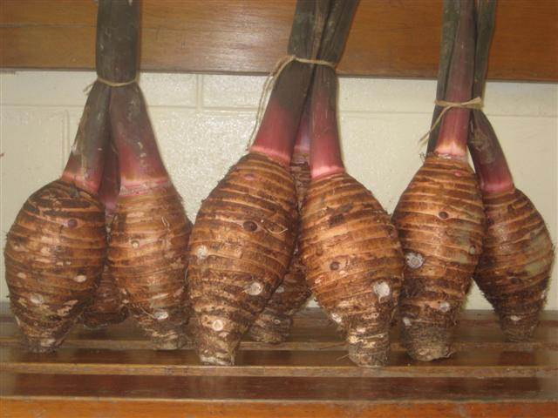
Primary food included:
domesticated pigs
taro and later sweet potatoes

Slide 18
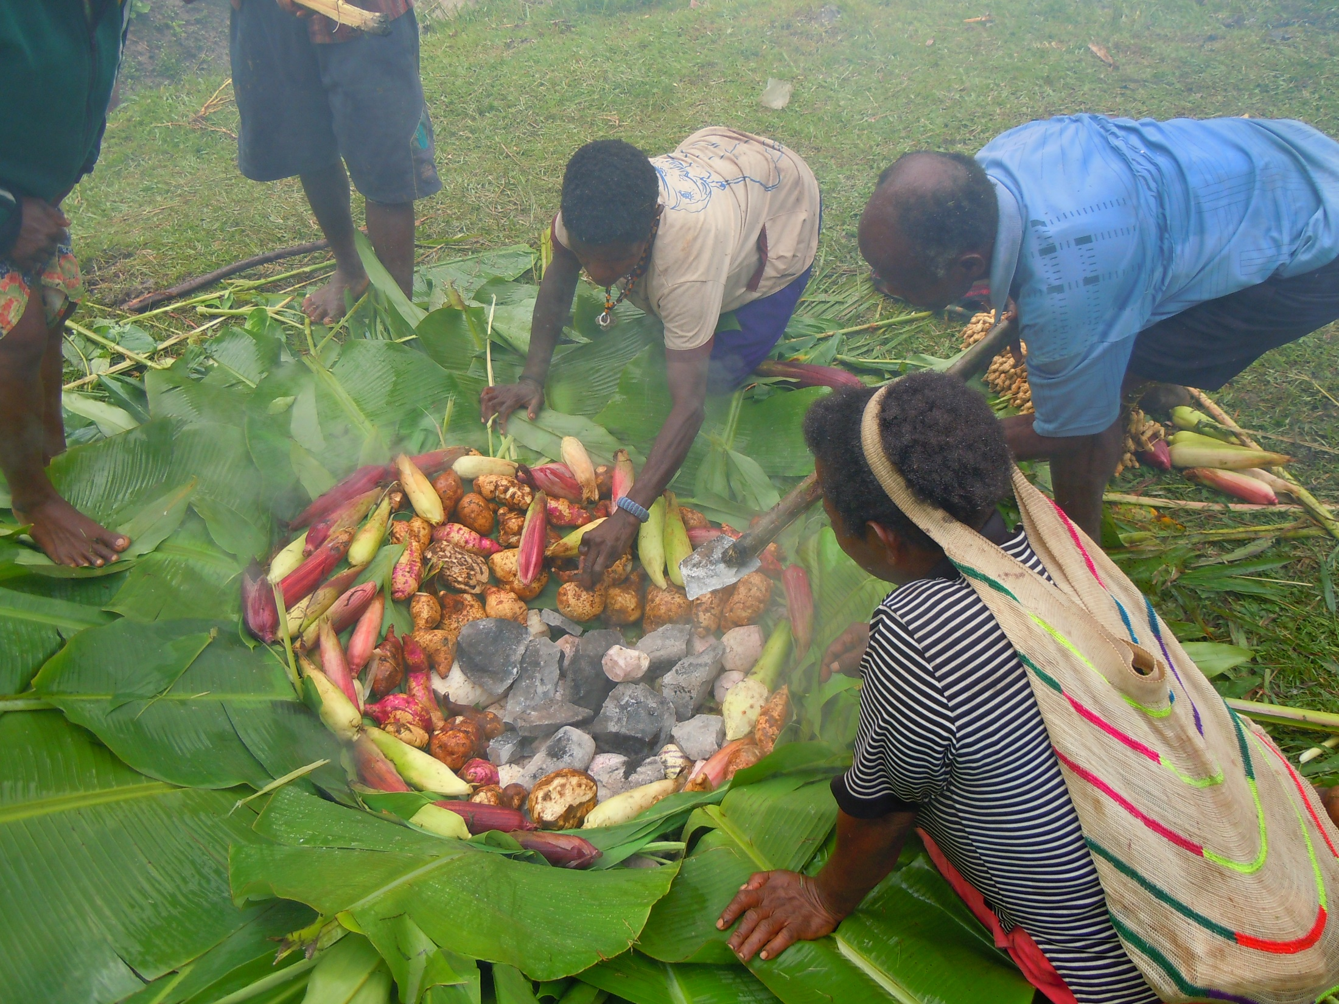

Slide 19
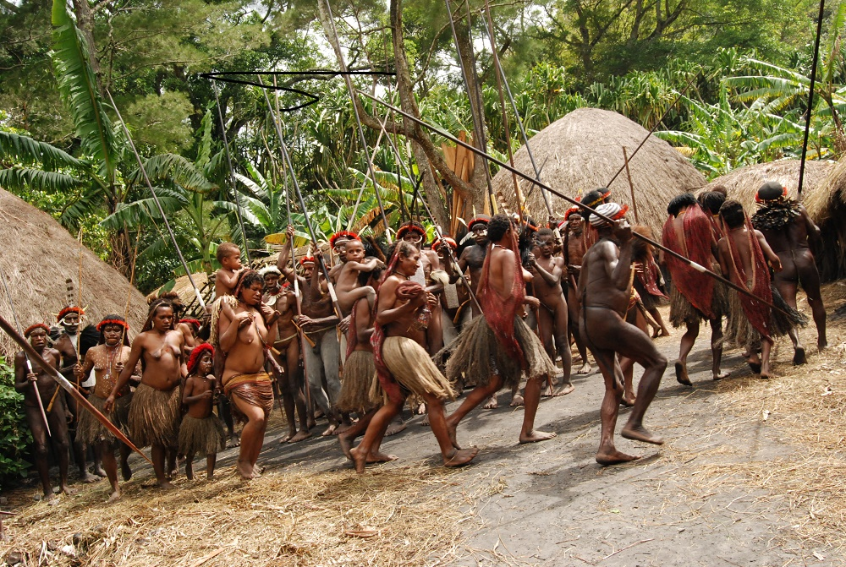
Tribal-level society:
Communities independent of each other
Generally egalitarian, with families paramount relationships.
Patrilineal and patrilocal.

Slide 20
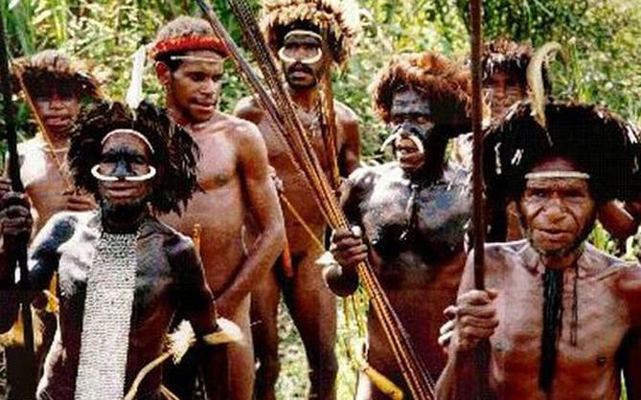
Men living in a single house, while women and children live in smaller, surrounding houses. Men have age ranks that organize their relationships.
Frequent moving led to warfare over land rights and sorcery. Bows and arrows.

Slide 21
Nagauyas (age-ranked group)
Includes men going through manhood initiation at same time. Long process that requires extensive isolation.
Nagauyas help each other through tough times, times of war, food shortages, etc. They also avenge the death of their fellows.

Slide 22
Fore’s Beliefs and Behaviors
Fore have a complex cosmology
the body has five souls (auma, ama, kwela, aona and yesegi)
One of the souls, ama, was powerful and could help the living. “When the deceased's body was eaten out of love and grief, the ama would give blessings to those who ate and the blessings increased their aona. After the mortuary rites have been completed, the ama departs to kwelanandamundi, from where it continues to assist the family when requested” (Whitfield et al. 2008).

Slide 23
Changes to Fore Culture
Economic. Began to:
grow cash crops (coffee)
trade for Western goods
adopt a money-based economy
Warfare declined. Villages moved from high, defensible locations to near their fields.

Slide 24
Sorcery
Can be used for good (benefit of the group) or for aggression (against an enemy group).
Problems often blamed on sorcery from other group.

Slide 25
“Kuru began with tremors. Despite her trembling and jerky motions, a South Fore woman in the Highlands of New Guinea could lean on her digging stick as she went to work – weeding her sweet potato garden and caring for her children. In several months, her coordination was worse; she could not walk unless someone supported her. Her eyes were crossed and her speech was slurred. Excitement made the symptoms of cerebellar dysfunction worse, and she was easily provoked to foolish laughter. Within a year, she could no longer sit up and was left lying near the fireplace in her low grass-roofed house. Death was inevitable. (McElroy and Townsend 1989:44)”

Slide 26
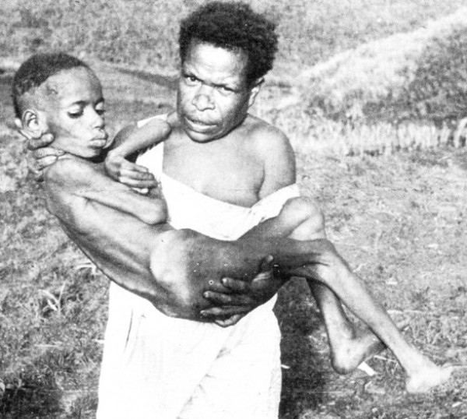

Slide 27
Kuru thought to be product of sorcerers
Affected primarily women
Steal a bit of victim’s hair, food, clothing, or feces. Wrap with magical charms.
Curse: I break the bones of your legs, I break the bones of your feet, I break the bones of your arms, I break the bones of your hands, and finally I make you die.
Bundle is then buried. As it decomposes, so does the cursed victim.
Once cursed, there was no cure.

Slide 28
Out of a population of 8,000 people, 1,100 Kuru deaths were recorded between 1957 and 1968. Major cause of female deaths. Ratio of female to male deaths was 25:1.
The exception was with children:
35% of kuru cases were children. Roughly equal mix between boys and girls.
Australian government took administrative control over Fore territory in 1950s. Very focused on finding cause/cure.

Slide 29
Kuru patterns changed
Became less common, especially among children.
Inconsistent with genetic cause.
So what is going on?
Linked to the process of cannibalism

Slide 30
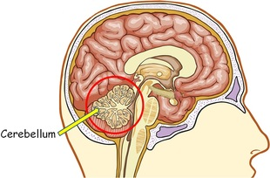
Prion
It is not a bacterial or viral disease. Contain no nucleic acid (DNA) and are resistant to destruction
The immune system does not attack it, and scientists are still trying to figure why it does not.
It is a “prion” disease like Mad Cow Disease
It attacks the cerebellum, which helps control coordination
The pathogen makes brain look like a sponge

Slide 31
Kuru
One can get the disease by coming into contact with an infected person
Or by consuming infected parts, mostly the brain

Slide 32
