Slide 1
Goals. Students will be able to:
Explain the process of dog domestication
Define neoteny and how is illustrated in Belyaev’s experiments

Slide 2
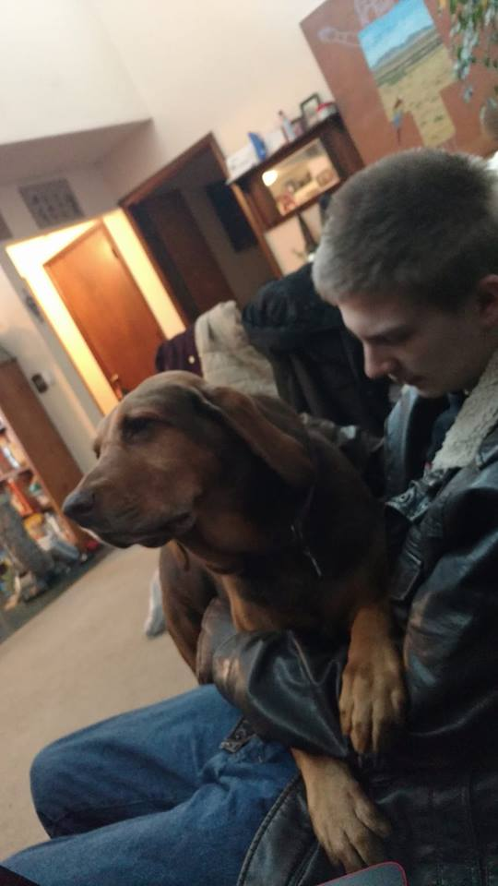
Human’s Best Friend

Slide 3
Domestication
Modification of a plant or animal such that it can no longer survive without the care of humans (or another animal).
Not unique to humans.
Ants and aphids.

Slide 4
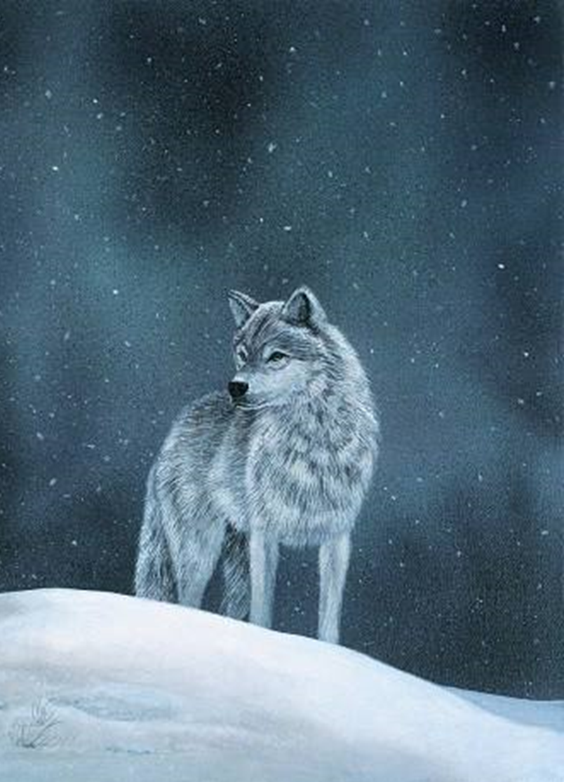
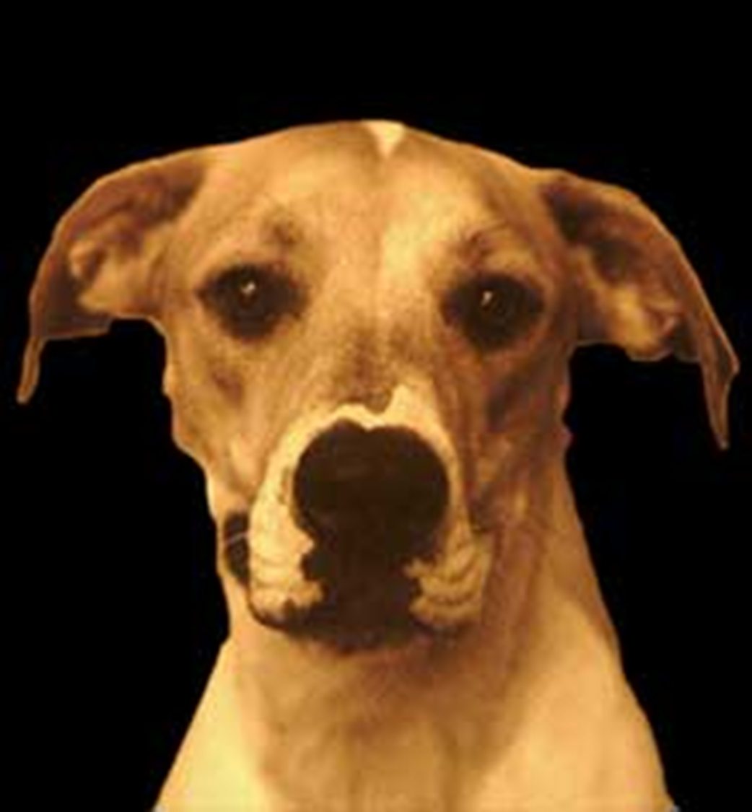
Two general divisions in dog development
Stage 1: Initial Domestication of Dogs (Pliestocene Hunter-gatherers)
Wolf
To
Dog
Notes:
Initial domestication of dogs and then the development of different breads

Slide 5
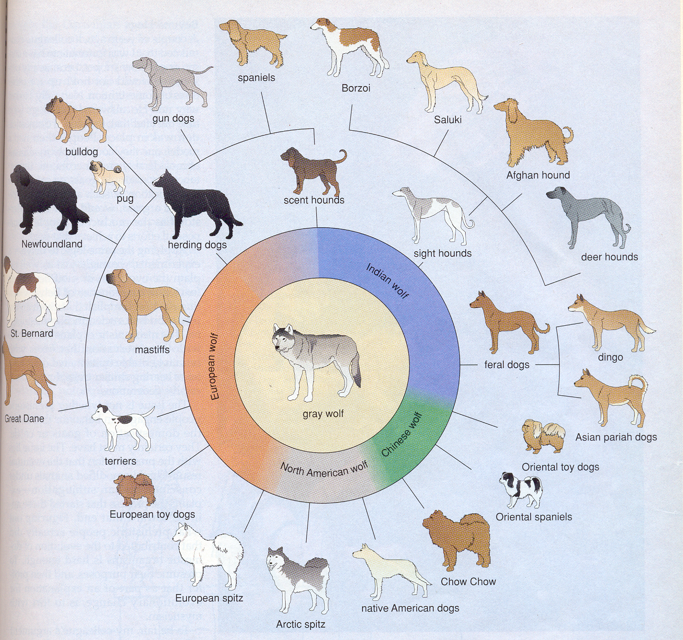
Stage 2: Development of various breeds
(Neolithic agriculturalists)
400 Specialized Breeds:
Behaviorally and morphologically distinct
Big/small
Loyal/independent
Aggressive/passive
“Ornamental dogs” started in Victorian Era

Slide 6
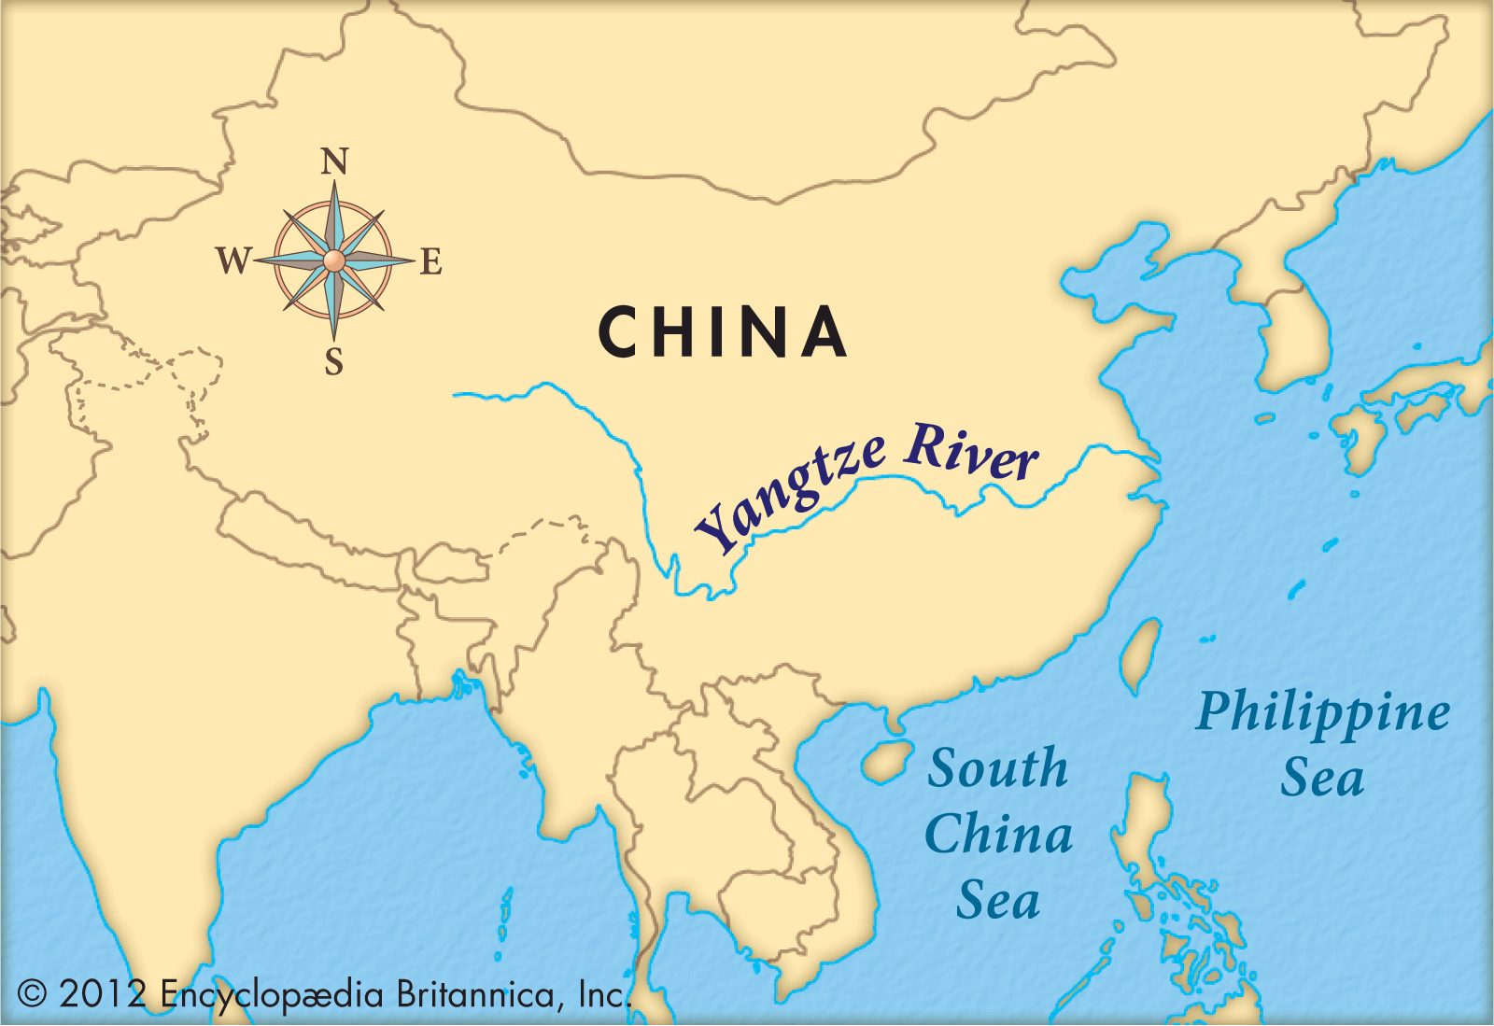
When and where were dogs domesticated?
When: Came over with Paleoindians. (Good guess is ~25,000 years ago, but perhaps as early as 30,000 years ago)
Where: Likely domesticated in what is now China, SE of the Yangtze River. (May have been domesticated elsewhere too)
What: Extinct form of Grey Wolf Perhaps specialized in hunting Pleistocene Megafauna.
Notes:
Freedman, Adam H., and Robert K. Wayne. "Deciphering the origin of dogs: From fossils to genomes." Annual review of animal biosciences 5 (2017): 281-307.

Slide 7
Dogs Cognitively Changed from Wolves
Wolf hybrids less playful, more fearful (e.g., easily startled) than dogs.
Dogs able to pick up on human cues. Better than chimps, in fact.
Experiment: Food hidden behind one of two doors. The human indicates the door with the food (by doing something like tapping, looking at it, pointing to it, placing a marker on it). Chimps no better than average at getting the right door. Dogs could consistently chose the right door. Wolves also better than chimps, but dogs are even better, and show this skill as pups. Skill not learned, but instead part of domestication.
Notes:
Hansen Wheat, Christina, et al. "Wolf (Canis lupus) hybrids highlight the importance of human-directed play behavior during domestication of dogs (Canis familiaris)." Journal of Comparative Psychology 132.4 (2018): 373.
Hare, Brian, et al. "The domestication of social cognition in dogs." Science 298.5598 (2002): 1634-1636.

Slide 8
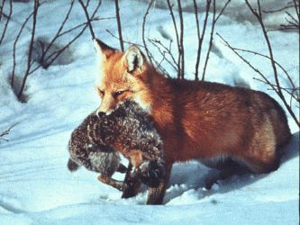
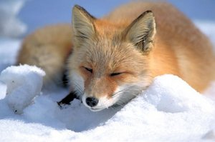
Belyaev’s Experiment: Vulpes Vulpes (Red Fox)
Notes:
Trut, Lyudmila N. "Early Canid Domestication: The Farm-Fox Experiment: Foxes bred for tamability in a 40-year experiment exhibit remarkable transformations that suggest an interplay between behavioral genetics and development." American Scientist 87.2 (1999): 160-169.

Slide 9
Neoteny
The retention of “adolescent” traits. In dogs this included smaller teeth, more rounded and forward-looking eyes, and a shorter snout.

Slide 10
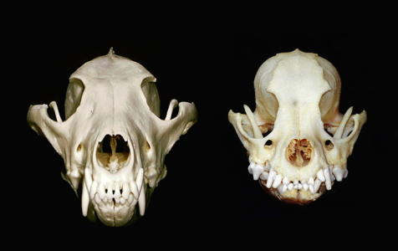

Slide 11
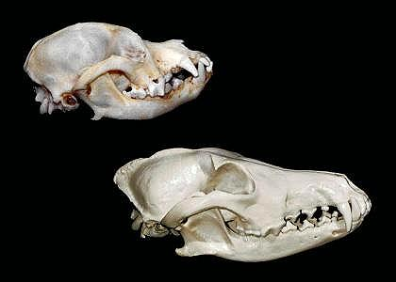

Slide 12
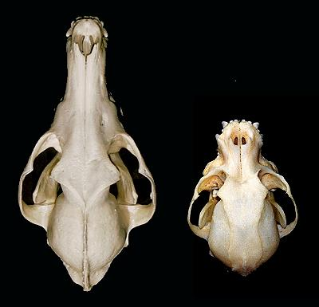

Slide 13
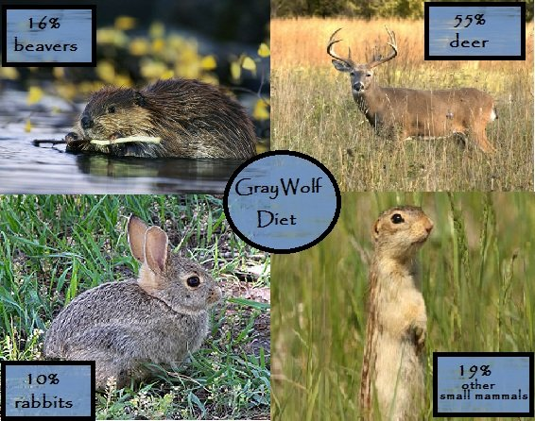
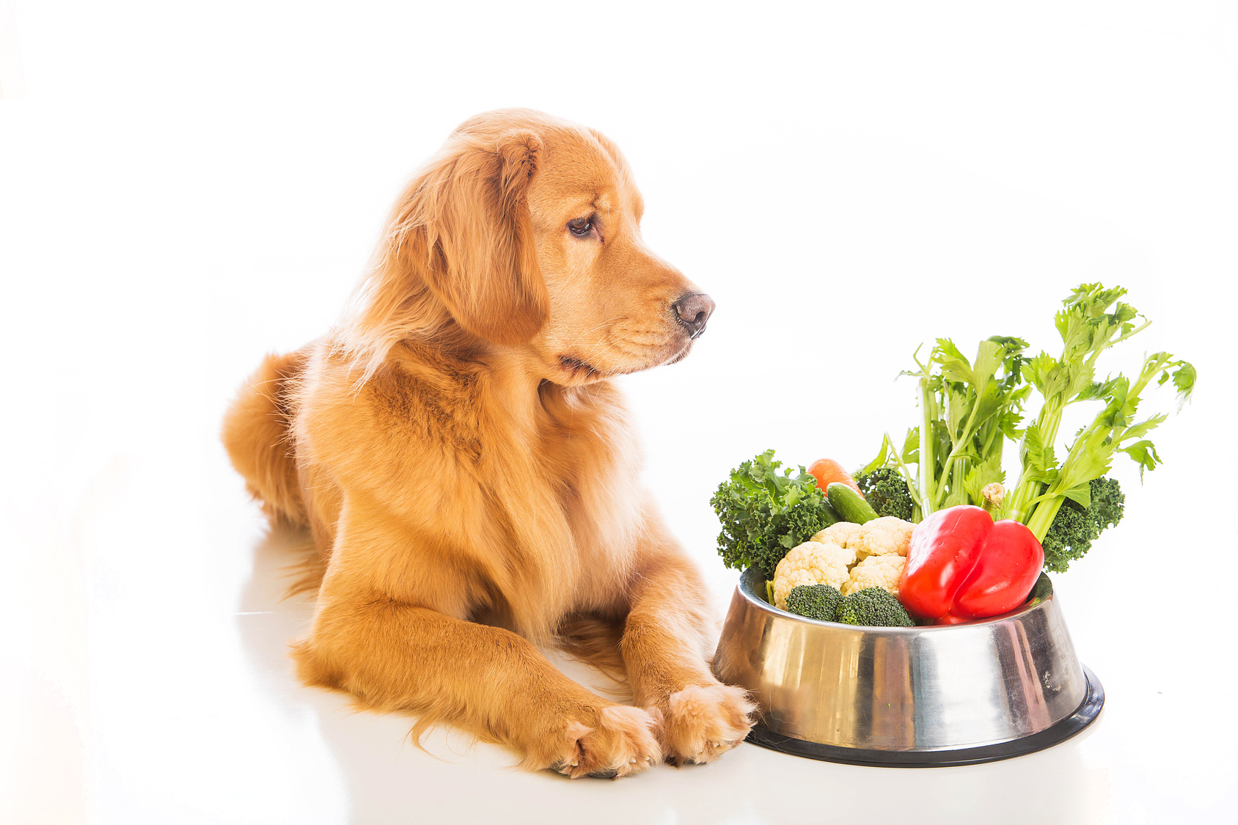
Another big change is increased ability of dogs to digest starches. Likely associated with agriculture.

Slide 14
Hypotheses about the process of dog domestication
Humans adopted wolf pups. Further selection favored animals that were social and less aggressive.
Wolves were scavenging canids that hung around humans. Selection favored those who were less frightened of humans. Over succeeding generations the wolves became more tame to the point, so much so that they moved into the human community and became pets/colleagues.

Slide 15
