Slide 1
Goals. Students will be able to:
Explain what the Mesolithic (Middle Stone Age) is.
Explain how the Mesolithic lead to agriculture.

Slide 2
Mesolithic
A time period between the Upper Paleolithic and the Neolithic.
There are no good dates, although it is often between 10,000 BP and 6,000 BP.
Isn’t present everywhere
Characterized by the use of nondomesticated plants and animals, but almost always lead to their domestication.
“A transitional period”

Slide 3
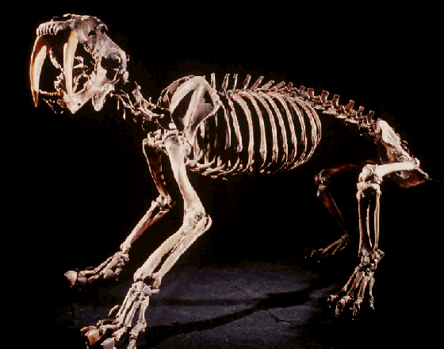
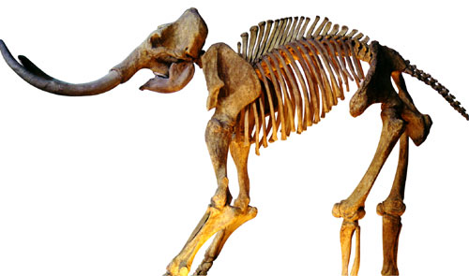
Changes at the End of the Last Ice Age (end of Pleistocene, beginning of Holocene)
Extinction of megafauna.
Stabilized environment relative to Pleistocene.
More packed landscape.
Consequence?

Slide 4
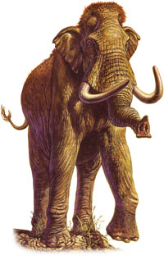
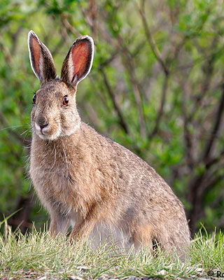
Settle Down and Use Resources Previously Ignored.
Optimal Foraging: High ranked vs. Low Ranked resources
Vs.
Note: Images not to scale, or that would be one big bunny!

Slide 5
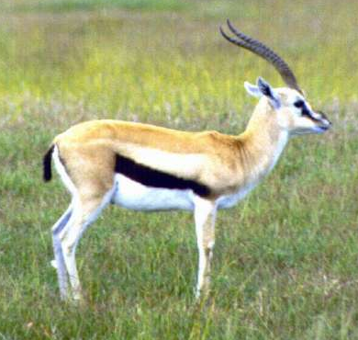
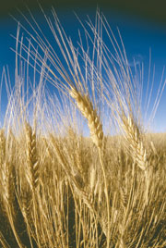
Vs.
Notes:
gazelle

Slide 6
Consequences
People began to be less mobile.
Changes in Technology
downsizing of projectile points.
specialized hunting weapons.
bow and arrow in the Old World around 15,000, but not in New World until 3,000 B.P.
versatile toolkits.
storage technology, such as basket and clay-line pits for nut and wild

Slide 7
Productive
Resources
Increased
Reliance and
Modification

Slide 8
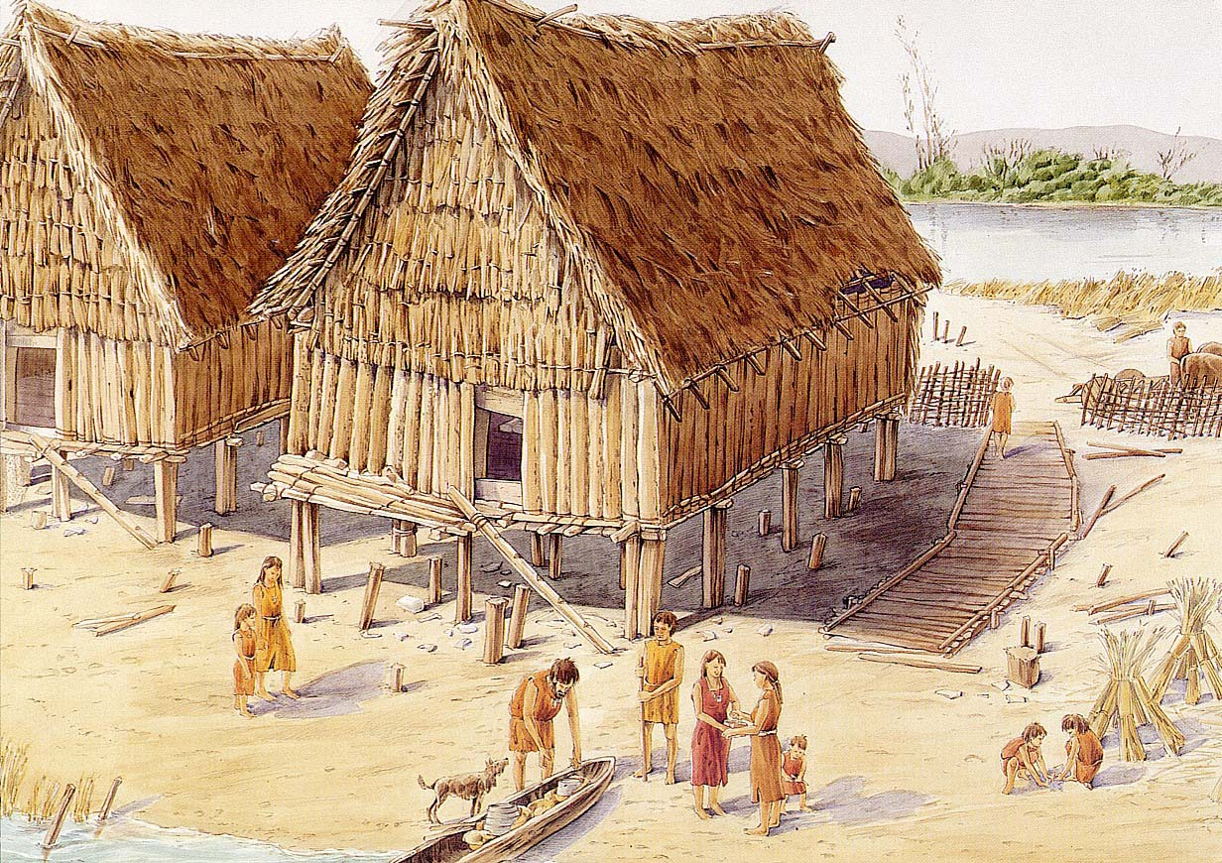
“Complex hunters and gatherers” living in sedentary communities
Implications for cultural transmission?

Slide 9
