Slide 1
Goals. Students will be able to:
Define the biological concept of species.
Explain and differentiate between cladogenesis and anagenesis

Slide 2
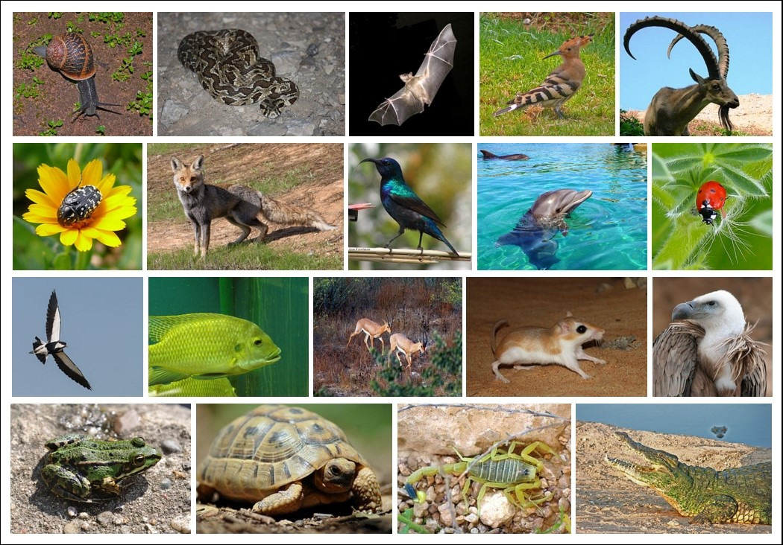
What are species?
Ecological Definition: the largest group of living organisms that [can] interbreed.

Slide 3
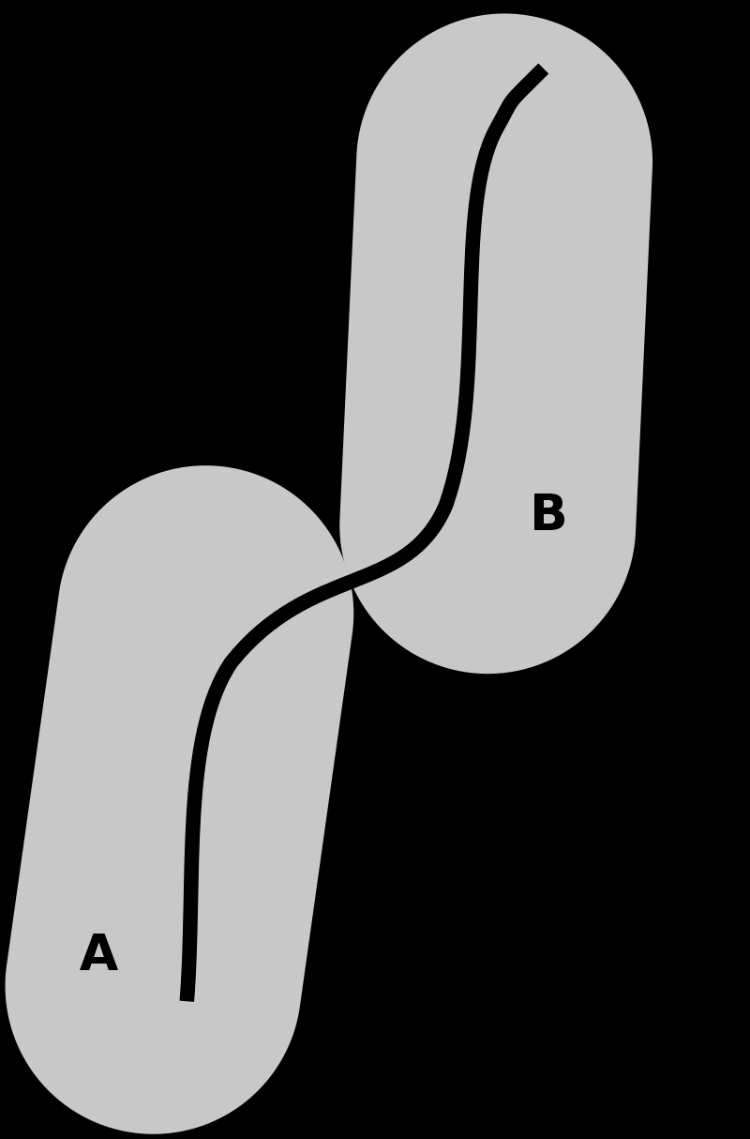
What are species?
Paleontological Definition: Breeding populations that are distinct enough to differentiate between them.

Slide 4
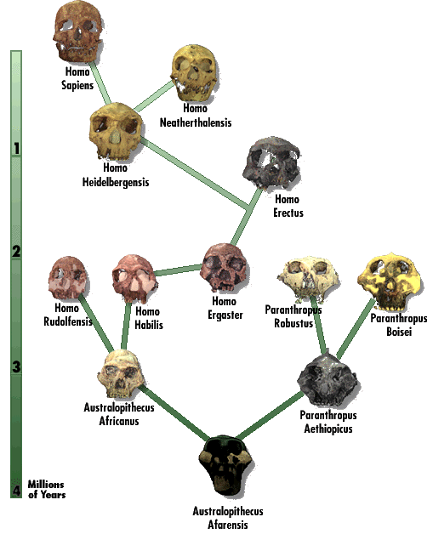
Lumpers vs. Splitters

Slide 5
Macroevolution and Speciation
Changes within species (microevolution) can lead to the creation of new species.

Slide 6
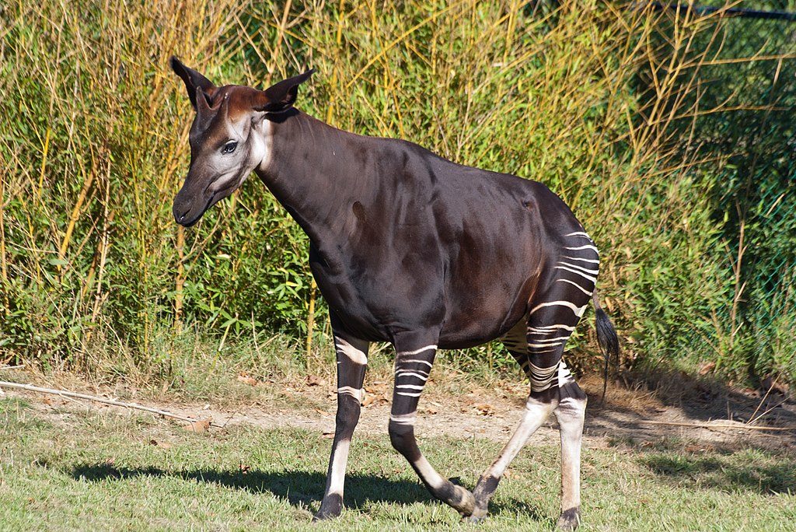
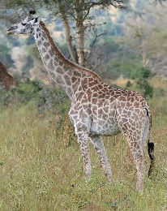
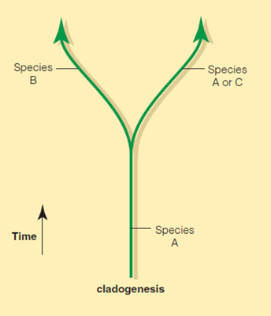
Macroevolution and Speciation
Two general ways this happens:
Cladogenesis: Isolating Mechanism can separate populations. No gene flow and the accumulation of random mutations cause two or more species to form.
Okapi
Giraffe
Different habitats led to genetic isolation. Okapi in forested areas. Giraffe in open savannahs.
11.5 MYA

Slide 7
Macroevolution and Speciation
Two general ways this happens:
Anagenesis: selection and drift create change through time without genetic isolation. ‘Transforms’ one species into a new one.

Slide 8
Goals. Students will be able to:
Identify when we last shared a common ancestor with other African apes
List examples of human adaptations
Identify the genera that developed from Australopithicus (Paranthropus and Homo)

Slide 9
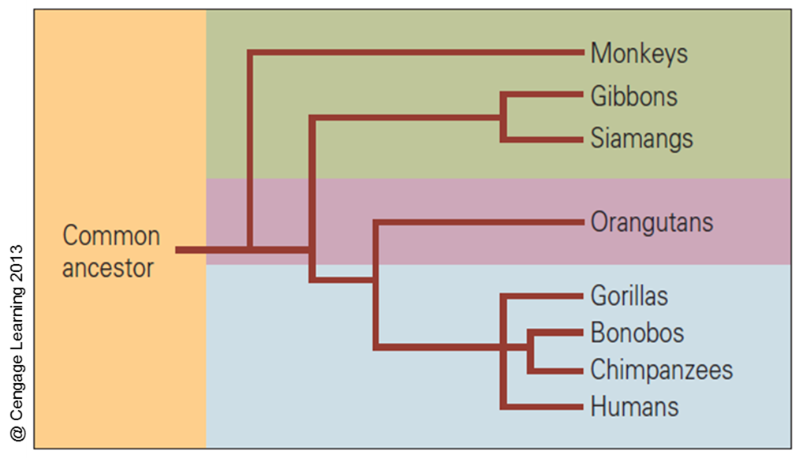
Genetics and anatomical analysis indicates the African apes (chimps, bonobos, and gorillas) are our closest reatives
Last common ancestor was between 8 and 5 MYA.

Slide 10
What determines whether a fossil is a human ancestor?
Similarities in DNA, including mutations
Such key attributes as bipedal locomotion, a long period of childhood dependency, big brains, and the use of tools and language are fairly recent
Some physical markers identifying certain fossils as early Homo populations were lost during subsequent human evolution
Behavioral traits. How would one see these?

Slide 11
Human Adaptations
Bipedalism
Use of fire
Use of simple artifacts (e.g., a stone flake)
Use of composite artifacts (e.g., a bow and arrow)
Kinship
Religion
Large Brains
Extremely long period of parental investment
Language
Medicine
Communal hunting
Marriage
Art
Families

Slide 12
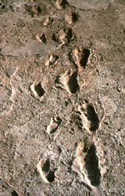
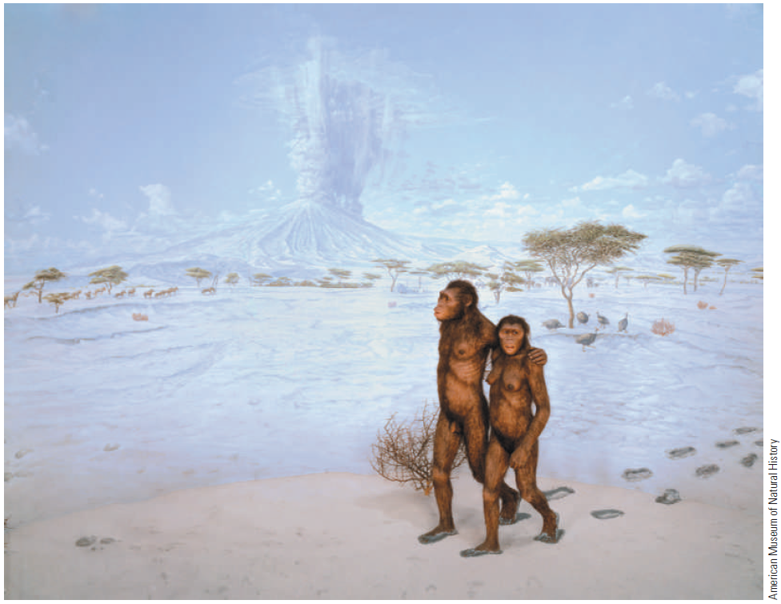
Australopithecus
Bipedal
In 1976, members of a team led by Mary Leakey discovered the fossilized footprints of human ancestors in Laetoli, Africa.
The footprints were formed 3.5 million years ago when at least two individuals walked over wet volcanic ash. The wet ash hardened like cement and was then covered by more ash.

Slide 13
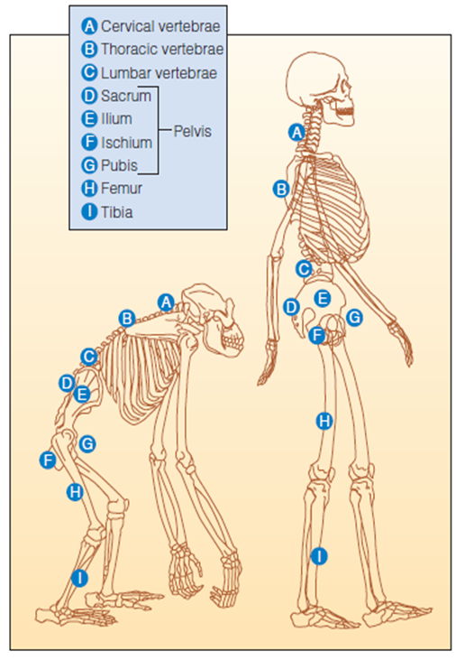
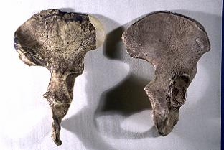
Bipedality Evidence
Anatomy of Bipedalism
Early pelvis on left,
modern human on right.
Notes:
Foramen Magnum Bipedalism can be inferred from the position of the foramen magnum, the large opening at the base of the skull. Note its relatively forward position on the human skull (left) compared to its position on the chimp skull.

Slide 14
BIPEDALISM
Ardipithecus (5.8–4.4 m.y.a.): earliest recognized hominin genus; shows the capacity for upright bipedal locomotion
Reliance on bipedalism differentiates early hominins from apes
Adaptation to open grassland
Ability to see over long grass (protection from predators), carry items back to a home base, use hands more efficiently, and reduce the body’s exposure to solar radiation
Travel longer distances more efficiently

Slide 15
Phylogenetic Tree for African Apes, Hominids, and Hominins
Evolution of hominids is “bushy”
Australopiths split into two dominant lines: Homo and Paranthropus
Homo ate meat, fruit, and other softer (and more nutritious) foods.
Paranthropus ate hard nuts and seeds that required more massive teeth and were harder to digest.

Slide 16
Homo compared to Paranthropus

Slide 17
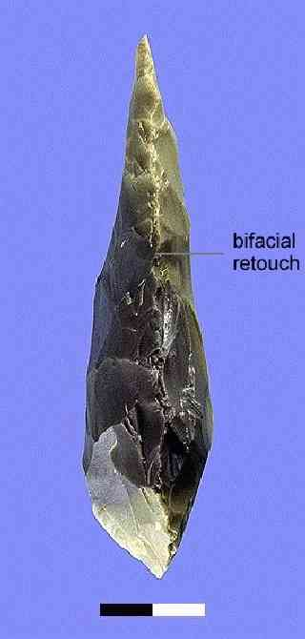
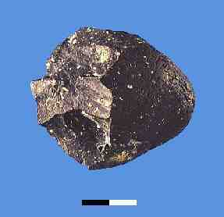
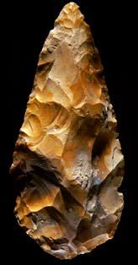
Oldowan
Achuelian

Slide 18
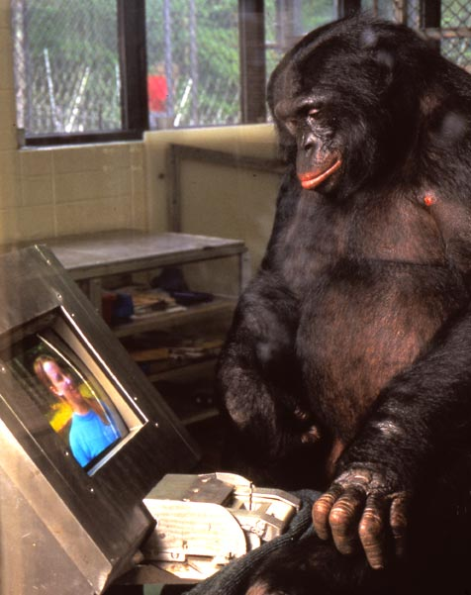
Kanzi
A bonobo
Renowned for language ability.
Taught by direct example.

Slide 19
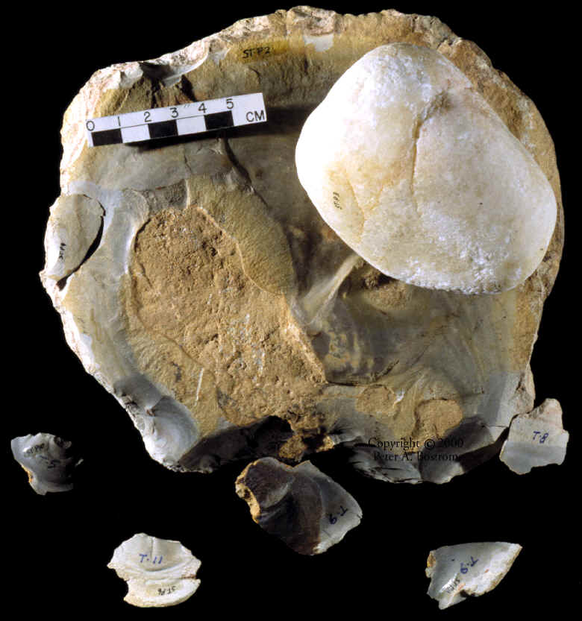
Kanzi’s Stone Tools
Initially throw it until it breaks right.

Slide 20
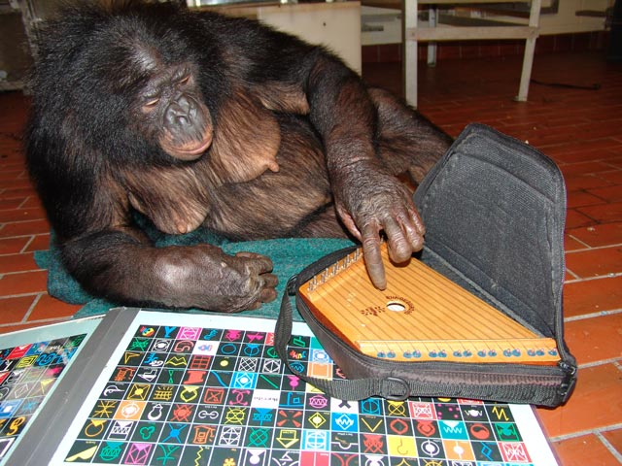
Panbanisha
Kanzi’s sister
Preferred hard hammer percussion.
Both Kanzi and Panbanisha could recognize the sound when a flake was about to be removed.

Slide 21
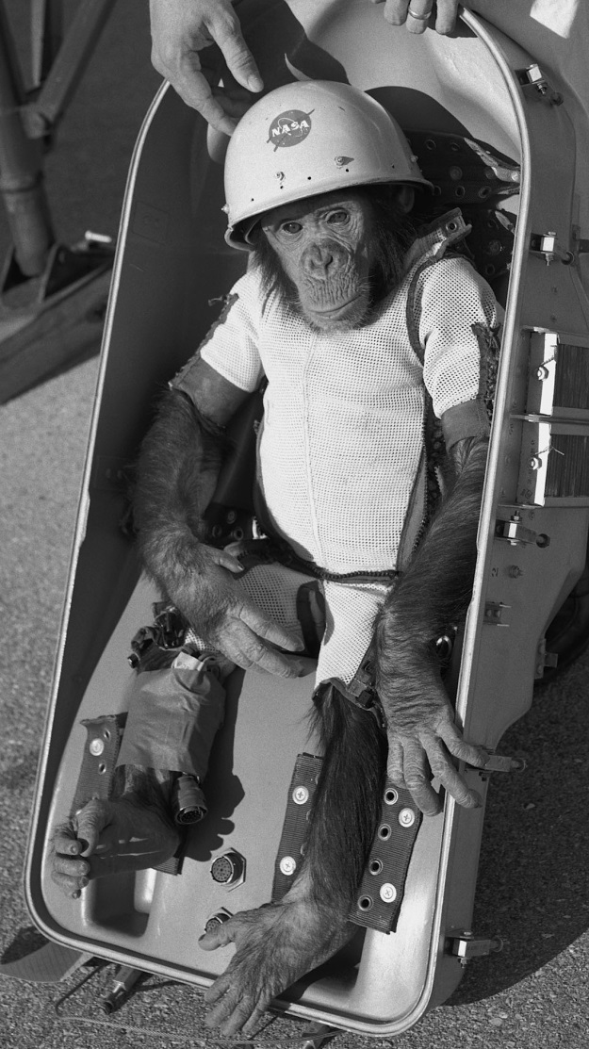
Kanzi (and perhaps Panbanisha) could make Oldawan style tools
However…
Unclear about cultural transmission.
Didn’t think it up on their own. Unclear if it would continue in the wild.
“Ham” in his space suit. Chimp in the Mercury program (1959).
Notes:
Space programs used monkeys for testing rockets and space vehicles. Alberts I-V all died from suffication, impact, or failed parachutes. Albert VI survived, although he died shortly thereafter because of excessive heat from the New Mexico sun.

Slide 22
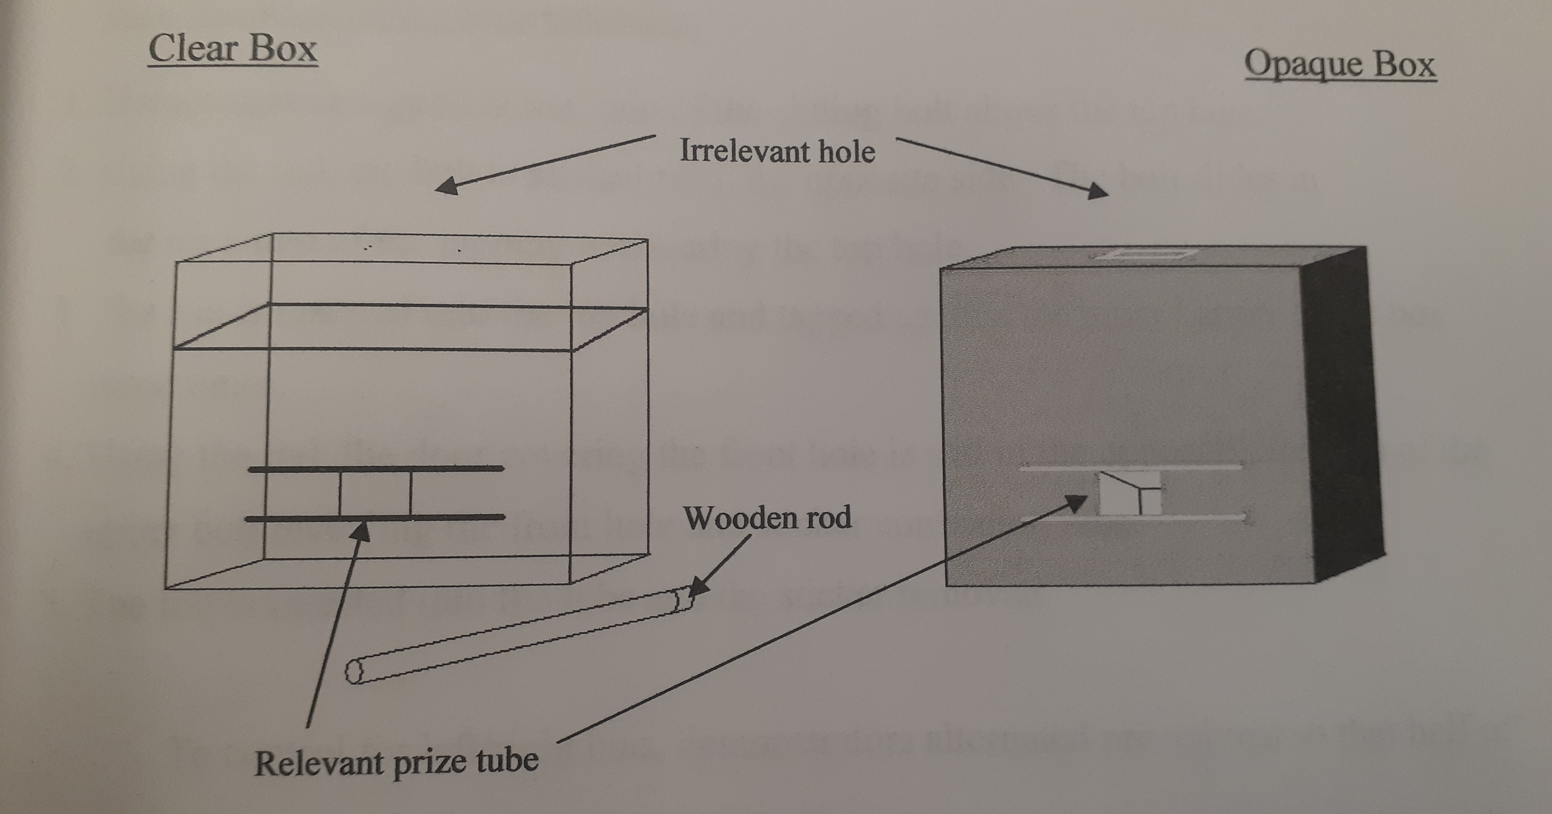
In Humans
Knapping is taught socially.
Bonobos emulate, humans imitate.
Allows “ratchet effect”. But this is the additional of a social factor, not the elimination of a “biological” factor.

Slide 23
