Slide 1
Goals. Students will be able to:
Describe how H. habilis differs from Australopithecus
Describe aspects of H. habilis culture

Slide 2
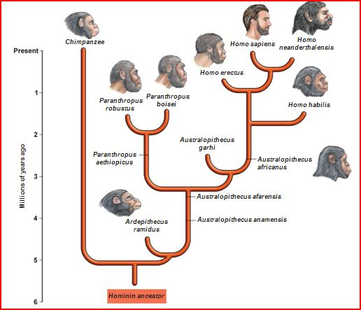

Slide 3
Human Adaptations
Bipedalism
Large(r) Brains
Long(er) period of parental investment
Use of simple artifacts (e.g., a stone flake)
Use of fire
Religion
Kinship
Language
Medicine
Use of composite artifacts (e.g., a bow and arrow)
Communal hunting
Marriage
Art
Families

Slide 4
Homo habilis
Homo habilis branches off from main line of the Australopithecus around 2.5 million years ago.
The skull of Homo habilis was larger and differently shaped than Australopithecus
A taller steeper forehead, and more rounded profile.
Larger brain; greater intelligence
H. habilis able to make and use stone tools.
Later australopithecines may have done so as well.
Evolved into another hominid species H. erectus by about 1.8 MYA. Rapid evolutionary change.
Punctuated equilibrium: evolutionary change is not constant, but can vary as the environment and evolutionary contexts change.

Slide 5
OLDOWAN HOMININS AT THE KANJERA SITE
Evidence for hunting and “persistent” reliance on meat around two million years ago has been found at the Kanjera South (KJS) site in Kenya
Marks on antelope bones should simple stone tools were used to remove animal flesh and crack open bones
Reliance on meat allowed for numerous changes:
Gender-based division of labor, pair bonding, and increased parental (especially male) investment in children
Population increase and territorial expansion
Increase in the size of the human body and brain

Slide 6
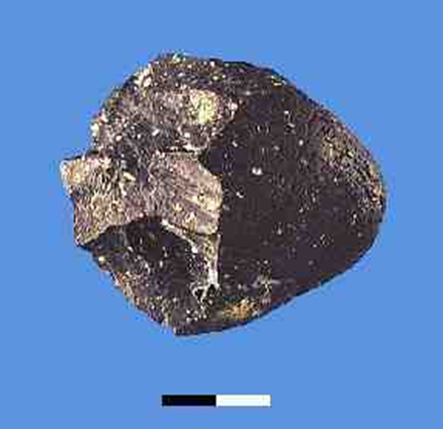
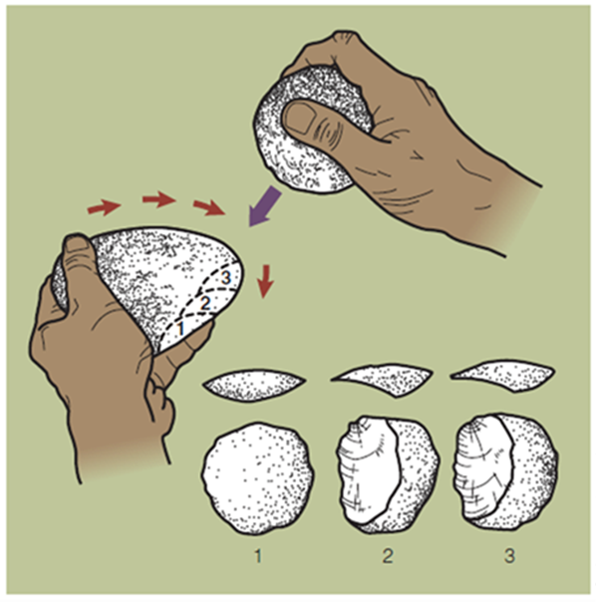
Oldawan

Slide 7
Goals. Students will be able to:
Describe the trends reflected in the transition to H. erectus from H. habilis
Describe Acheulian tools

Slide 8
Human Adaptations
Bipedalism
Use of simple artifacts (e.g., a stone flake)
Large(r) Brains
Long(er) period of parental investment
Use of fire
Religion
Kinship
Language
Medicine
Use of composite artifacts (e.g., a bow and arrow)
Communal hunting
Marriage
Art
Families

Slide 9
The Fate of Homo habilis
Existence of Homo habilis was relatively brief
Remains disappear entirely sometime after about 1.8 million years ago.
Habilis appears to have evolved into another hominid species. (Co-existed for a period too)
What happened?
Bigger brain
More efficient walking
Shorter arms but taller bodies.
In short, became a different species: Homo erectus (also sometimes other species)

Slide 10
H. HABILIS AND H. ERECTUS: HUNTING, TOOLS, AND TEETH
Ecological niche separating H. erectus from earlier hominins involved greater reliance on hunting, along with improved cultural capability
Greater variety of tools with symmetry, uniformity, and functional differentiation
New tools and dietary changes eased the burden on the chewing muscles, so these and supporting structures developed less
Smaller back teeth; larger front teeth for pulling, twisting, and gripping objects

Slide 11
Early Human Behavior: Scavengers or Hunters? Some bones at early sites have tool marks on top of animal tooth marks

Slide 12
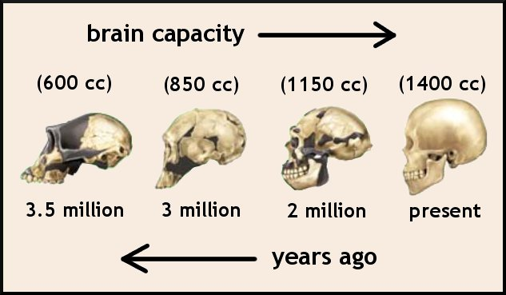
Australopithecus: 440 cc
Paranthropus: 519 cc
Homo habilis: 640 cc
Homo erectus: 1,029
Homo sapiens: 1,350 cc

Slide 13
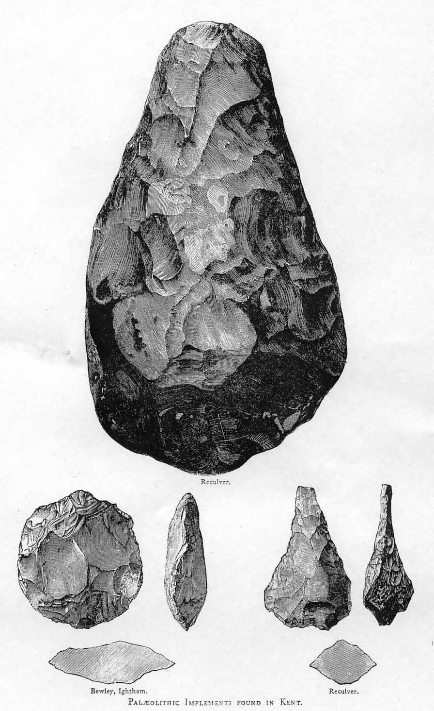
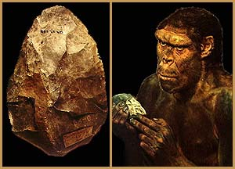
Acheulian Hand Axes
Retouched and repaired by a “thoughtful” creature
Notes:
Clockwise from top, cordate, ficron, and ovate.

Slide 14
Homo erectus
lived from approximately 1.8 MYA to around 400,000 years ago (but as recent as 50,000 BP in some areas).
has a larger brain, with adult brains ranging from 900 to 1200 cc.
fifty-percent increase in brain size over H. habilis
The largest brain sizes fall within the range of modern humans, although the brain was configured somewhat differently.

Slide 15
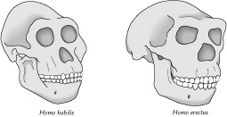
Homo erectus
The skull of Homo erectus is larger and less apelike than that of Homo habilis. Still, it remains more prognathous than that of a modern human.

Slide 16
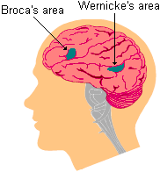
H. Erectus Traits
Analysis of cranial endocasts of Homo erectus specimens shows similarities to the modern human brain.
Language
Growth of Broca’s and Wernicke’s areas
Broca’s controls speech
Wernicke’s controls comprehension

Slide 17
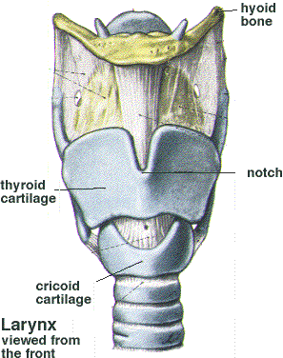
Language
Placement and structure of the larynx is central to speech. H. erectus had narrower throat, so could not have made the full range of sounds that we can.

Slide 18
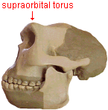
H. erectus Traits
From the neck down almost exactly like modern humans
Above the neck is where the differences were. Had no chin, thick and big brow ridges
Homo erectus crania display a massive ridge of bone called a supraorbital torus. Present in the skulls of all ape species but generally absent in the modern human form.
Bigger teeth than modern humans
Males were much bigger than females, but this changes over time
More robust body
Body Size
male:170cm,66kg
female:150cm, 56kg

Slide 19
Raising Homo erectus
Homo in a difficult situation: natural selection is favoring both increased intelligence and bipedalism.
Increased intelligence requires a larger brain.
Bipedalism requires narrow hips and pelvis.
What’s the problem?
What’s the solution?
This issue became central to evolution of Homo erectus.

Slide 20
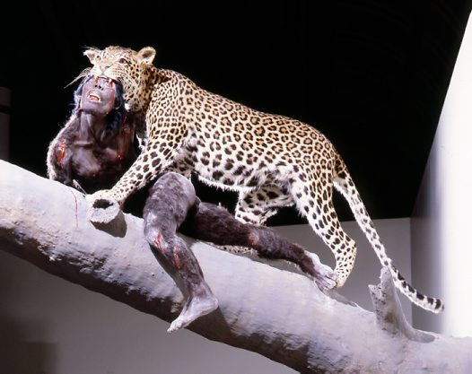
Famous H. erectus finds
Swartkrans, South Africa
Cave site excavated in the 1960s
Co-existence of Paranthropus and Homo (H. habilis and H. erectus).
Controlled use of fire by about 1.5 mya
Bone tools possibly used for digging termite mounds. (Usewear and experimental analysis).

Slide 21
Homo out of Africa
The control of fire was a big deal
Allows cooking, which increases nutrition and helps eliminate parasites and other pathogens
Allows great range of environments. H. erectus is the first member of the genus Homo to venture beyond Africa.
The earliest H. erectus finds are in the Rift Valley of Africa and in South Africa.
Stone tools and camp sites are widely distributed over Africa, including sites in what is now the Sahara desert. By at least 1.7 million years ago, H. erectus migrated out of Africa to Asia and Europe.

Slide 22
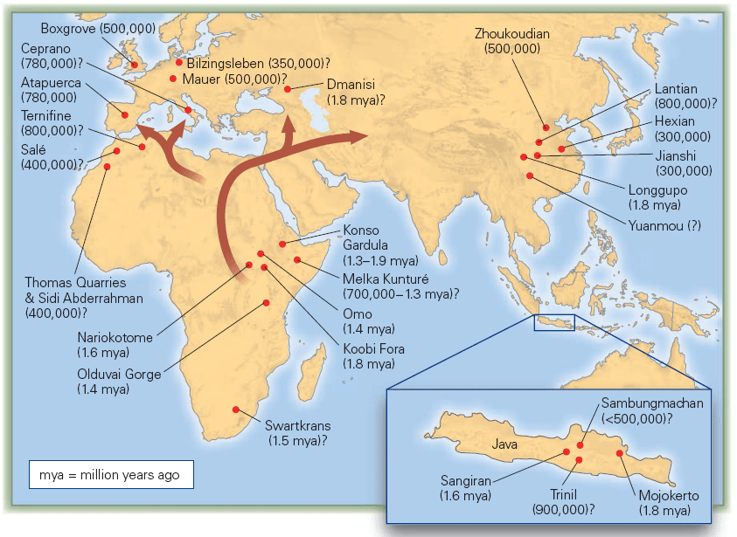
Homo Erectus
Fossil localities of Homo erectus.

Slide 23
Goals. Students will be able to:
Define the Lower Paleolithic.

Slide 24
Lower Paleolithic
Homo habilis and Homo erectus.
Dates from 2.5 mya to around 50 kya. Long period of cultural stasis, with extreme biological change.
Use of fire
Scavaging and perhaps some hunting
“Hunting and gathering” lifestyle (and all that that entails)

Slide 25
Lower Paleolithic Tool Traditions
Two primary tool traditions: Oldowan (aka Olduwan and Oldawan) and Acheulian
DO NOT confuse the tool types with species. Not all H. erectus used Acheulian tools, and some H. habilis used virtually identical tools.
Oldowan, expedient tools.
Acheulian, differentiated from Oldowan by “retouch”.

Slide 26
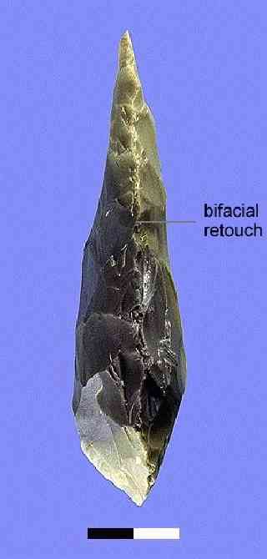
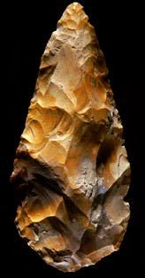
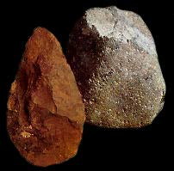
Oldowan
Achuelian

Slide 27
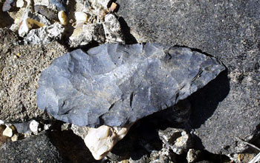
Acheulian Tools
Creation of tool requires a concept of symmetry, bifacial reduction, and forethought.
The core was important, as opposed to the flakes.
Lots of different forms. Different uses?
Soft hammer reduction using antler and bone.

Slide 28
