Slide 1
Goals. Students will be able to:
Describe key somatic and cultural features of archaic (pre-modern) Homo sapiens

Slide 2
Human Adaptations
Bipedalism
Use of fire
Use of simple artifacts (e.g., a stone flake)
Large Brains
Long period of parental investment
Kinship
Families
Language
Use of composite artifacts (e.g., a stone tipped spear)
Religion
Medicine
Communal hunting
Marriage
Art

Slide 3
Change in H. erectus
Beginning as much as 600,000 years ago, and well-established by 400,000 years ago, premodern Homo sapiens.
Anatomically modern Homo sapiens appear in the African fossil record around 195,000 B.P.

Slide 4
The Neanderthals (130,000 to 28,000 BP)
The best known of the premoderns are the Neanderthals.
The Neanderthals were just one group of premodern human beings.
They are well known for several reasons
They were abundant in Europe, where most early paleoanthropological research was done.
Neanderthals used caves extensively, and archaeological remains are better preserved in cave settings.

Slide 5
Geographic Distribution of Neanderthal Fossils

Slide 6
Morphological Evidence
Neanderthal brain size often surpassed that of modern human beings.
Larger bodies ordinarily require larger brains to control them, and Neanderthals did have more massive bodies than anatomically modern human beings.
The Neanderthal face was large, with the lower portion far forward of the eyes and brows.
The nasal bridge was wide and flaring, and they lacked the thin, pointy chin that typifies modern human beings.

Slide 7
COLD-ADAPTED NEANDERTHALS
Neanderthals were stocky, with large trunks relative to their limb length
Phenotype minimizes surface area and conserves heat
Massive nasal cavities of Neanderthal fossils suggest they had long, broad noses to expand area for warming and moistening air
Neanderthals’ front teeth: extremely large, show evidence of wear
Probably used for many jobs later done by tools
Neanderthal technology: Middle Paleolithic tool tradition called Mousterian

Slide 8
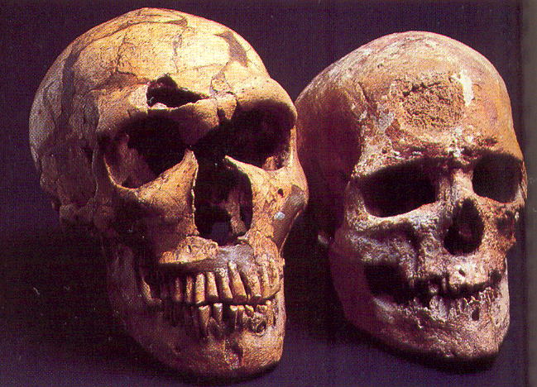

Slide 9
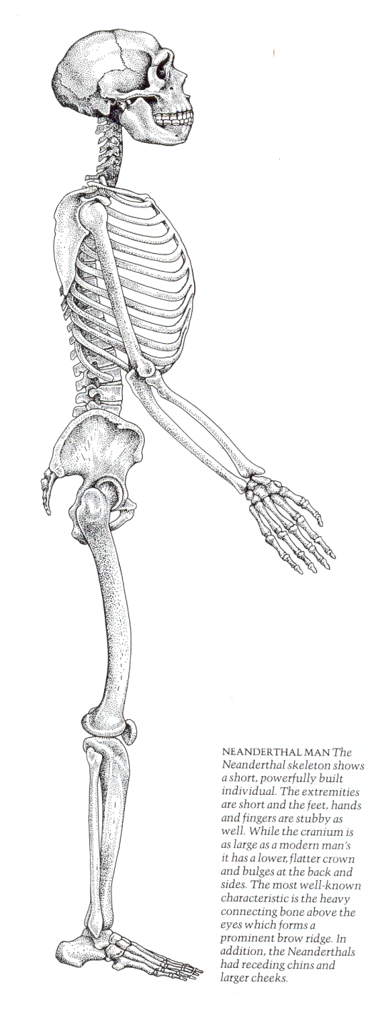
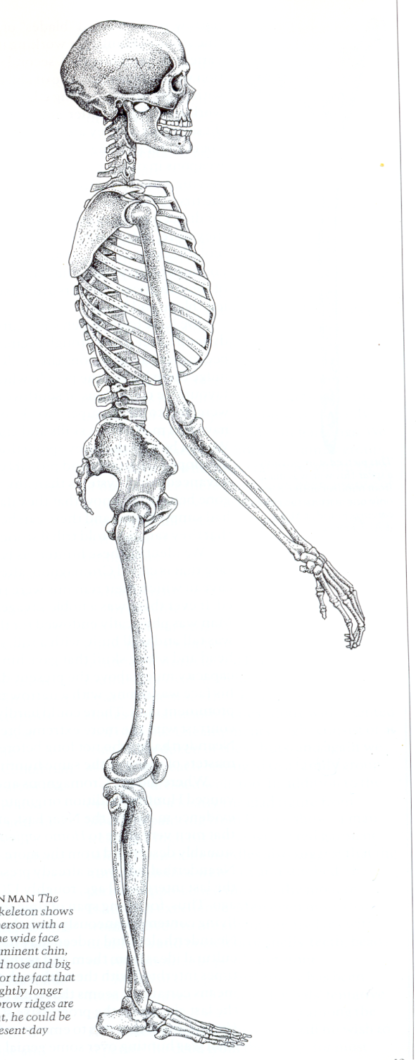
Neanderthal
Cromagnum
(early anatomically modern human

Slide 10
Goals. Students will be able to:
Describe the defining characteristics of the Middle Paleolithic.

Slide 11
Middle Paleolithic
Lasts from 300 kya (but later in some areas) to around 40 kya (but earlier in some areas).
Characterized by a more complex stone tool technology.
Associated with premodern and modern H. sapiens.

Slide 12
Neanderthal Culture
Use of fire was essential in a cold Europe
Lived in small bands/families, in open air and cave locations
Had language (but not as good as ours)
They buried their dead—ritual behavior (but no clear evidence of religion)

Slide 13
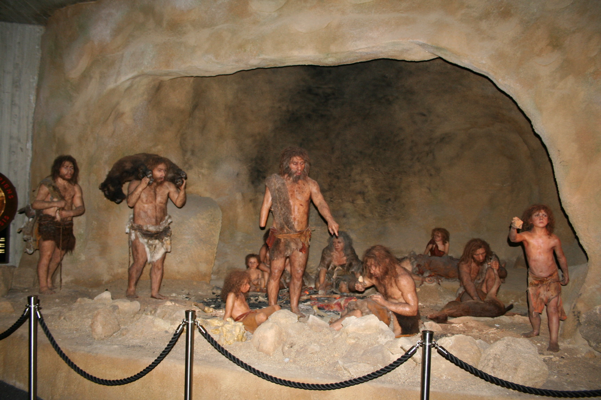

Slide 14
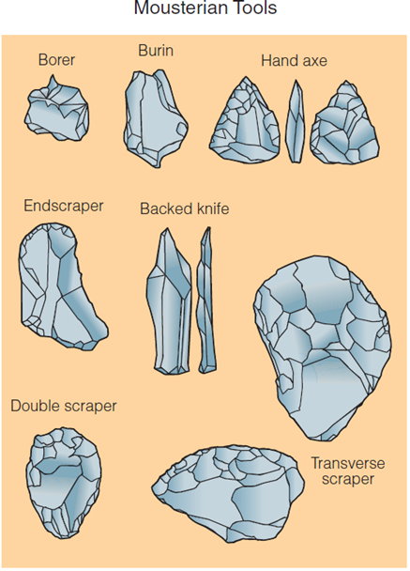
Development of premodern Homo Sapiens did not correspond with a great cultural break.
Handaxes similar to those manufactured by Homo erectus are common at premodern Homo sapiens sites in Europe and Africa.
By 200,000 years ago, a new and more efficient industry developed.

Slide 15
