Slide 1

Goals. Students will be able to:
Describe key cultural features of the Upper Paleolithic
Describe key stages in human cognition.

Slide 2
Human Adaptations
Bipedalism
Use of fire
Use of simple artifacts
Large Brains
Long period of parental investment
Language
Families
Use of composite artifacts
Symbolic Language
Kinship
Religion
Medicine
Communal hunting
Marriage
Art

Slide 3
Upper Paleolithic
Lasts from 60 kya (but later in some areas) to around 10 kya (but continuing to the historic period in some areas).
Characterized by a more complex stone tool technology, increased symbolic expression, greater social complexity (e.g., obvious signs of religion).
Associated with modern H. sapiens.

Slide 4
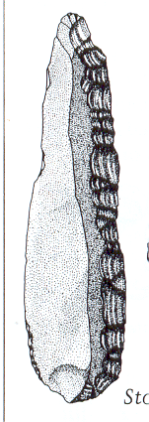
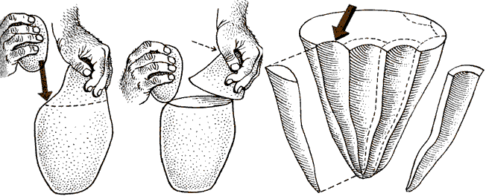
Unifacial cores are often used to produce blades.
Blades: at least twice as long as they are wide

Slide 5
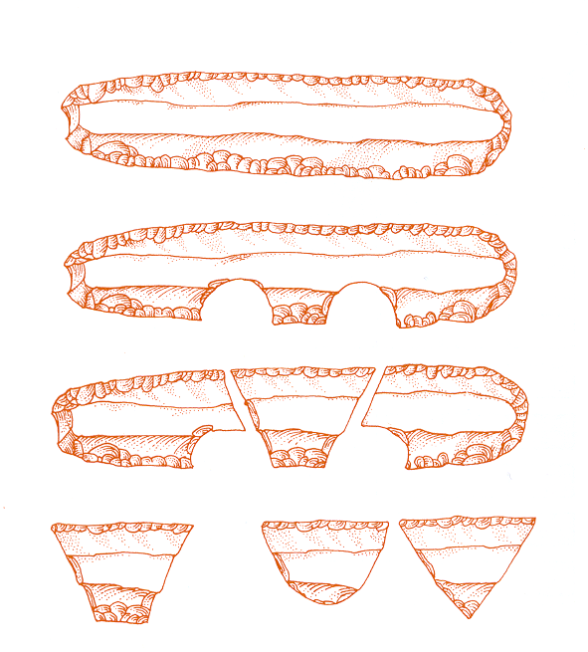
Microliths

Slide 6
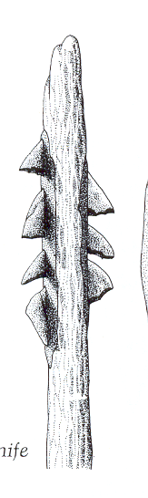
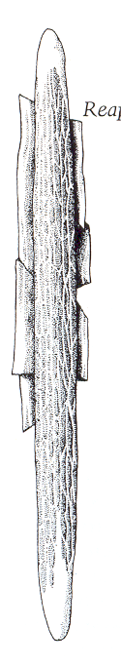
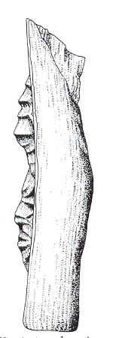
Egypt
Western
Mediterranean
Eastern
Mediterranean

Slide 7
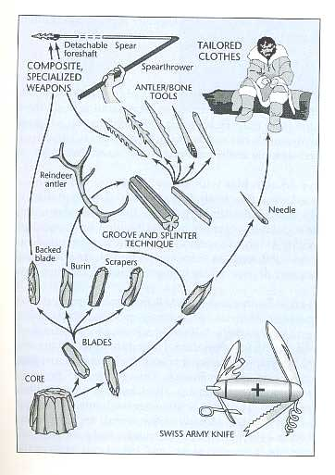

Slide 8
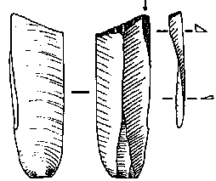
Burin: a chisel-like tool formed by strengthening an edge so that it can be used to incise bone, antler, or horn.

Slide 9
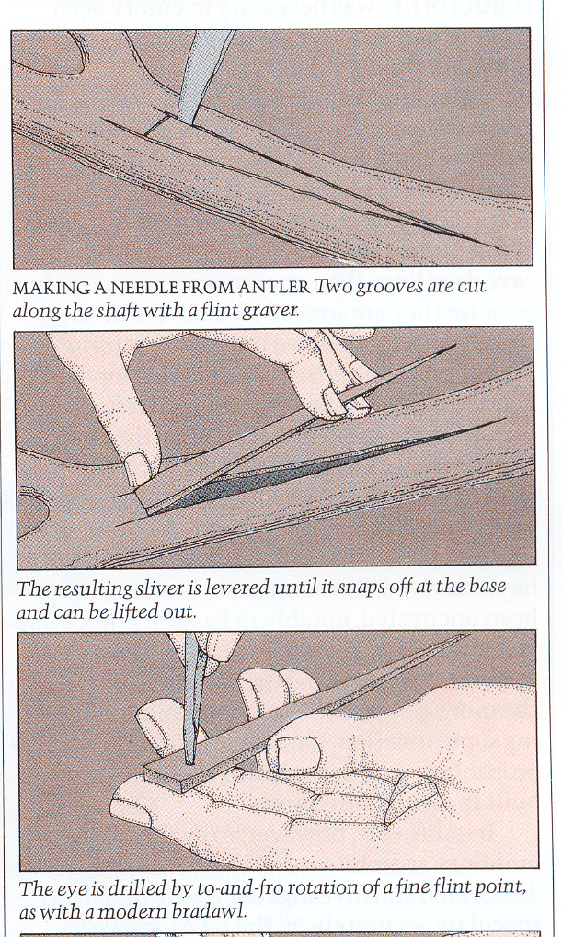
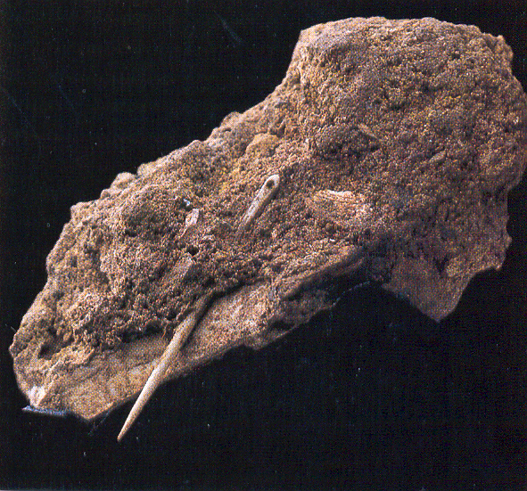

Slide 10

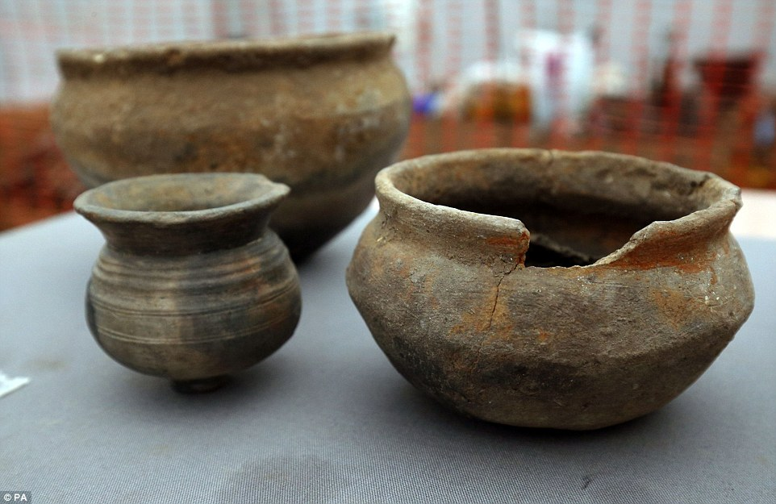
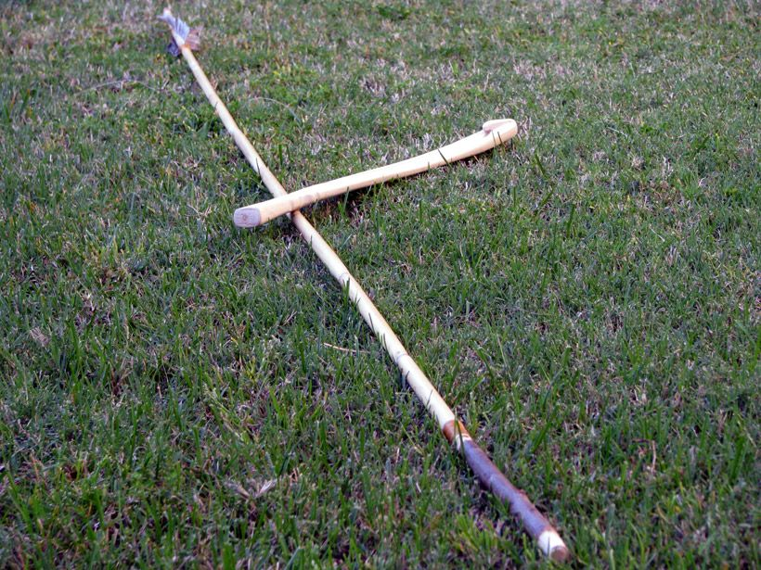
Brain/Language Development over the last 100 mya
Towards the end of the Lower Paleolithic, normativity develops (imitation).
Notes:
Coevolution of Composite-Tool Technology, Constructive Memory, and Language Implications for the Evolution of Modern Human Behavior by Stanley H. Ambrose

Slide 11
The Lower Paleolithic
Towards the end of the Lower Paleolithic, normativity develops (imitation). Reflected in the Acheulean technology (symmetry, regional traditions).
  Probably developed based on exploitation of medium to large carcasses (too big to process with hands likes chimps do).
  Larger social groups. Communal animal processing. Even transported heads to elephants.
  Normative behavior = more standardized cooperation
Notes:
Coevolution of Composite-Tool Technology, Constructive Memory, and Language Implications for the Evolution of Modern Human Behavior by Stanley H. Ambrose

Slide 13
The Middle Paleolithic
Development of normative behavior allows more humans to interact effectively. Hominid interaction becomes most significant fitness factor.
Results in adaptation of recursion: link behaviors sequentially in hierarchies of action (e.g., hafted tools).
Increases efficiency (e.g., better hunting weapons; holding on to good quality stone material for a long distance; too use/reuse through stages).
Still, people move randomly in circumscribed areas. Expedient, opportunistic use of resources. Hostile to other groups. (lots of evidence of strenuous activities, high movement, and violence)

Slide 14
The Middle Paleolithic
Development of normative behavior allows more humans to interact effectively. Hominid interaction becomes most significant fitness factor.
Results in adaptation of recursion: link behaviors sequentially in hierarchies of action (e.g., hafted tools).
Increases efficiency (e.g., better hunting weapons; holding on to good quality stone material for a long distance; too use/reuse through stages).
Still, people move randomly in circumscribed areas. Expedient, opportunistic use of resources. Hostile to other groups. (lots of evidence of strenuous activities, high movement, and violence)

Slide 15
The Upper Paleolithic
Abstraction: Think about intangible things (e.g., an afterlife; family relationships beyond immediate relatives [kinship], morality).
Troop-to-tribe transition. Long distance trade and social relationships.
Bones with ‘counting notches’ common. Extra-somatic stored information

Slide 16
Before the Upper Paleolithic, people seem to have reacted to their environment. AMH (after 70 kya) planned for their environment.
A ‘culturally constructed’ environment (trade, planned trips, cooperation).

Slide 17
“I need a tool.”
“There are wildebeests over there.”
“I heard the wildebeest migration started early. If we moved to the game pass and worked together, we could get enough meat for both of our families for many days. Would you like to join our camp?”

Slide 18
Language and Our Brain
Broca’s area starts growing by H. habilis.
Hypoglossal nerve shows growth by 500 kya (late H. erectus).
Changes in ability to use tools and have long-term planning linked to better language
  ‘Mental time travel’ linked to planning is uniquely human. Linked to abstraction.

Slide 19
Language
We are overbuilt for language:
  We can make over 120 different distinct sounds. No single language uses all of them.
  Huge vocabularies. Average person on street has a speaking vocabulary of 3,000 words (plus gestures). Shakespeare's vocabulary is estimated at 24,000.
Chimps make 20+ vocalizations/gestures.

Slide 20


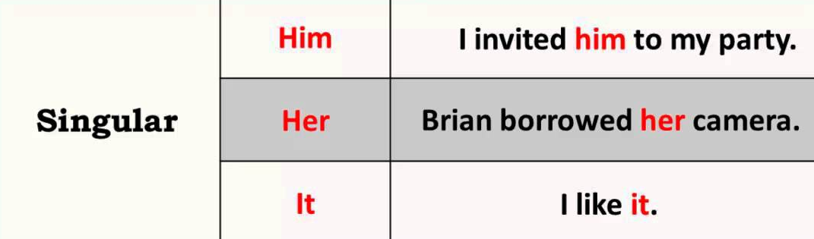
Language
Developed gradually
Our language includes:
  Symbolism (you are as pretty as a rose).
  Grammar (every language distinguishes between nouns and verbs)
  A body that allows it (areas of the brain for processing linguistic information, control of the tongue [hypoglossal nerve])

Slide 21
LANGUAGE ALLOWS:
Large social organization
Better cultural transmission
Trade and economic cooperation
Increased safety and security
Increased efficiency (e.g., hunting)

Slide 22
Our Throat
Throat and mouth structure appropriate for speech present around 150 kya.
Our style of language probably sometime after 100 kya. Linked to development of abstract thought.
  You smell like a mammoth.
  With all due respect…

Slide 23
