Slide 1
Goals. Students will be able to:
Describe specialized mega-fauna hunters as an example of Upper Paleolithic culture
Describe key features of Upper Paleolithic art.
Explain arguments for shamanism as the dominant religious system in the Upper Paleolithic

Slide 2
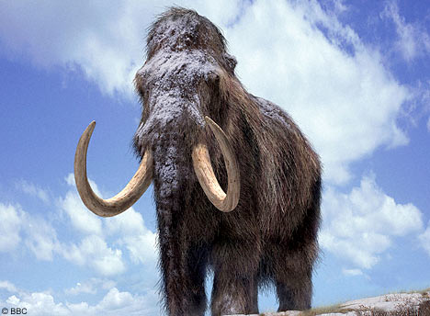
The Mammoth Hunters
Mammoth roughly 150% the size of an African elephant.
Primary game in Eastern Europe.
Dolni Vestonice: remains of 800 to 900 mammoth.

Slide 3
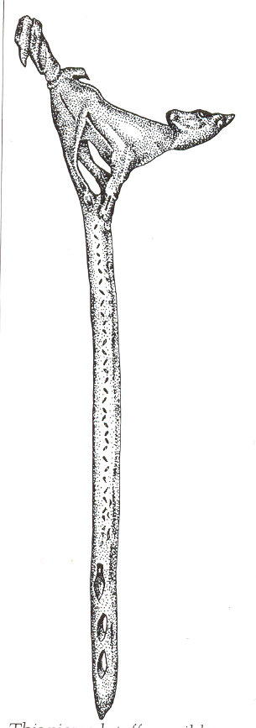
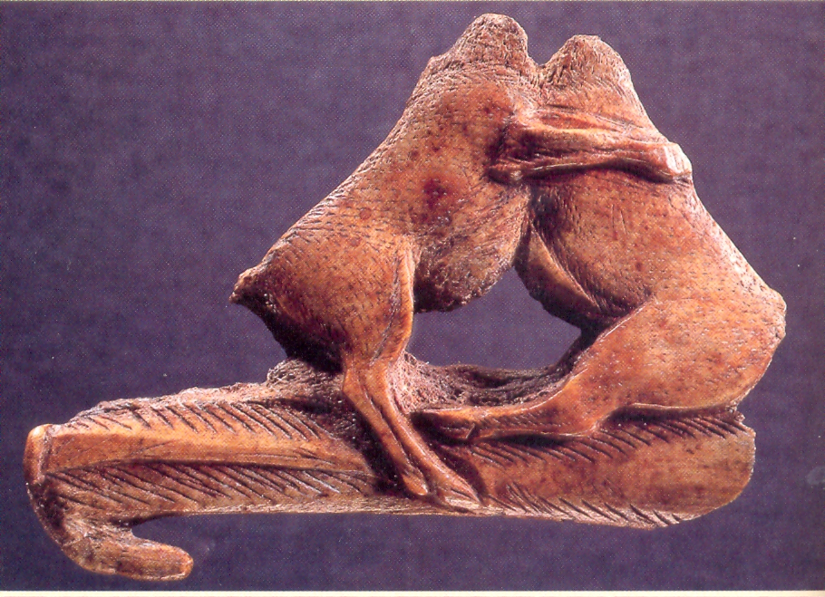

Slide 4
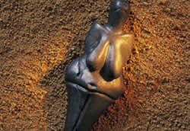
Dolni Vestonice
In Czech Republic.
Dates to about 25,000 BP.
Heavily disturbed by solifluction.
Mammoth bones sorted by type, and some were used for building structures.
Little wood on the landscape.
Venus of Vestonice—portable art.
Made of clay.

Slide 5
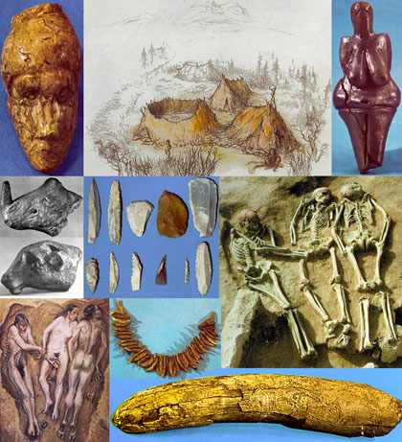
Likely occupied year round.
Blades.
Burial of elderly female with congenital nerve damage. Assymetrical facial expressions.
Buried under two mammoth shoulder blades and next to the bones of an Artic fox.

Slide 6
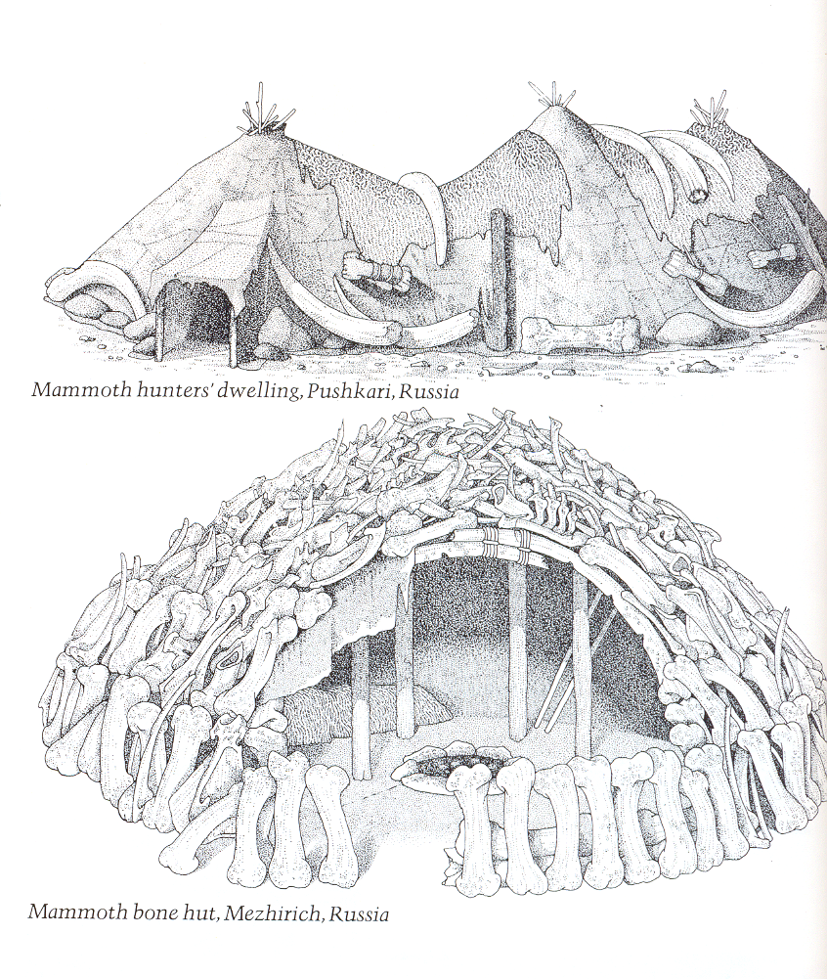

Slide 7
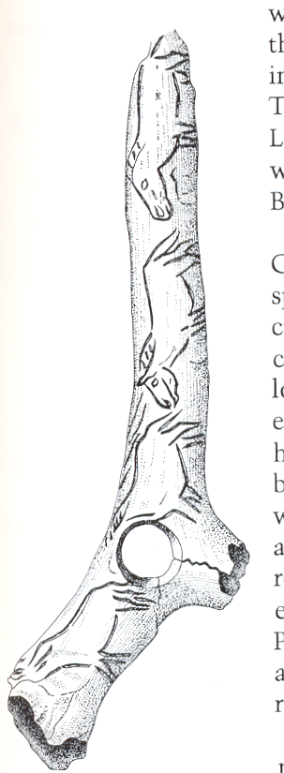
Portable and Mural Art
Portable art
Atlatl and shaft “straightener”
Notes:
Upper Paleolithic Atlatl from France

Slide 8
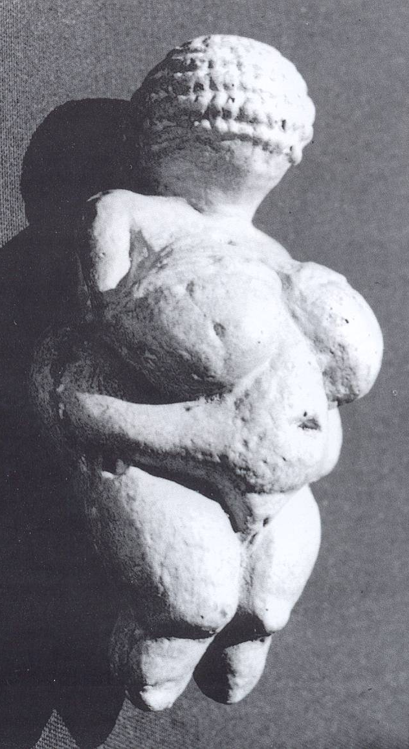
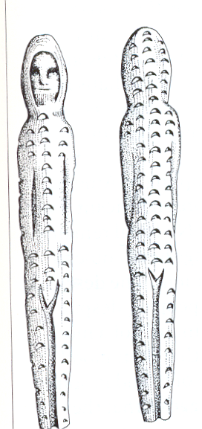
Notes:
Portable art: Venus of Willendorf, “shaft straightener” or carved baton from Europe, ivory figurine from Siberia.

Slide 9
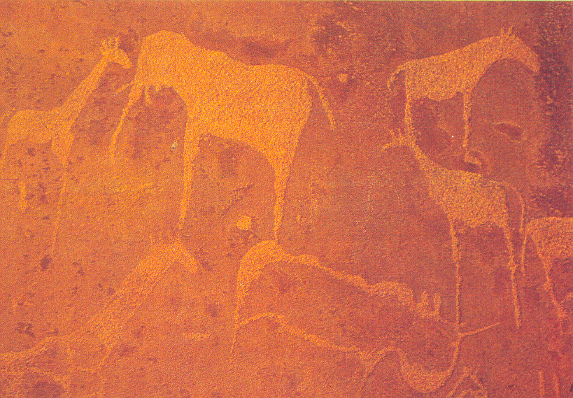
Rock Art (from Nambia)
Notes:
Twyfelfontein, Damaraland, Nambia. (2,500 rock art depictions)

Slide 10
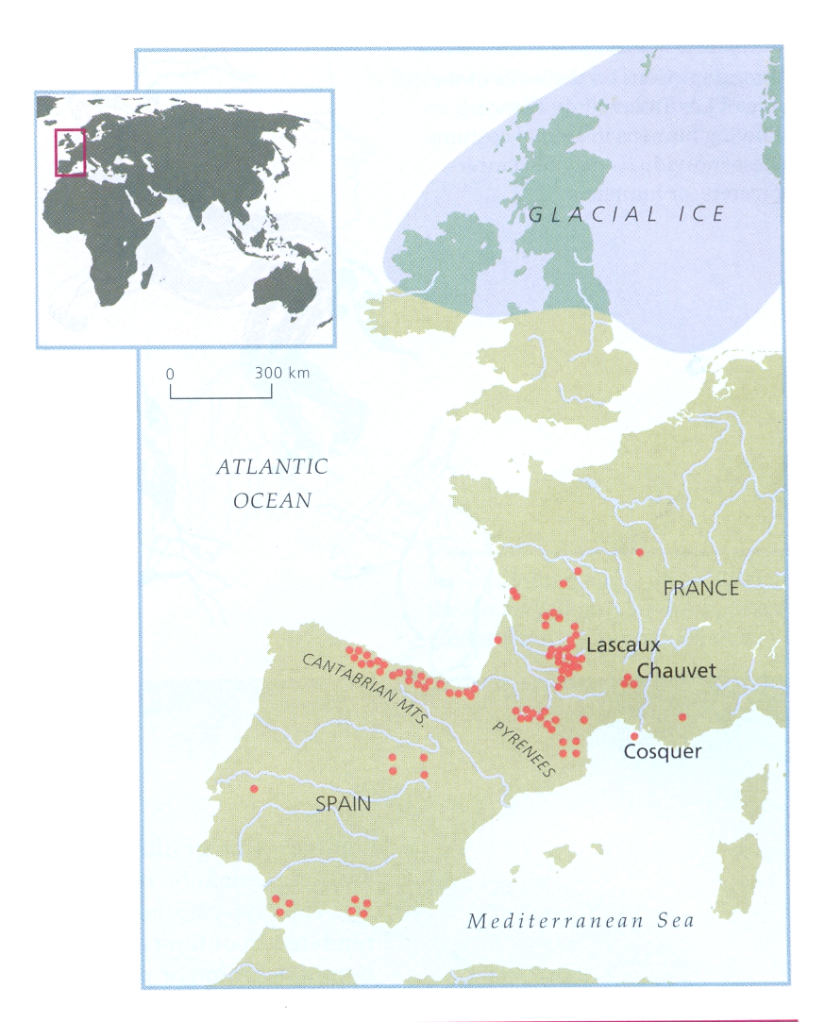
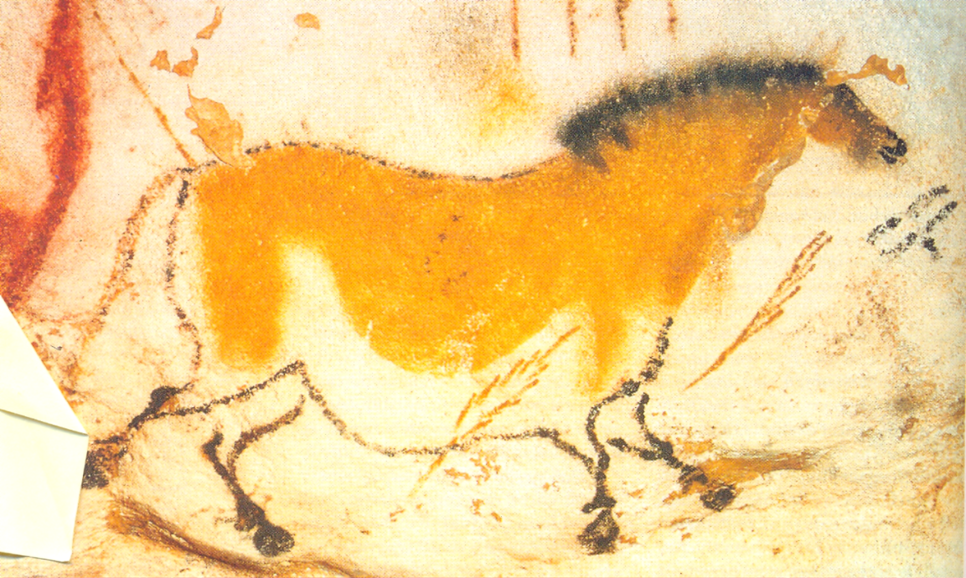
Location of Upper Paleolithic Cave Rock Art Sites in Western Europe
Mural art is most common in Western Europe, perhaps because of preservation.
Horse from Lascaux, France

Slide 11
Lascaux, Southwestern France
In a topographically complex area. Lots of caves, rivers, cliffs, etc.
Used by Late Paleolithic people.
Lascaux found by boys in 1940
Tree blown over by wind left opening to the cave.
Cave had been sealed for about 15,000 years

Slide 12
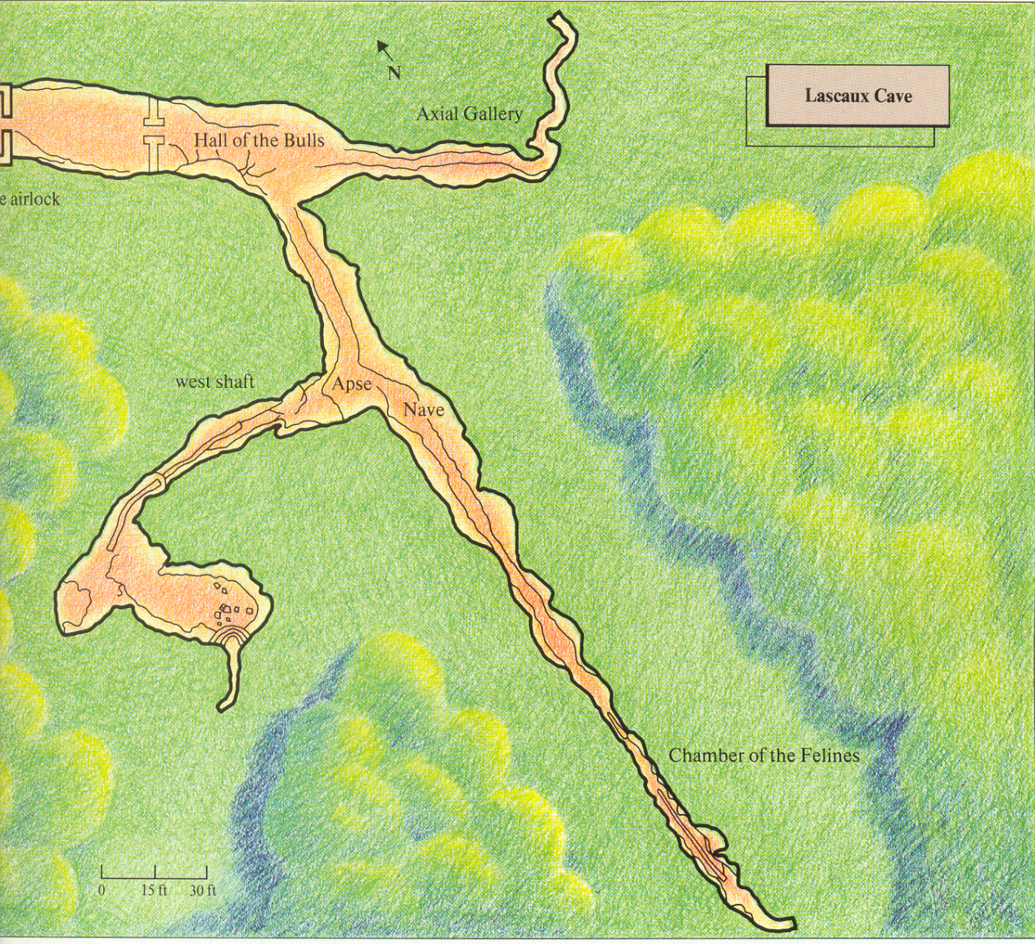
Cave was visited only briefly by few individuals. Not a habitation site.
Mostly animals, not humans.
Human hands and humans involved in “ceremonies”.
Hands tend to lack fingers.

Slide 13
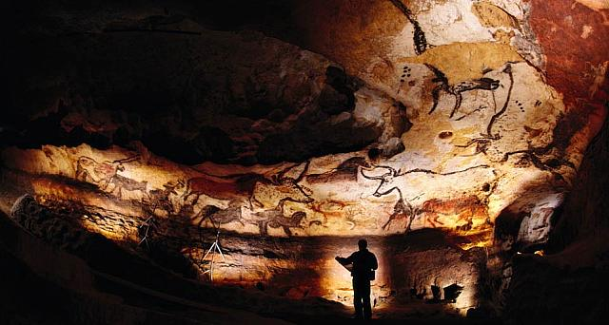

Slide 14
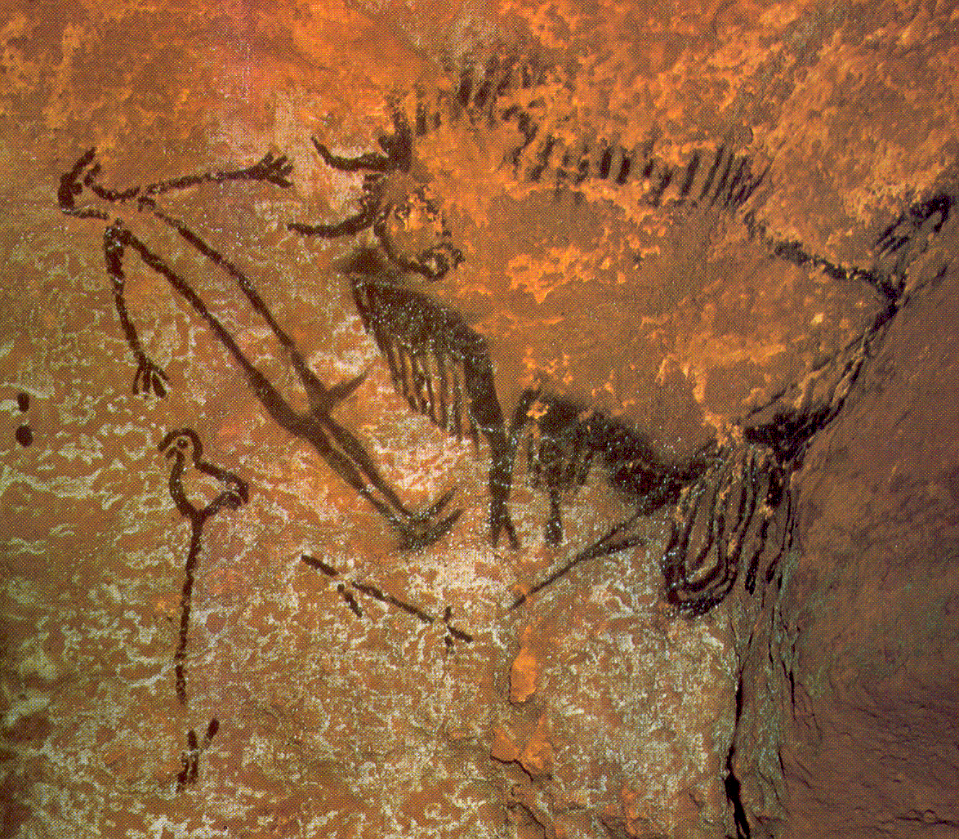

Slide 15
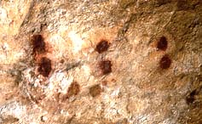
Lascaux: Such red dots are associated with the “Scene of the Dead Man.”

Slide 16
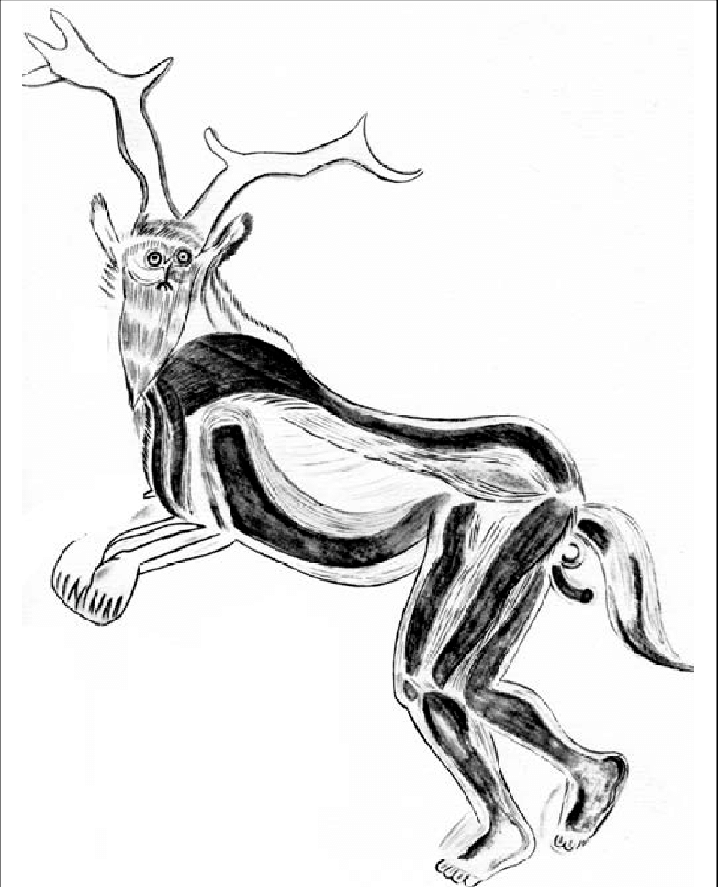
Shamans
The “Classic” Shamanic Journey
The shaman enters into a trance. His (most shamans are male) spirit leaves his body.
The shaman’s spirit travels to the spirit world, where it interacts with spirits and various deities. The shaman gains knowledge or asks for favors.
The shaman’s spirit returns to his body as the shaman leaves his trance.

Slide 17
ASC
Shaman frequently experiences the sensation of flying as he journeys to the spirit world
Becomes a spiritual entity himself, transforms into an anthropomorphic spirit
In the spiritual realm the shaman communes with supernatural beings

Slide 18
Stages of ASC (Stages 1 through 3)
Stage 1
entopic images—geometrics
Stacked geometrics
Stage 2
Movement, often rotation
Vortex
Stage 3
Icons and Interpretations
Spirit Realm full of spirit creatures
Differences in stages are general (heuristic), not absolute
Different drugs also have different stages

Slide 19
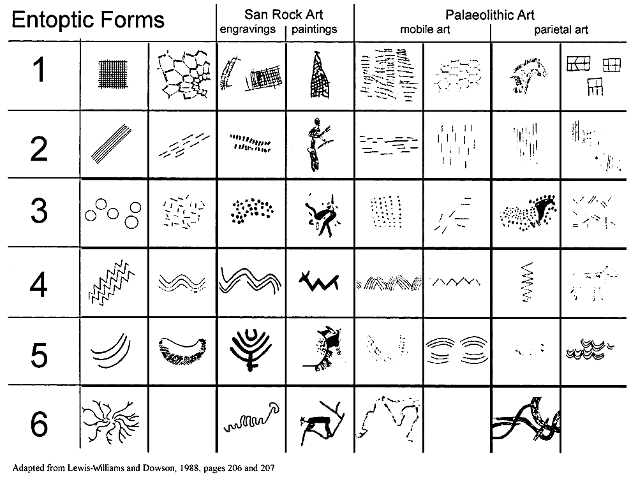
Entopic Images

Slide 20
(Images from Siegel and West, 1975)
Hallucinations by
Yando 1970-1972
LSD Hallucination
By Oscar Jeniger
Huichol Peyote hallucination

Slide 21
Themes in Shamanic Imagery
Liminal creatures (creatures that span different realms, e.g. ground and sky)
Anthropomorphs such as birdmen, jaguarmen, or bearmen
Ghosts or Spirits
Shamanic universe with at least three levels
Elements of hallucination imagery

Slide 22
