Slide 1
Goals. Students will be able to:
Define bias transmission and the general pattern of technological development.
Explain why the idea of “technological progress” fails as an explanatory concept in archaeological contexts.
Identify the unique structure of Tasmanian technology and explain the problem of lost technology in this case.

Slide 2
Goals. Students will be able to:
Define bias transmission and the general pattern of technological development.
Explain why the idea of “technological progress” fails as an explanatory concept in archaeological contexts.
Identify the unique structure of Tasmanian technology and explain the problem of lost technology in this case.
Explain why Tasmanian technology became simpler over time and identify the implications to cultural development in general (e.g., the impact of more efficient cultural transmission; the impact of demographic factors)

Slide 3
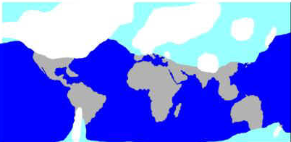
World a Much Smaller Place: Land Exposed during last glacial maximum (ca. 18,000 B.P.)

Slide 4
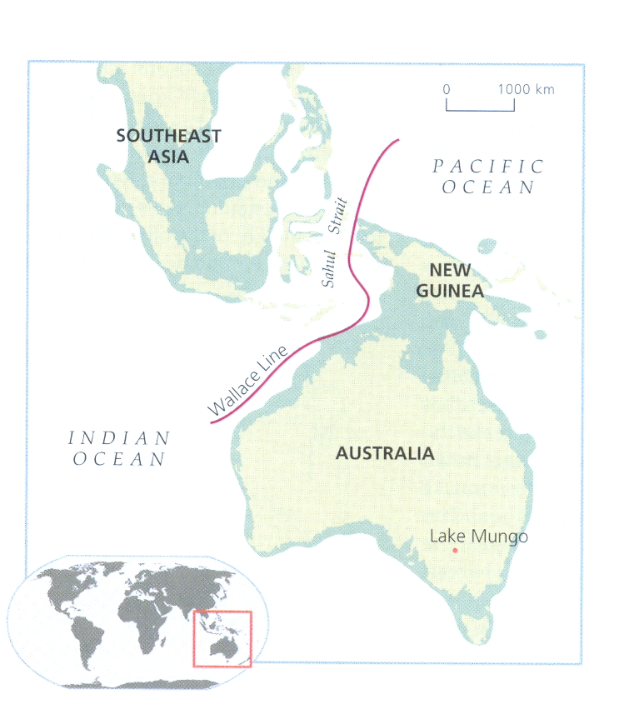
Wallace Line created by Sahul Strait: At least 65 miles of open water.
Boats: Suggested boats range from accidental rafts to bamboo rafts to full canoes.
Must have been large enough to carry a viable initial breeding population (8-9 people but likely more).

Slide 5
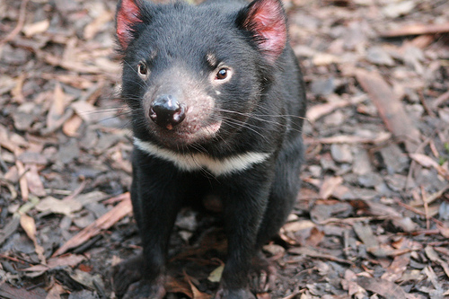
Australian culture amazingly stable Upper Paleolithic occupation. Not so for Tasmania.
At European contact, simplest technology in the world. Middle Paleolithic technology.
Colonized from Australia 34,000 BP, when it was a single land mass.
Separated from Australia about 9,000 BP.
“Lost technology”

Slide 6
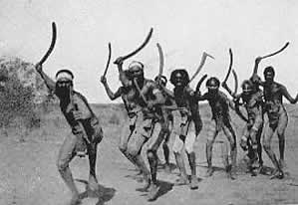
Lost:
Bone tools of all kinds
Cold-weather clothing
Fishhooks
Hafted tools
Fishing spears
Barbed spears
Fish/eel traps
Nets
Atlatl
Boomerangs

Slide 7
To hunt or fight, Tasmanians used only rocks, one-piece spears, and throwing clubs. Entire toolkit consisted of only 24 items.
Australian aborigines’ toolkit (and Tasmanians tool kit at time of isolation) included atlatl, mounted adzes, multipronged fishing spears, composite tools, swen bark canoes, boomerangs, a variety of hunting nets, ground-edged axes, wooden bowls, etc

Slide 8
Bone tools
Frequency, variety, and complexity decreased from 8,000 to 3,000 years ago, until the technology was completely lost.
Cold weather clothing
Only a few hundred kilometers from the expanded Antarctica. Tasmanians had only wallaby blankets. This was supplemented by spread grease or ochre over their skin.
Other examples: Loss of fishing technology.

Slide 9
Problem for Archaeologists
Oswalt: “In technological terms they did not have any complex weapons (including hunting tools), nor did they make an composite instruments or weapons. These factors set the Tasmanians apart from all other peoples in the world.”

Slide 10
