Slide 1
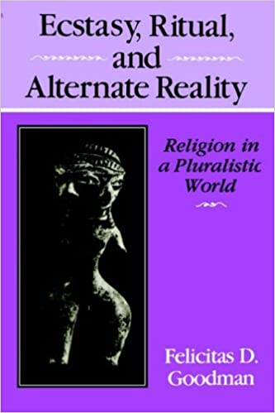
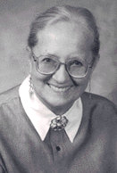
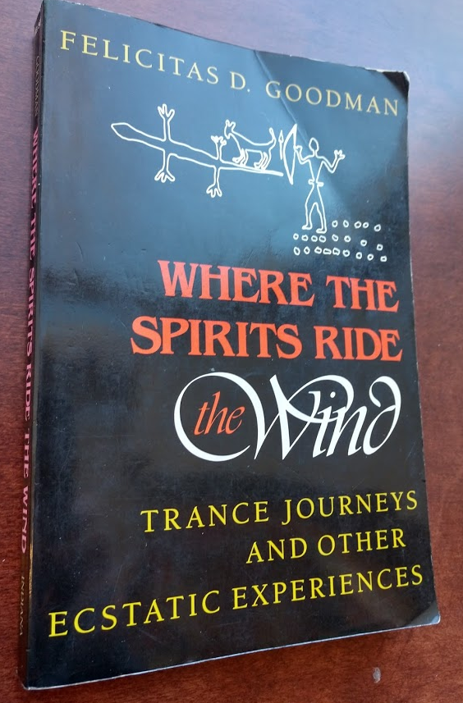

Slide 2
Brainwaves and Altered States of Consciousness (Ecstatic Trance)
In 1984 Dr. Felicitas Goodman worked with an unnamed PhD student in Professor Johann Kugler’s neurophysiological laboratory at the University of Munich, Germany (Goodman 1990: 25, 1999).
4 subjects held ritual postures while listening to a rattle (210 beats per minute) for 15 minutes.
Brain activity was measured with an electroencephalogram (EEG).
Subjects that did RBP in the laboratory were wired to the EEG machine and bloodwork and blood pressure was taken before, during, and after trance.
The EEGs indicated that trance caused theta waves (4-7 Hz) (waking brainwaves are much faster) and they were primarily distributed in the occipital regions of the left and right hemispheres (Goodman 1999:56).
There was a decrease in various catecholamines (epinephrine and norepinephrine) during trance and by the end of the trance they were absent in the blood serum; epinephrine (adrenaline) and norepinephrine are related to the brain’s stress response.
Towards the end of the trance the brain began to synthesize beta-endorphins, which are part of the brain’s reward and pain response system and are well known to cause euphoria.
In practical terms, the person has an energetic but relaxed “waking dream” that leaves them feeling less stressed and otherwise feeling ‘good.’

Slide 3
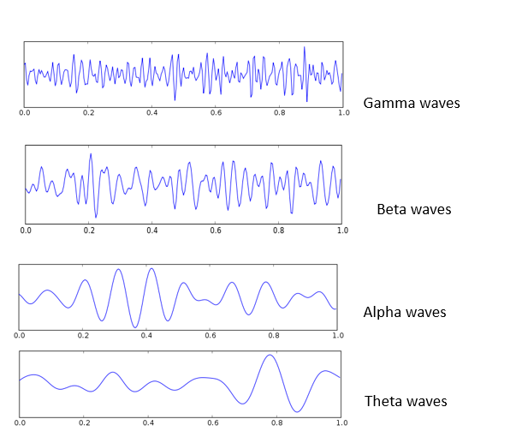
Brainwaves and Activities
39-42 Hz; modulates perception and consciousness, problem solving
13-38 Hz; state of mental intellectual activity
8-12 Hz; state of relaxation, brain is in idle; it can respond as needed (back to concentration or fall to sleep).
4-7 Hz; very relaxed state; daydreams and trance; twilight zone between sleep and waking
Delta waves
1-3 Hz- sleep, taking up nutrients

Slide 4
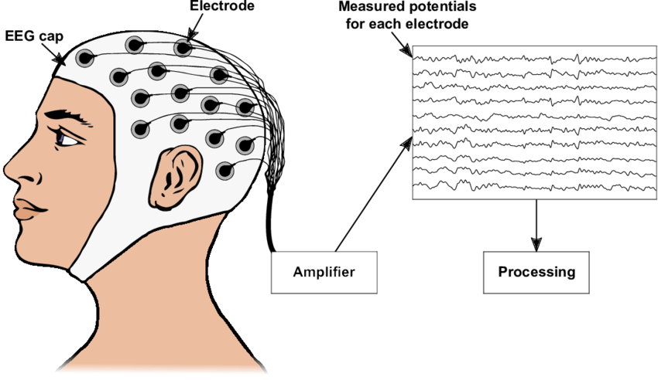
Electroencephalography (EEG)
Goodman (1988) stated that EEG data provide a “liquid” brain map of the exterior of the brain. They do not point to specific areas of the brain.
Other techniques are used to look at specific areas.

Slide 5
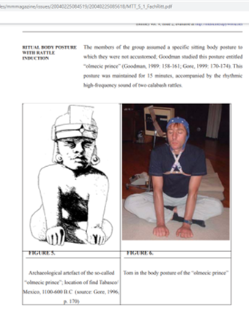
Fachner et al. (2007) and Hunger and Rittner (2015) confirmed Goodman’s RBP changes the electric brain activity in additional studies
19 subjects were evaluated over a 10-month period (Hunger and Rittner 2015).
Both set of researchers found that the use of a rattle or a monochord increases brain voltage (2,500 to 3,000 microvolts, which is ten times higher than normal). However, while the voltage is increasing the brainwaves are slowing down from the alpha range to the theta range.
These researchers use Guttamann’s (1990) term “paradoxical arousal” or “relaxed tension” to explain this unusual brain phenomenon (Fachner et al. 2007).
EEGs and RBP
Notes:
Fachner, Jörg,and Sabine Rittner
2007 EEG Brainmapping of Trance States Induced by Monochord and Ritual Body Postures in a Ritualistic Setting. In Receptive Music Therapy - Theory and Practice, edited by Isabelle Frohne-Hagemann, p. 189-202. Reichert Verlag, Wiesbaden.
Hunger, Christina, and Sabine Rittner
2015 Ritual Body Postures: Empirical Study of a Neurophysiological Unique Altered State of Consciousness. The Humanistic Psychologist 43:371–394.

Slide 6
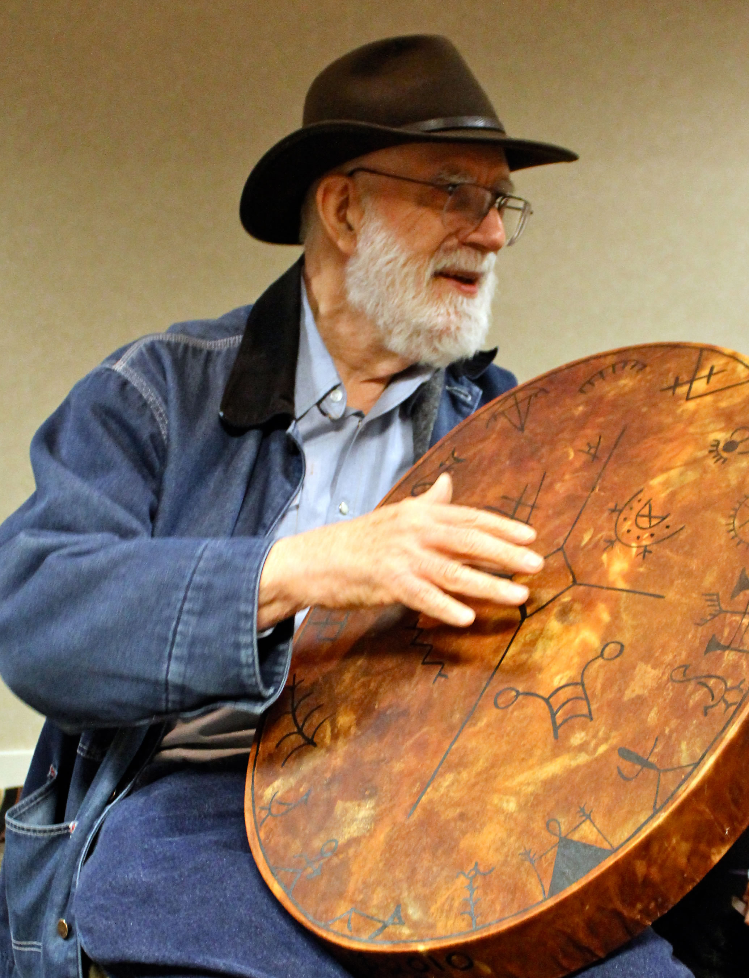
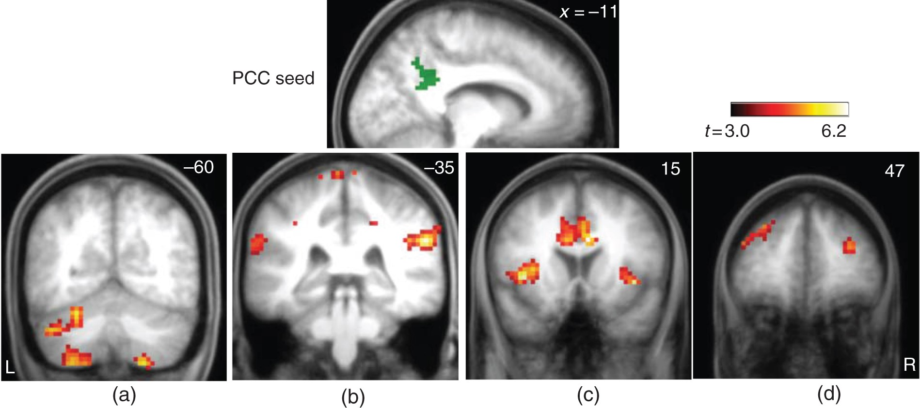
“They (Hove et al. 2016) then played these participants rhythmic isochronous drumming (trance condition) versus drumming with a more regular timing. In what might be the greatest use of a Likert scale of all time, Participants rated if [they] “would describe your experience as a deep shamanic journey?” (1 = not at all; 7 = very much so)”, and indeed described the trance condition as more well, trancey” (Allen 2016 (https://neuroconscience.wordpress.com/2016/06/09/fmri-study-of-shamans-tripping-out-to-phat-drumbeats/)
This article used drumming at 240 beats per minute
Rattling and/or drumming around 210 beats per minute (Harner 1990:104), which is a little less than 4 Hz
Hove, Michael J., Johannes Stelzer, Till Nierhaus, Sabrina D. Thiel, Christopher Gundlach, Daniel S. Margulies, Koene R. A. Ban Dijk, Robert Turner, Petter E. Keller, and Bjön Merker
2016 Brain Network Reconfiguration and Perceptual Decoupling During an Absorptive State of Consciousness. Cerebral Cortex 26:3113–3124.
https://doi.org/10.1093/cercor/bhv137

Slide 7
Shamanism as Neurotheology and Evolutionary Psychology by Michael Winkelman
ASC and Eliade’s trends can be explained through Neurology.
“ASC’s involves high-voltage, slow-frequency brain wave activity originating in the brain stem connections that drive synchronizing patterns into the frontal cortex.”
“This integrates activities of different levels of the brain with coherent brain wave impulses from lower brain structures through the frontal cortex, producing a synthesis of behavior, emotion, and thought.” (Winkelman 2002:1879)
Notes:
American Behavioral Scientist Vol.. 45 no. 12: 1875-1887.

