Slide 1
Goals. Students will be able to:
Explain the relationship between cultural anthropology, ethnology, and ethnography.
Define key terms such as emic and etic.
Be able to identify key approaches to gaining ethnographic information.

Slide 2
ETHNOGRAPHY: ANTHROPOLOGY’S DISTINCTIVE STRATEGY
Traditionally, the process of becoming a cultural anthropologist required field experience in another society
Ethnography emerged as a research strategy in societies with greater cultural uniformity and less social differentiation than modern industrial nations
Ethnographers tried to understand the whole culture

Slide 3
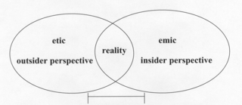
ETHNOGRAPHIC PERSPECTIVES: EMIC AND ETIC
Emic: research strategy focusing on local explanations and meanings
Etic: research strategy emphasizing the ethnographer’s explanations and categories
Ethnographers typically combine emic and etic perspectives in fieldwork

Slide 4
