Slide 1
Goals. Students will be able to:
Be able to identify key approaches to gaining ethnographic information.

Slide 2
ETHNOGRAPHIC TECHNIQUES
Direct, firsthand observation. Used quantitative (e.g., questionnaires) and qualitative (e.g., guided interviews) to gain data.
Conversation
Genealogical method
Detailed work with key consultants
In-depth interviewing
Problem-oriented research
Longitudinal research
Team research

Slide 3
OBSERVATION AND PARTICIPANT OBSERVATION
Ethnographers pay attention to and record the details of daily life
Keep a personal diary
Strive to establish rapport
Ethnographer cannot be totally impartial and detached

Slide 4
OBSERVATION AND PARTICIPANT OBSERVATION
Ethnographers pay attention to and record the details of daily life
Keep a personal diary
Strive to establish rapport
Ethnographer cannot be totally impartial and detached

Slide 5
CONVERSATION, INTERVIEWING, AND INTERVIEW SCHEDULES
Participating in local life means constantly talking to people and asking questions
Naming phase: asking name after name of objects
Ethnographic survey
Interview schedule: form or guide used to structure a formal, but personal, interview
Questionnaire: form used by sociologists to obtain comparable information from respondents

Slide 6
THE GENEALOGICAL METHOD
Genealogical method: using diagrams and symbols to record kin connections
Kinship is a prominent building block in nonindustrial societies
In many nonindustrial societies, kin links are basic to social life

Slide 7
KEY CULTURAL CONSULTANTS
Cultural consultants: people who teach an ethnographer about their culture
Key cultural consultants: experts on a particular aspect of local life
Also called key informants
Every community has people who can provide the most complete or useful information about particular aspects of life

Slide 8
LIFE HISTORIES
Life history: a personal portrait of someone’s life in a culture
Reveals how specific people perceive, react to, and contribute to changes that affect their lives
Many ethnographers include collection of life histories as part of their research strategy

Slide 9
PROBLEM-ORIENTED ETHNOGRAPHY
Most ethnographers enter the field with a specific problem to investigate
Researchers gather information on factors such as population density, environmental quality, climate, physical geography, diet, and land use
Local people may lack knowledge about many factors that affect their lives

Slide 10
LONGITUDINAL RESEARCH
Longitudinal research: long-term study of a community, region, society, culture, or other unit, usually based on repeat visits
Example of longitudinal research: study of Gwembe District, Zambia, that has continued for over 60 years

Slide 11
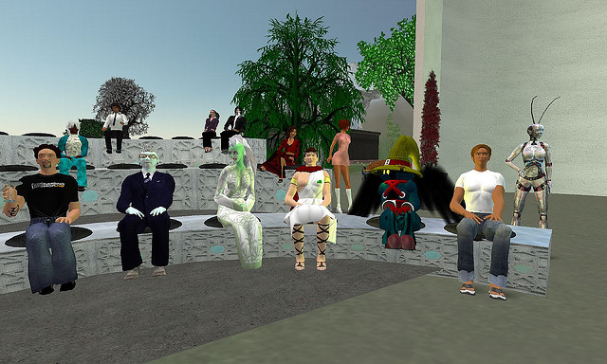
ONLINE ETHNOGRAPHY
Virtual worlds such as Second Life and World of Warcraft allow study of forms of play, performance, creativity, and ritual
Virtual research employs techniques similar to those used by other ethnographers

Slide 12
SURVEY RESEARCH
Survey research: study of society through sampling, statistical analysis, and impersonal data collection
Sample: smaller study group chosen to represent a larger population
Random sample: all members of the population have an equal statistical chance of being chosen for inclusion
Variables: attributes that differ from one person or case to the next

Slide 13
