Slide 1
Goals. Students will be able to:
Explain the concept of culture as an adaptation
Summarize the fundamental premises of functionalism.

Slide 2
Cultural Adaptation
Cultural adaptation is a complex of ideas, activities, and technologies that enable people to survive and even thrive in their environment.
By manipulating their environment, for example, people have been able to migrate throughout the world; however, what is adaptive in one context may be maladaptive in another.

Slide 3
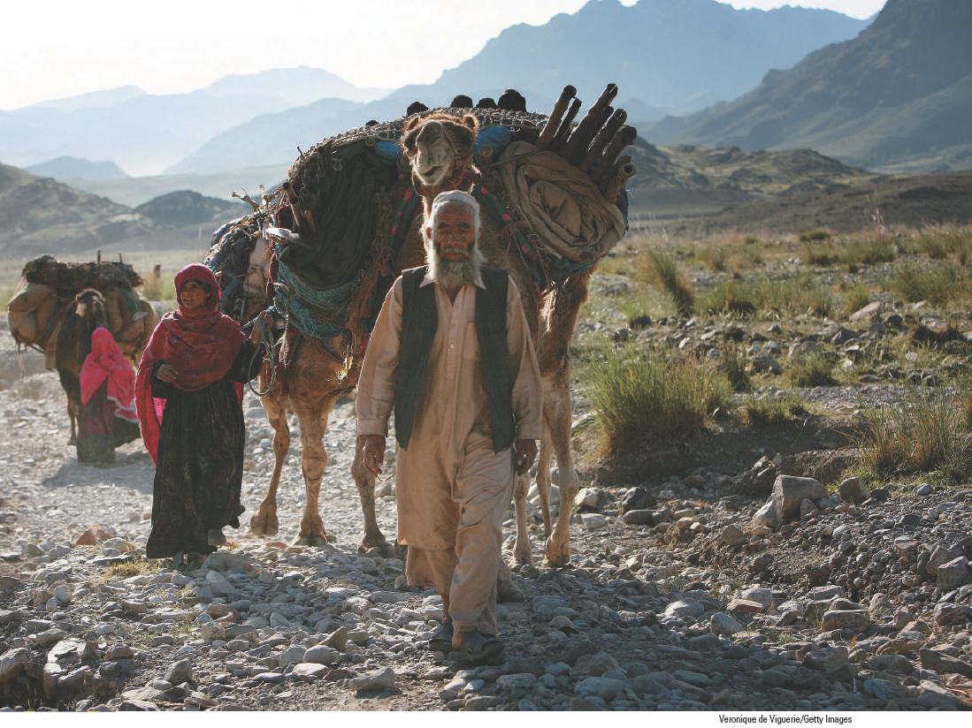
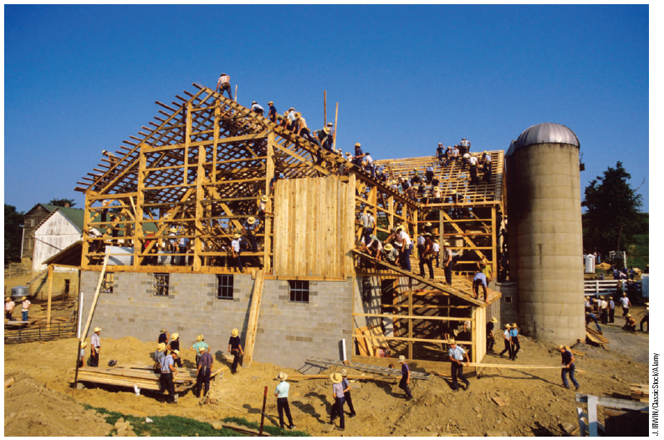
Cultures may be similar, but each culture is unique – in the clothes we wear, the way we speak, how we live, what we value, and even what animals we own.
A pastoral nomad in Afghanistan moves in search of grazing lands.
Amish raise a barn.

Slide 4
Culture is a society’s shared and socially transmitted ideas, values, and perceptions that are used to make sense of experience and generate behavior and are reflected in that behavior.
Everyone learns their culture through the process of enculturation.
Each culture determines in its own way how biologically-determined needs will be met.

Slide 5
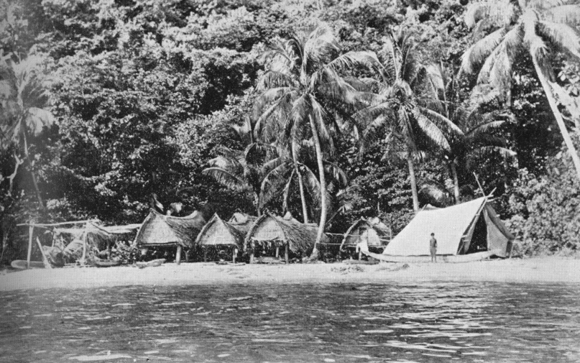
Functionalism
Synchronic perspective. Cultural Anthropologists can’t reconstruct history. Instead look at culture as it operates NOW.
Culture (customs and institutions) are integrated and interrelated. Humans need to live. Customs developed to fulfill these needs.
The function of any cultural trait is to maintain the cultural system relevant to the practice. What is the function of education? What is the function of weapons? What is the function of medicine?

Slide 6
