Slide 1
Goals. Students will be able to:
List and explain the fundamental characteristics of culture.

Slide 2
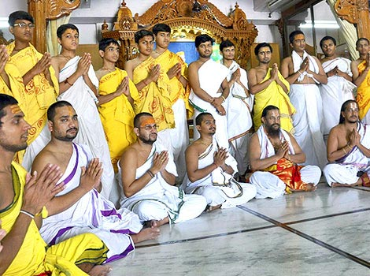
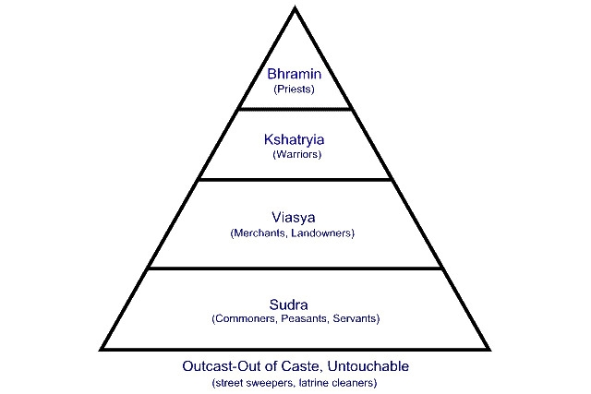
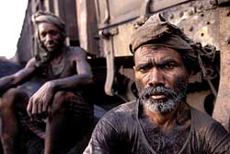
Culture is shared.
Shared values, ideas, and behavior, but everything within a culture is not uniform.
For example, there is some difference between male and female roles (gender).
Often distinct age ranks or class/caste differences.

Slide 3
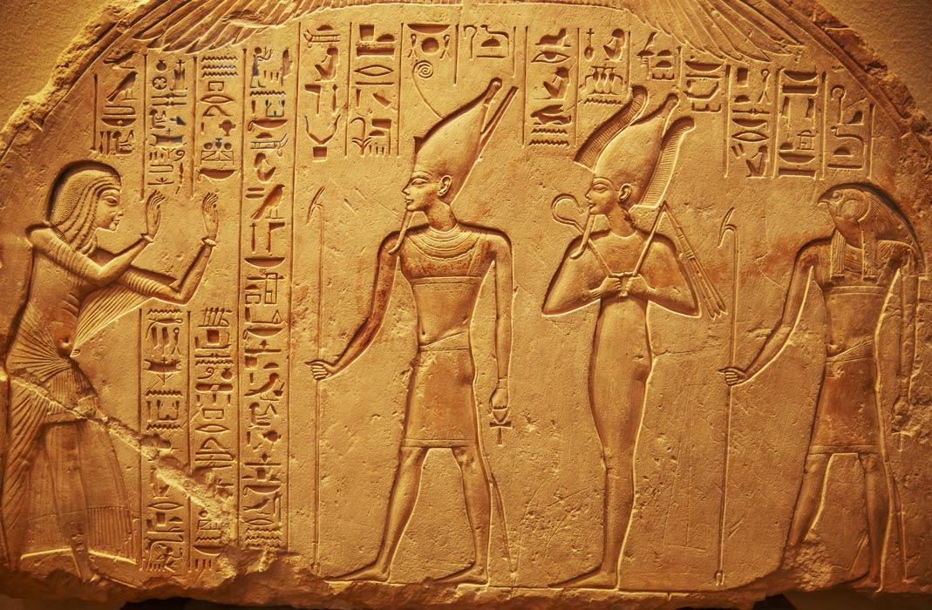
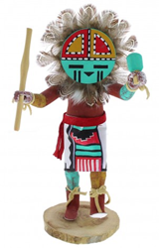
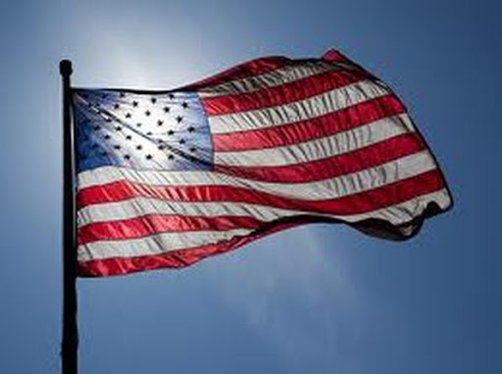
Culture is based on symbols.
A symbol is a sound, gesture, mark, or other sign that is arbitrarily linked to something else and represents it in a meaningful way.
Language—using words to represent objects and ideas.
Art—direct and abstract representations.

Slide 4
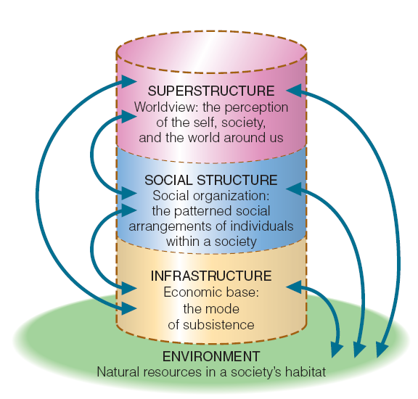
Culture is integrated.
A system made up of distinctive parts that function together as an organized whole.
Economic system
Subsistence system
Religious system
Political system

Slide 5
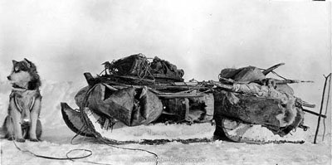
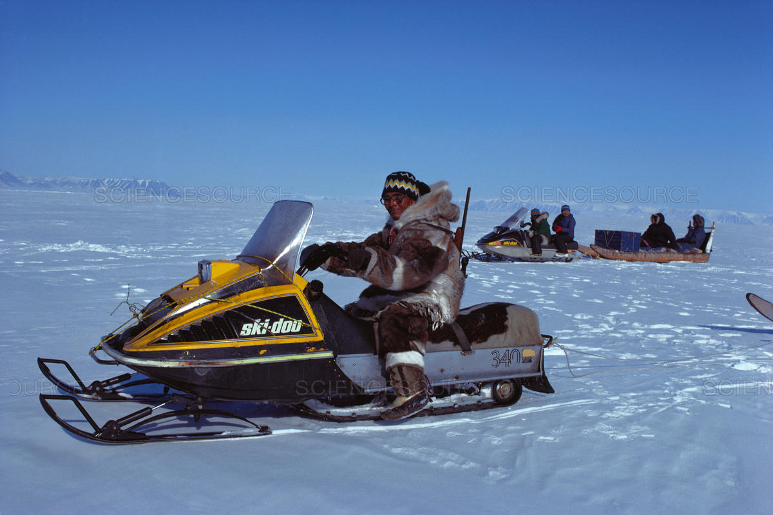
Culture is dynamic
Cultures respond to changing situations:
Cultures must be flexible in the face of unstable or changing circumstances. Rigid/overspecialized cultures are not likely to endure.

Slide 6
