Slide 1
Goals. Students will be able to:
Identify who the Yanomamo people are and briefly summarize aspects of their culture.

Slide 2
Remember ethnocentrism and the naturalistic fallacy Yanomamo war is terrible. But remember: People are people

Slide 3
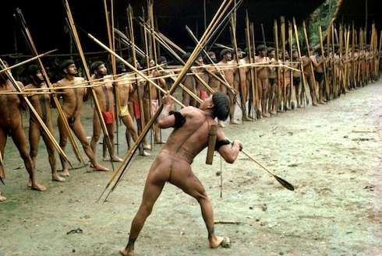
The Yanomamo
25,000 people in 200+ villages
Boys socialized for warfare
30% of adult males die violently. 44% of males had participated in a killing. 70% have lost close genetic relative to violence.
Notes:
Stands in contrast to “group warfare over resources.”

Slide 4
Gendered Component of Violence
Targets men. Male violence is expected.
Capture women. High levels of male on female violence.
Children can be captured or killed.
Strongly patriarchal, but females are not passive. Social power is diffuse and contextual.

Slide 5
Unokais: Those who have Killed
Have higher status than other men.
May switch villages (village composition is transient, based on fission and fusion of different patrilineal lines).
Often have more than one wife. (One man had 43 children from 11 wives)
Age | Unokais |  | Non-Unokais
 | n | Average # offspring | n | Average # offspring
20 to 24 | 5 | 1.00 | 78 | 0.18
25 to 30 | 14 | 1.57 | 58 | 0.86
31 to 40 | 43 | 2.83 | 123 | 2.02
>41 | 75 | 6.99 | 193 | 4.19
Total | 137 | 4.91 | 380 | 1.59

Slide 6
Yanomamo Violence
Small-scale, tribal society. Fights start with shouting matches and can escalate to killings with axes, machetes, or bows/arrows. Killings within villages lead to village fission and the start of raiding. Killings among villages likewise lead to revenge raiding.
NOT fighting over resources. They’re in a rain forest. Resources are the same in all directions…
Seems like the rational decision is to not kill and hence stop the system of raiding, right?

Slide 7
