Slide 1
Goals. Students will be able to:
Describe explanations for the origins of political complexity and social inequity.
Explain what the Lapita Culture was and how people spread across the Pacific Islands.
Explain a case study demonstrating the development of political complexity and the formation of chiefdoms.

Slide 2
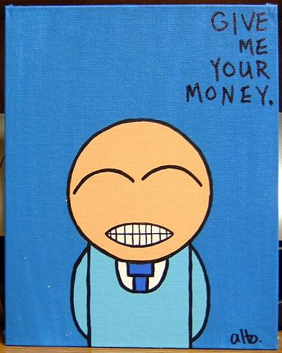

Slide 3
Why does complexity develop?
Old ideas:
Inborn tendency. Humans like to band together in socially complex groups.
Childe’s Neolithic Revolution
Agriculture →surplus→ideal time for specialists→trade→administrators→social complexity
Irrigation
Irrigation→cooperation among large groups
War Chiefs
Powerful chiefs become warlords→forces others to band together for defense→really successful warlords become kings.

Slide 4
Current Understanding
Likely no single cause, but historically dependent causes instead.
The rule of 6.
Complexity develops when people can’t move away from each other for whatever reason.

Slide 5
Hunter-Gatherer Complexity
Stereotype
“Hunter-gatherers move around in small groups”
Based on living, marginal groups such as the !Kung San and the Inuit.
Much greater diversity.
Conditions for more complexity
Higher-than normal pop, concentrated in relatively small areas such as river valleys, circumscribed by geography and neighbors.
More intense, diverse, specialized food gathering.
Food storage and preservation
Sedentary settlements.
Highly developed food procurement and processing technologies.
Division of labor , Simple social ranking, and trade.
More elaborate ritual and ceremonial beliefs.

Slide 6
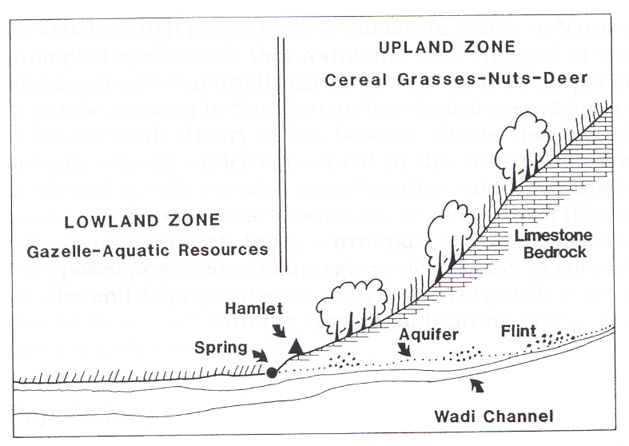

Slide 7
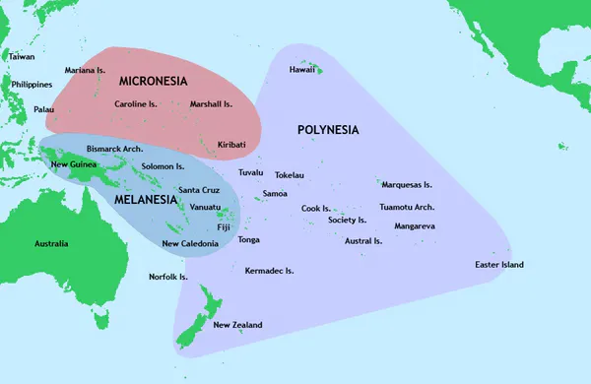

Slide 8
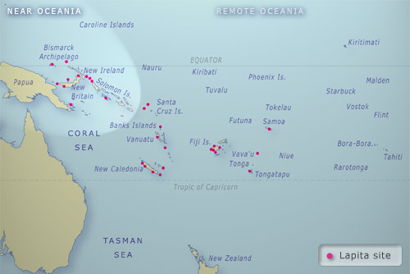
Lapita Culture
By 10,000 BP, humans occupied most habitable areas except for Pacific Islands.
Carrying capacity too small.
About 4,000 BP, people began to colonize them.
Origin in
Bismark Archipelago
Notes:
The Pacific Ocean overs about 1/3 of globe and has half of the liquid H2O. Enormous region dotted with a few islands.

Slide 9
Notes:
Red area is origin. “ISEA” stands for Island Southeast Asia (~3400 BP). Movement eastward to Samoa and Tonga by about ~2,800 BP (Green). Pause of ~1,800 years. Migration into the Society Islands ~1,000 BP(orange). Settlement of the rest of the islands in the blue area by ~700 BP.

Slide 10
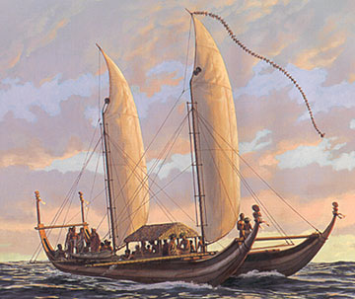
Not accidental discoveries. Planned colonization.
Needed:
Ocean going boats.
Double hulled canoes. Carried large loads.
Resources to increase islands’ carrying capacity.
Over 3,000 years, occupied all major chains, and all big islands. 600 mile voyages.

Slide 11
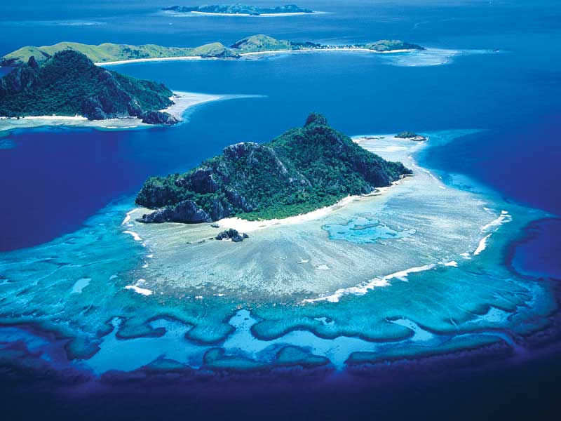
Notes:
Need agriculture to live on them.

Slide 12
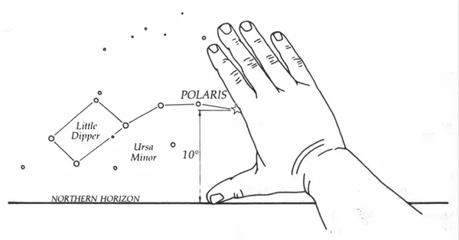
Incredible Navigators
Used the stars. Example: Where Polaris hit reflects your latitude.
Could use clouds, birds, etc. to find islands.

Slide 13
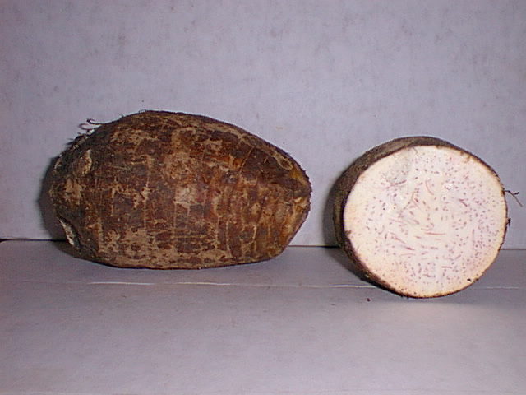
Taro
Lapita Culture:
No metal. Relied on stone.
Domesticated plants and animals key
Taro (a tubor that looks like a fat carrot)
Kumara (aka sweet potato)

Slide 14
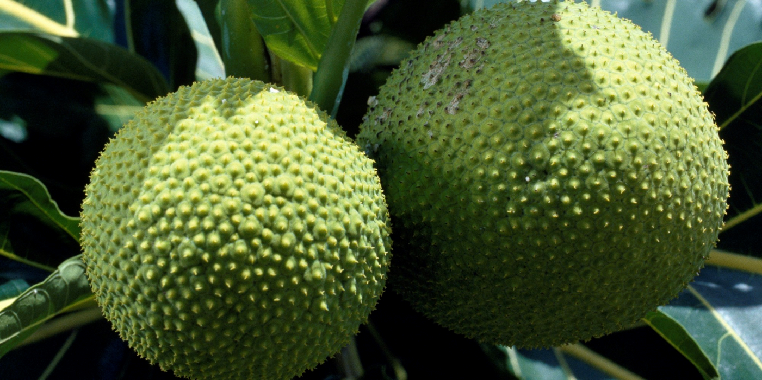
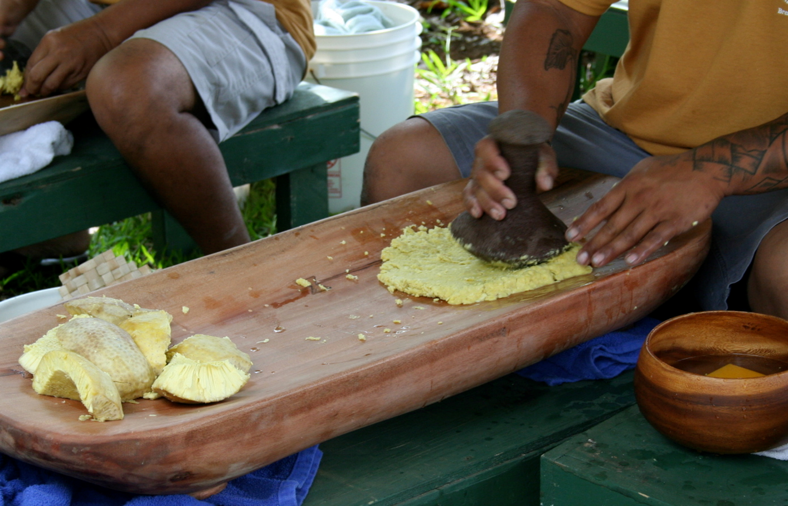
Bread Fruit

Slide 15
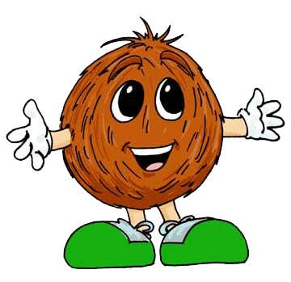
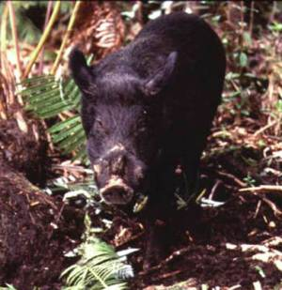
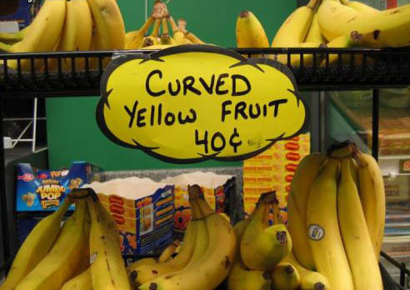
Domesticated plants and animals key
Coconuts
Bananas
Pigs
Chickens
Dogs

Slide 16
On an island. You can’t really move. Creates a general pattern typical of the Lapita.
Quick development of complexity. Chiefdoms.
Control over surplus the primary means of wealth.
Kin groups inherited status.
Generally heavy warfare. Fortified villages.

Slide 17
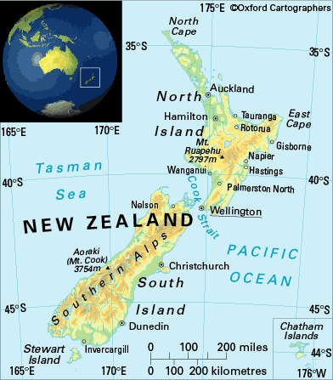
Consider New Zealand
Inhabited by Lapita culture. Isolated island.
Taro and kumara in northern island. Population focused there. (Southern too cold for agriculture).
Only dogs. Chickens and pigs perhaps present, but didn’t make it.
Tamed (not domesticated) black-backed seagulls. Used to keep kumara caterpillar under control. (They hatch by the 1,000s).

Slide 18
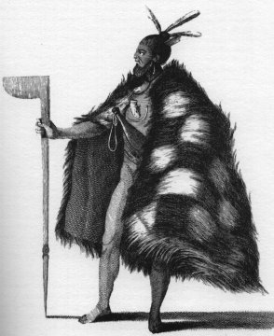
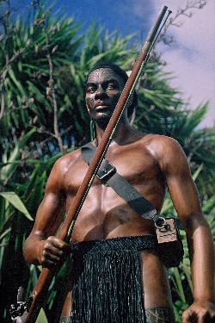
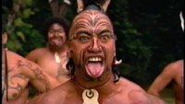
Dense population in northern agriculturalists. Chiefdoms.
Intense warfare. Pa fortified villages built on ridges, with low walls and ditches on flanks.
Loved the gun. 600 fortified sites during initial European occupation.
Maori

Slide 19
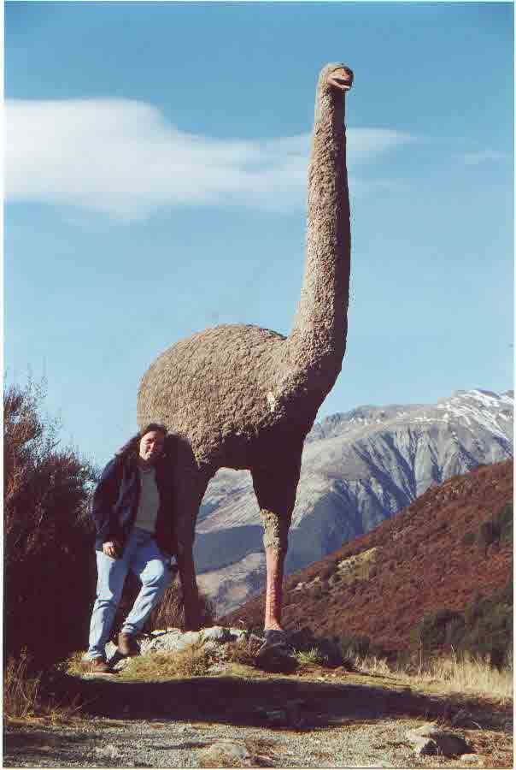
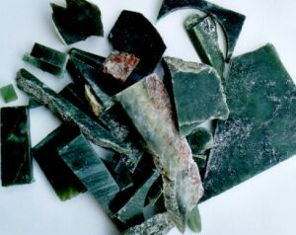
Southern Island
Non-egalitarian H-G.
Traded “greenstone” with northern peoples.
Hunted Moa, a large flightless bird. (Extinct because of mice. Some try to blame human overhunting.)
Also shell fish, eel, seals, sea birds.
Stored dried fish.
No intense warfare. Tribal level people with limited inherited status.
Moa

Slide 20
