Slide 1
Goals. Students will be able to:
Define gender and explain why it is important.
Define sex-based divisions of labor.
Explain why they are important.
Explain common patterns associated with sex-based divisions of labor.

Slide 2
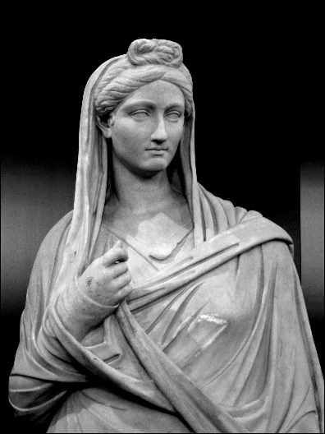
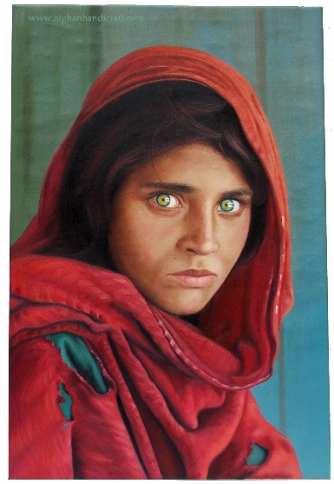
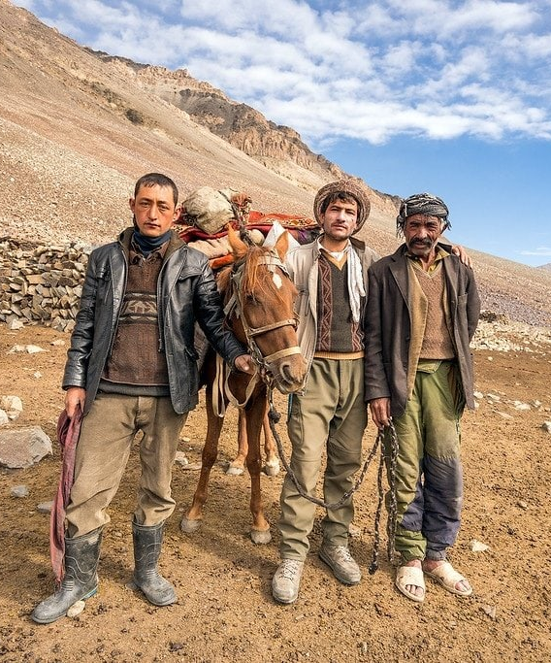
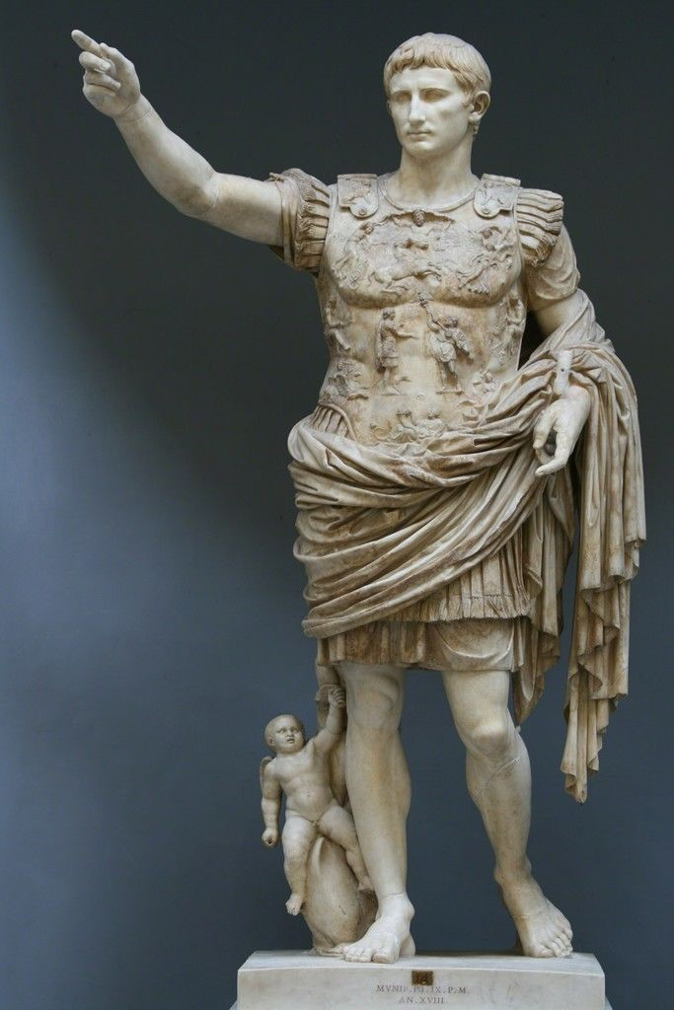
What is Gender?
Social categories that structure the expression of biological sex in culture. Not the same as biological sex, but always includes categories of men and women associated with males and females. Sometimes transgendered individuals, sometimes additional genders.
What it means to be a man or woman varies from culture to culture.

Slide 3
Why Does Gender Matter?

Slide 4
Why Does Gender Matter?
Every culture has gender distinctions. (In fact, all primates behaviorally and socially distinguish between males and females.)
Gender is typically of singular importance to social identity.
Economically import: sex-based divisions of labor.
Typically central to raising children.
Typically influences/determines peer group, social obligations, and social opportunities.

Slide 5
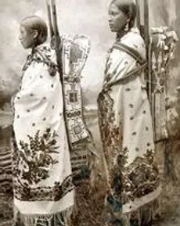
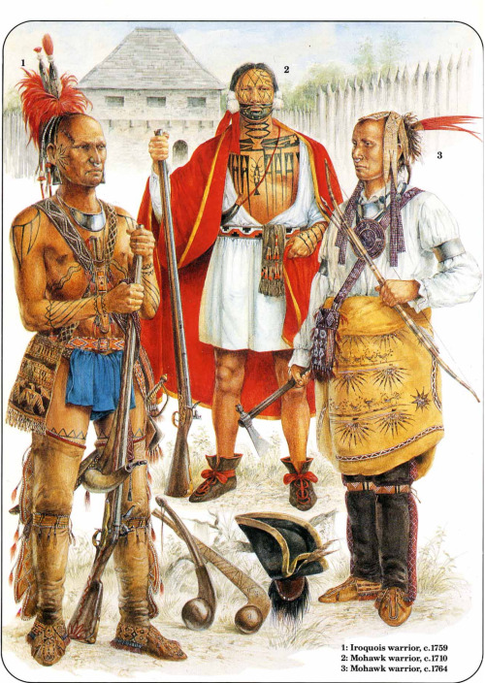
Sex-based Divisions of Labor
Brown (1970): Women engage in repetitive, interruptible, non-dangerous work that was consistent with child care. Men complete tasks that require physical strength, sudden energy expenditure, frequent travel, and/or dangerous.

Slide 6
Sex-based Divisions of Labor
There are three common patterns of division of labor by gender:
flexible/integrated pattern
segregated pattern
dual sex configuration

Slide 7
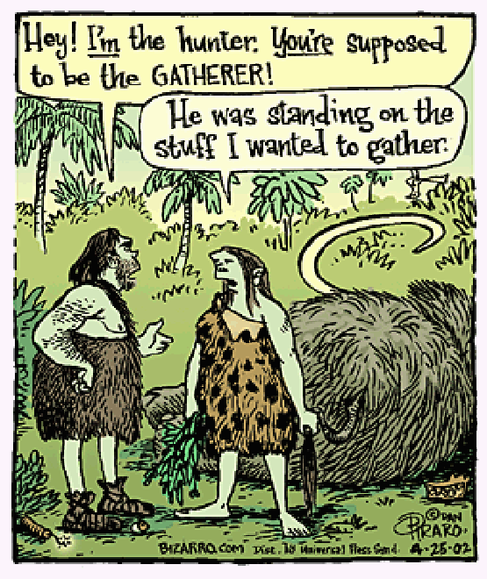
Flexible/Integrated Pattern
Flexible/integrated pattern:
Common among H-G and subsistence farmers.
Men and women perform up to 35 percent of activities with equal participation.
Adult men and women interact with each other on a relatively equal basis.

Slide 8
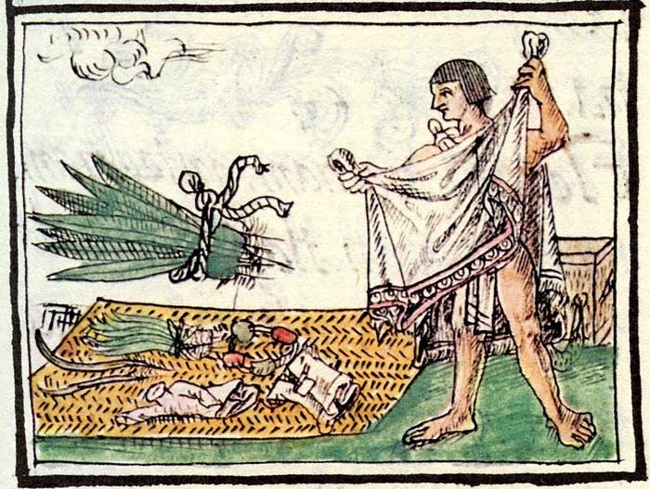
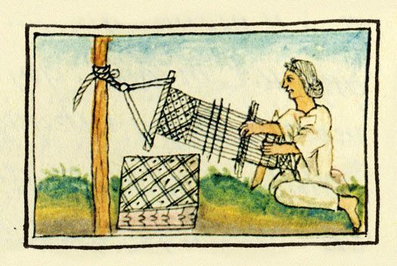
Segregated Pattern
Segregated pattern:
Most work defined as masculine or feminine. Men and women rarely engage in joint efforts.
Common in pastoral nomadic, intensive agricultural, and industrial societies.
Aztec men: farmers, warriors, merchants, craftsmen
Aztec women: cooking, childcare, textile work

Slide 9
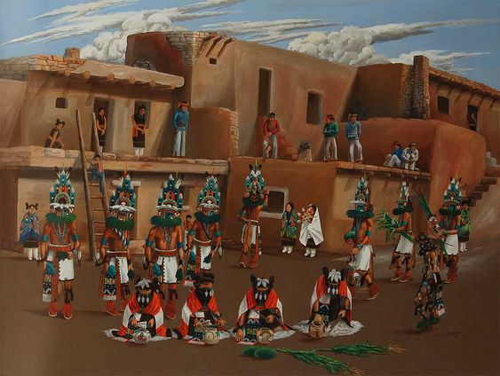
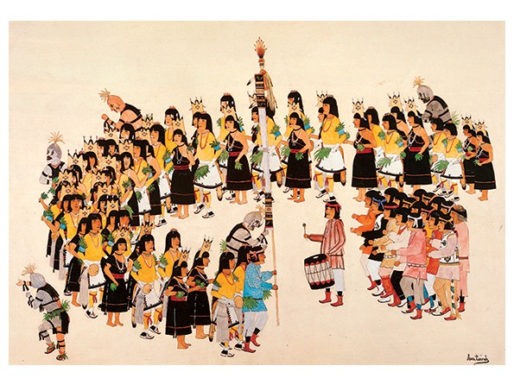
Dual Sex Configuration
Common among Native Americans.
Tasks separated but coordinated so that both men’s and women’s labor is required (and valued).
High levels of equality, but separate sex-based hierarchies.

Slide 10
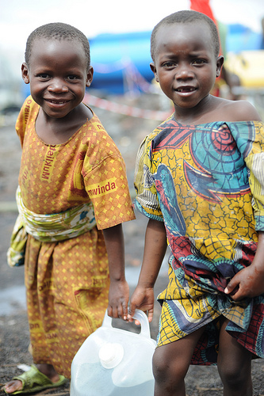
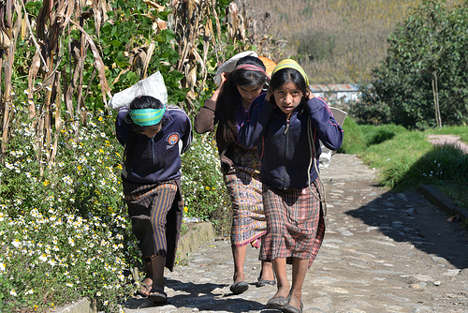
Division of Labor by Age
In all societies, there is some type of division of labor by age:
In traditional farming societies, children and older people make a greater contribution to the economy in terms of work than in postindustrial societies.
Igbo (Nigeria) girls carrying water
Guatemala girls farming

Slide 11
