Slide 1
Goals. Students will be able to:
Summarize the historical development of the anthropological study of race.
Explain the development of the idea of cultural relativity and historical particularism.
Explain why anthropology has rejected a biological basis for racial categories.
Explain the general sources of variation typically described as race.

Slide 2
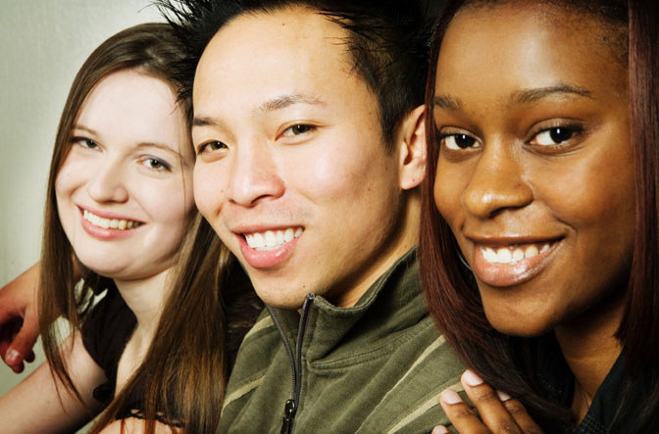
Race is sometimes one of the major factors related to social and personal identity.
Not a human universal, although all people do differentiate between “themselves” (however defined) and “other groups” (however defined). (Language, nationality, religion, occupation, class/caste, kin group, gender, and age rank can often be as or more important.)

Slide 3
How Old is the Concept of ‘Race’
Humans have likely always differentiated among each other based on ancestry, behavior, language, and appearance.
Early European scholars:
Struck with variation around world.
Tried to classify Homo sapiens into subspecies based on geography and features such as skin color, body size, head shape, and hair texture.
Linnaeus divided humans into subspecies based on geography and classified all Europeans as “white,” Africans as “black,” New World Natives as “red,” and Asians as “yellow.”

Slide 4
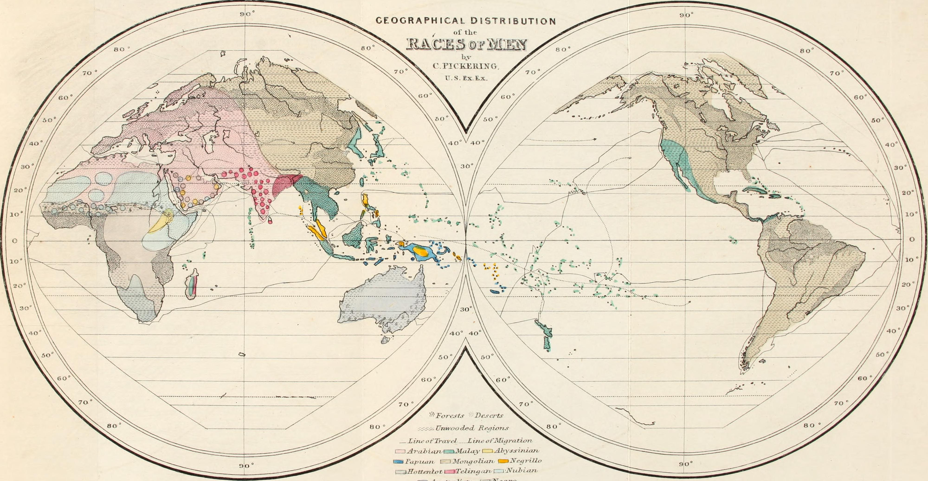
Started with Classification. Expanded to Explanation.
Charles Pickering: Races of Man and Their Geographic Distribution

Slide 5
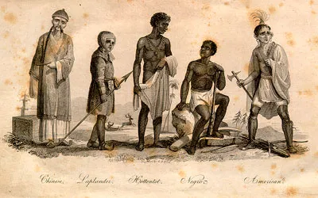
Example: Louis Agassiz
Polygenism:
Argued that humans were created by God in different places and with different traits/abilities.
Darwin explicitly argued against this perspective in The Descent of Man, which stressed humanity’s common origin and the superficiality of race.

Slide 6
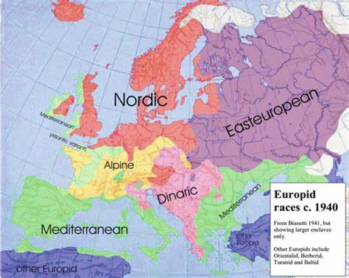
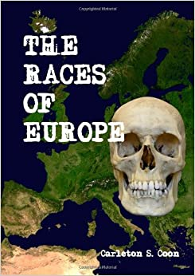
Carleton Coon: The Races of Europe (1939)
Notes:
Different races derived from different mixtures of neandertal and HSS genes during Upper Paleolithic. It’s true that we can trace ancestry, but these don’t create distinct groups as required by race.

Slide 7
Boas and the separation of race, language, and culture
Challenged the concept of ‘race’ as inherent and tied to behavior.
Studied immigrant populations to demonstrate generational shifts.
Differences in people result from: history, culture, geography/environment.
All cultures are ‘complex.’ All ‘work.’ All are ‘equally developed.’

Slide 8
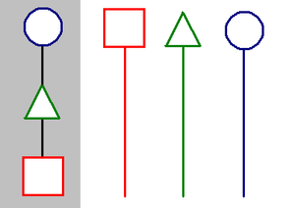
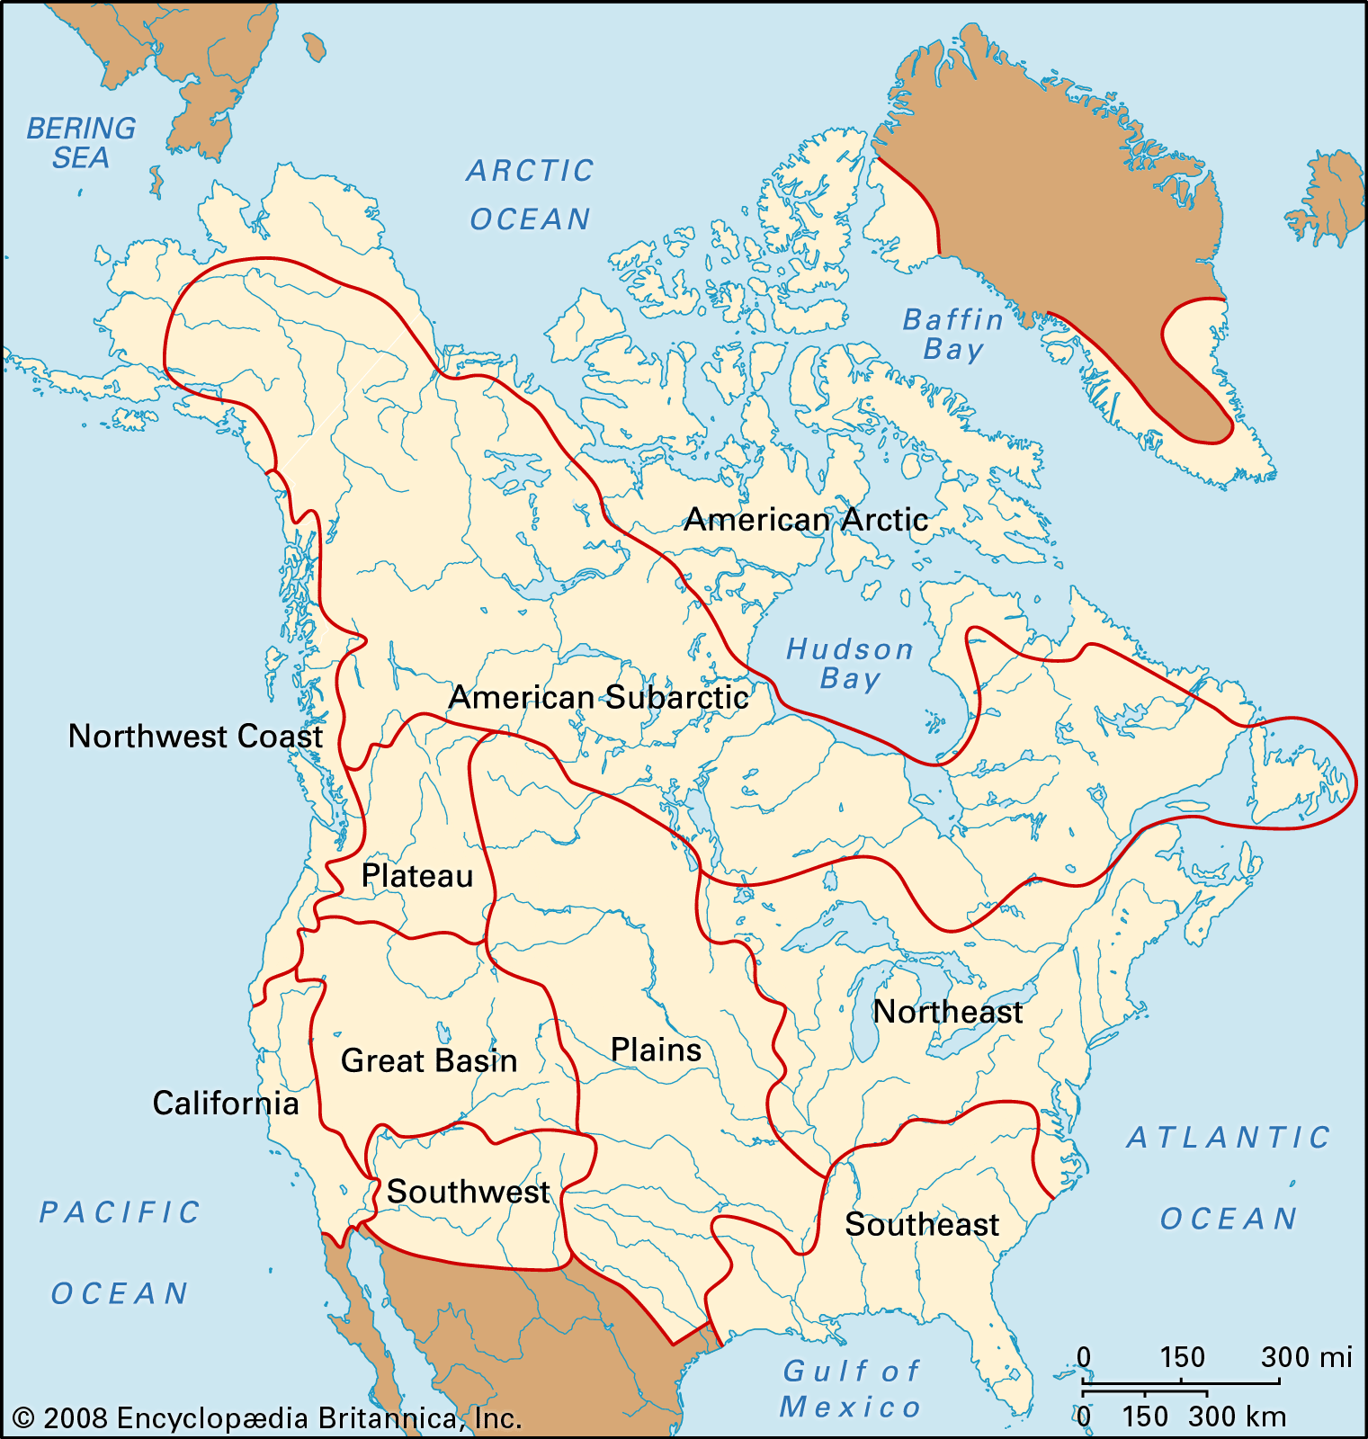
Boas and Historical Particularism
Each culture unique. Each culture has its own history of development.
Cultures cannot be arranged in a sequence of “progress: that applies to all cultures everywhere”
A sequence like “Stone Age, Bronze Age, Iron Age” may be useful descriptively, but not analytically.
Culture areas a better approach.

Slide 9
Question: What does race mean?
Historically, scientists have two answers:
Racial classification, now largely abandoned
Social classification, varies within and among
In biology, the taxonomic category of subspecies is not applicable to humans because the division of humans into discrete types does not represent the true nature of human biological variation.
In some societies, race is an important social category.

Slide 10
SCIENTIFIC FACT: humans are 99.9% genetically similar. In other words, you are 99.9% similar to the person you are sitting next to or a random person you meet in a foreign country.
If races were biological
What we actually find

Slide 11
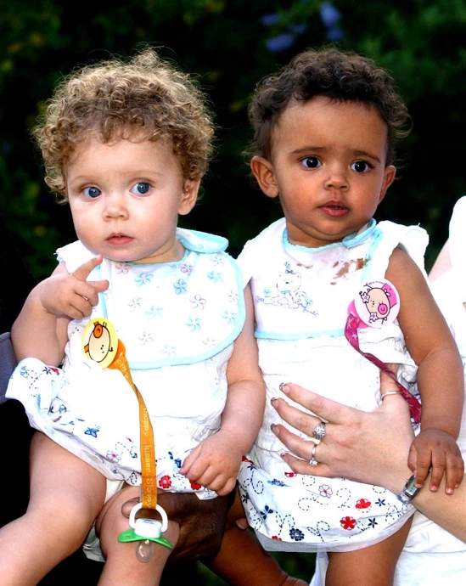
Human genetics AND variation
Millie and Marcia Biggs
Marcia and Millie Biggs

Slide 12
Race and Human Diversity
Humans are a single, highly variable species inhabiting the entire globe.
Though biological processes are responsible for human variation, the biological concept of race cannot be applied to human diversity.
The vast majority of human variation exists within populations rather than among populations.

Slide 13
Human BIOLOGY AND variation
Phenotype: organism’s observable traits, its “manifest biology”—anatomy and physiology
Phenotypic traits (such as skin color and facial features) have been used for racial classification
This is problematic from a biological study
Notes:
These observable traits can an outward expression, morphological traits as hair color, skin color, ear shape etc. They can also be internal biochemical traits such as sickle cells.

Slide 14
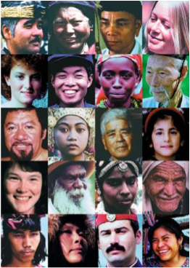
Phenotypic variation

Slide 15
WHY DO WE APPEAR SO DIVERSE?
Genes
Environment
Culture

Slide 16
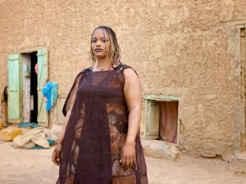
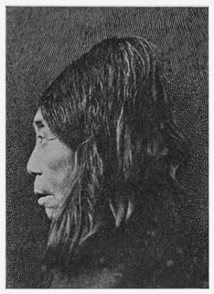
COMPONENTS OF HUMAN VARIATION
Culture
Genes
Environment
Twiggy
Mauritanian woman
Flathead Native woman, Vancouver Island
Notes:
https://www.marieclaire.com/politics/news/a3513/forcefeeding-in-mauritania/

Slide 17
COMPONENTS OF HUMAN VARIATION
Genes
Culture
Environment
South Korean Males
North Korean Males

Slide 18
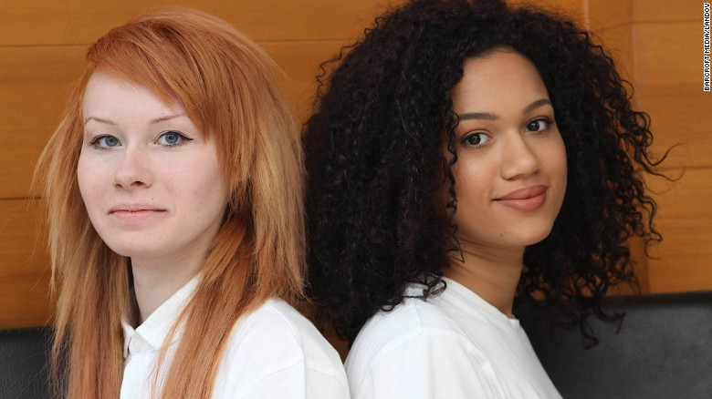
COMPONENTS OF HUMAN VARIATION
Environment
Culture
Genes
The Olsen Twins
Lucy and Maria Aylmer, Twins

Slide 19
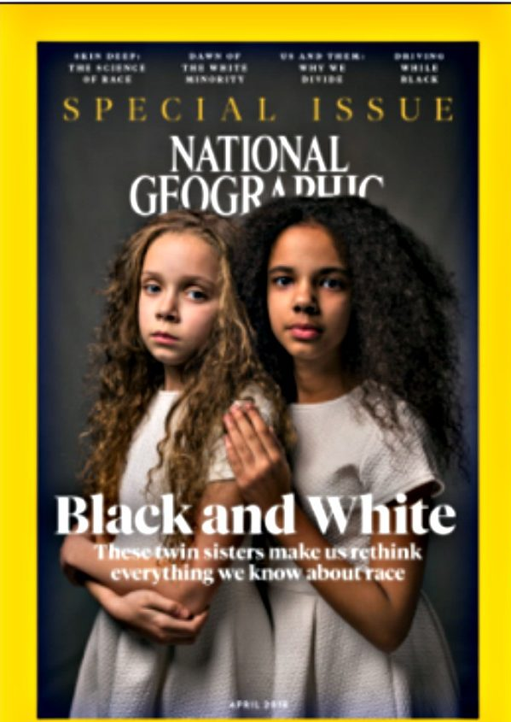
HUMAN BIOLOGICAL DIVERSITY AND THE RACE CONCEPT
Race is “a cultural, not scientific, category that groups people according to so-called racial distinction” (Bonvillain 2018:319).

Slide 20
