Slide 1
Goals. Students will be able to:
Define ethnicity and status as they are defined in anthropology.

Slide 2
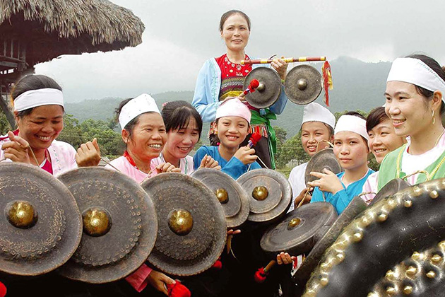
ETHNIC GROUPS AND ETHNICITY
Ethnic group: a group whose members share certain beliefs, values, habits, customs, and norms because of their common background
Ethnicity: Social category based on a complex mix of ancestry, culture, and self-identification
Ethnic feelings and their associated behavior vary in intensity within ethnic groups and countries over time
Gong-a traditional instrument of Muong people
The Elks Club is a Fraternal Order focused on bettering communities While members share values, beliefs, etc., it is not an ethnic group. Not based on shared ancestry.
Notes:
The Muong ethnic group is the 4th largest ethnic group in Vietnam. Most live in the Hoa Binh province and some mountainous districts of the Thanh Hoa province.

Slide 3
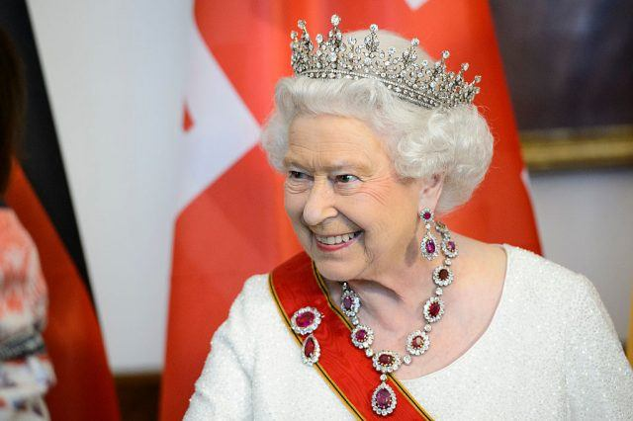
STATUS AND IDENTITY
Cultural differences may be associated with ethnicity, class, region, religion, and other social variables
Status: positions that people occupy in society
Ascribed status: a social position that a person attains by birth. A person is born into an ascribed status
Achieved status: status (positive or negative) attained by a person’s own efforts and skills
Notes:
(Queen Elizabeth II and J.K. Rowling) One’s net worth is $500 million and the other’s net worth is $650 million

Slide 4
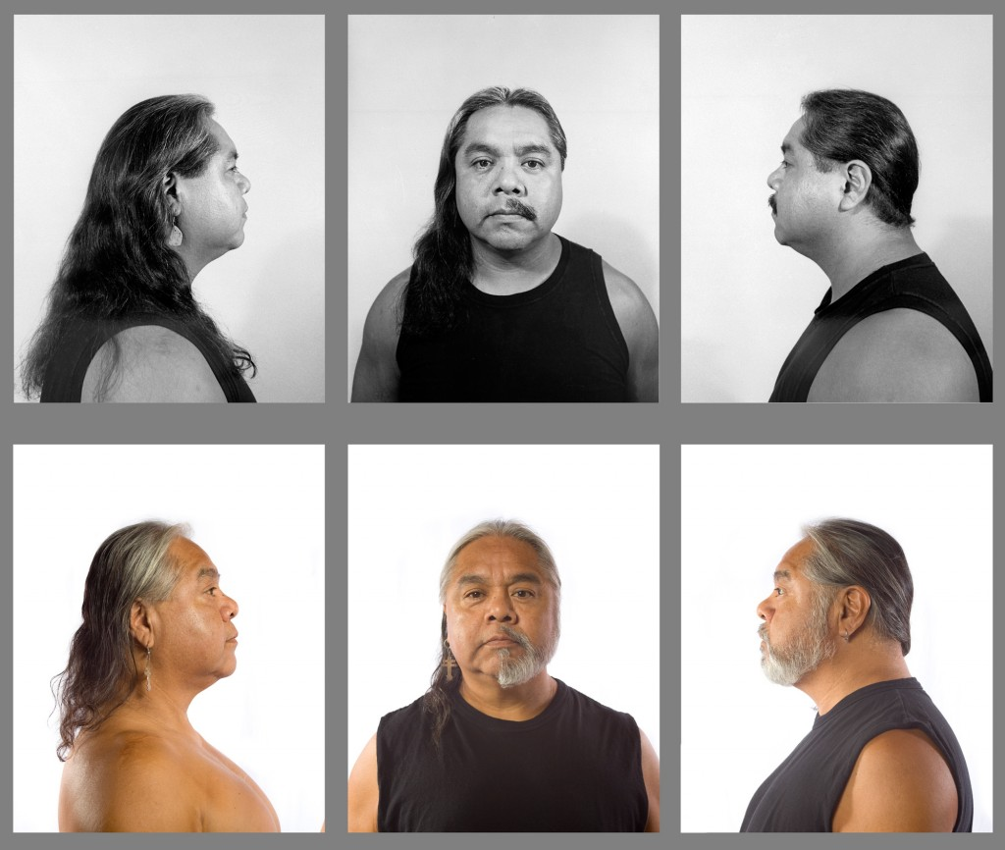
Race and Ethnicity
Some categories are contextual: one identity is used in certain settings, another in different settings
Referred to as the situational negotiation of social identity

Slide 5
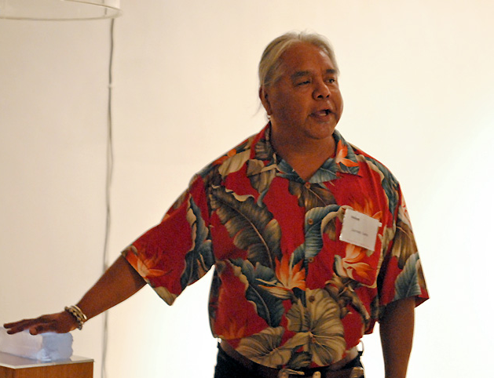
James Luna
Is a Payómkawichum (Luiseño), Ipi (Diegueño) and Mexican-American performance artist
Born Orange, California in 1950
He moved to the La Jolla Indian Reservation in 1976 and lived there until he died
1976 earned a Bachelor of Fine Arts degree at the University of California, Irvine
1983 earned a Master of Science degree in counseling at San Diego State University.
2011 received an Honorary Ph.D. from the Institute of American Indian Arts
Passed away on March 3, 2018
Notes:
http://firstamericanartmagazine.com/james-luna-walks/

Slide 6
James Luna
Quotes from interviews with the Smithsonian
You’ve been called “one of the most dangerous Indians alive.” What are you trying to say?
Well, at times the message can be potent. One of my subjects is with ethnic identity—how people perceive us and how we perceive ourselves. Not everybody can talk about that, so I guess that makes me a dangerous character.
Notes:
https://www.smithsonianmag.com/arts-culture/james-luna-30545878/

Slide 7
James Luna
Could you give an example of one of your pieces and how it deals with ethnic identity and perception?
I had long looked at representation of our peoples in museums and they all dwelled in the past. They were one-sided. We were simply objects among bones, bones among objects, and then signed and sealed with a date. In that framework you really couldn’t talk about joy, intelligence, humor, or anything that I know makes up our people.

Slide 8
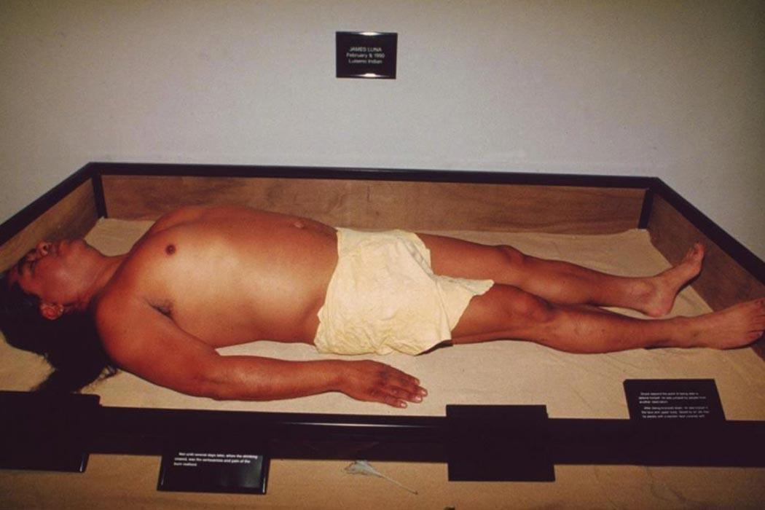
“Artifact Piece” (1987) by James Luna
In “The Artifact Piece” I became the Indian and lied in state as an exhibit along with my personal objects. That hit a nerve and spoke loud both in Indian country, the art world and the frontier of anthropology.
Notes:
James Luna is a Luiseno Indian artist and activist who uses his performances, installations, and words to challenge the confines of art-historical and museum exhibition practices, questioning the ways that Native American Indians are often remembered, “honored,” and pictured in the white imaginary.

Slide 9
