Slide 1
Goals. Students will be able to:
Define “the problem of warfare”.
Define key terms including coalitionary killings.
Explain that coalitionary killings are not limited only to humans, but are also present among other primates.

Slide 2
The “Problem of Warfare”
Common but Unhelpful Questions:
Is war inevitable?
Is war natural?

Slide 3
More productive questions:
What factors influence the frequency and intensity of warfare?
How does warfare influence culture in particular contexts?

Slide 4
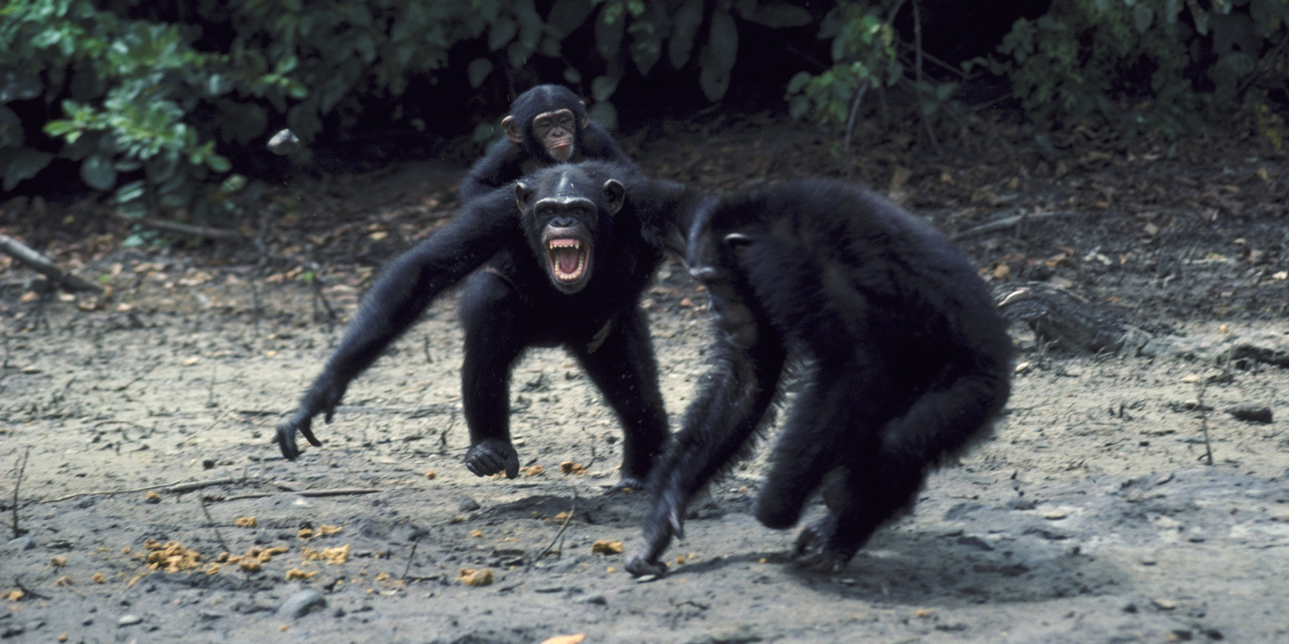
‘‘current evidence supports the hypothesis that selection has favored a hunt and kill propensity in chimpanzees and humans, and that coalitional killing has a long history in the evolution of both species’’

Slide 5
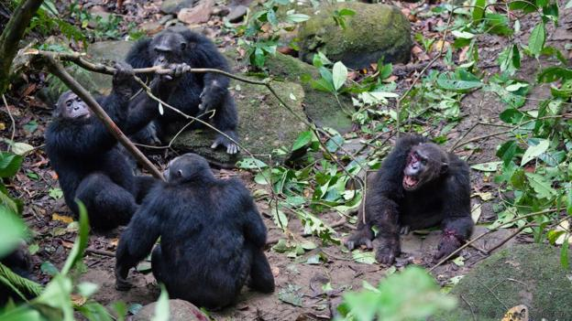
Explanation for “Coalitionary Killing”
Problem: Conflict among primates comes with (potentially great) cost. Why bother?
Solution: More land = more resources = higher fitness. Males killing members of other troops (with limited potential cost to self) increases fitness through more resources (and greater access to females). Idea is called the Imbalance-of-power and Intercommunity Dominance-drive hypotheses.
Notes:
Imbalance of power and intercommunity dominance

Slide 6
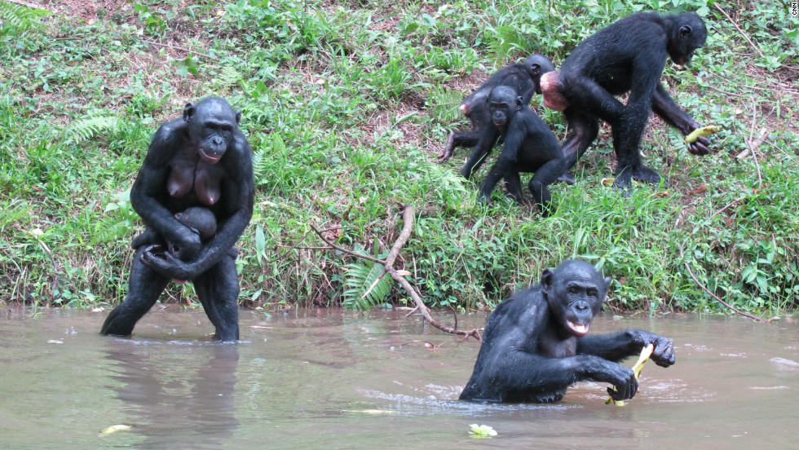
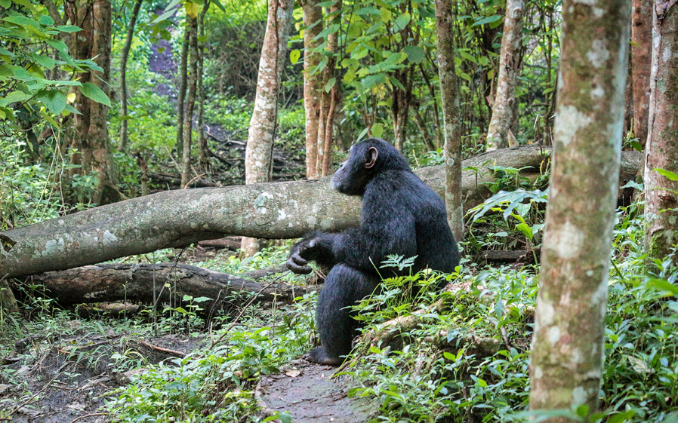
BUT, border avoidance
Concern of attack means border areas underutilized. Most activity occurs in core 35% of territory for chimps. Instead of increasing territory, conflict might decrease effective territory.
Wouldn’t not fighting be better? Don’t have to risk injury while also allowing larger effective range?
Bonobos: move in groups.
Rarely attack or are attacked.
Safety in numbers.
Chimps: lone foragers.
Neighboring chimps tend to attack
when 3:1 odds.
Notes:
Yes, so there is probably much more to warfare than just “getting resources.”

Slide 7
