Slide 1
Goals. Students will be able to:
Define warfare and differentiate it from other types of violence.
Explain why it is anthropologically important.
Describe broad shifts between warfare before and after the start of the Neolithic.

Slide 2
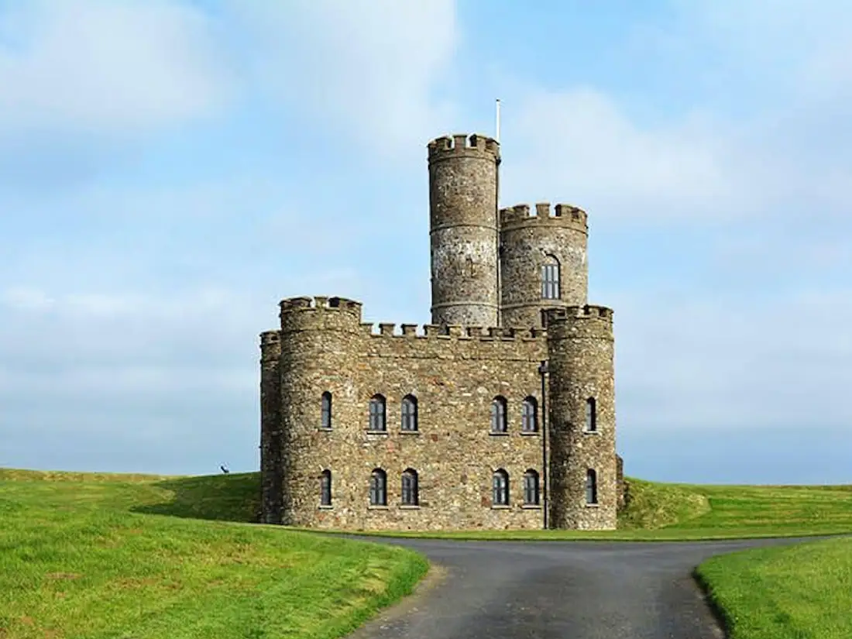
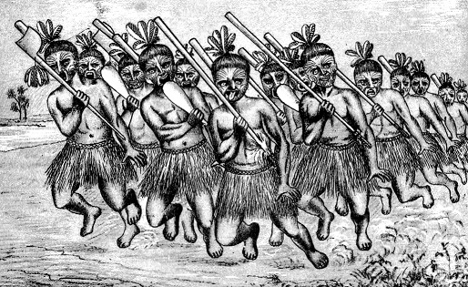
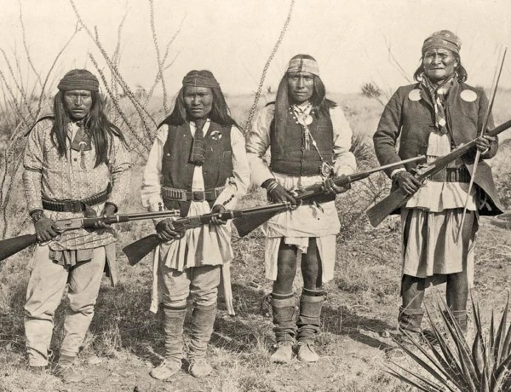
War
The actual or implied armed conflict between politically (often based on family or ancestry) distinct groups.
It is not just interpersonal violence (e.g., Cain and Able or revenge killing based on a cheating spouse are not warfare)
Different than common definitions in fields like history.

Slide 3
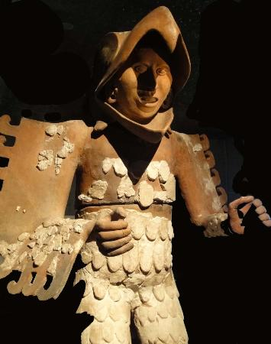
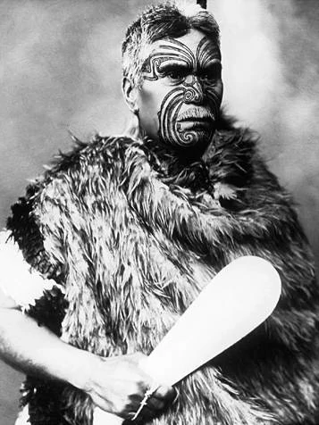
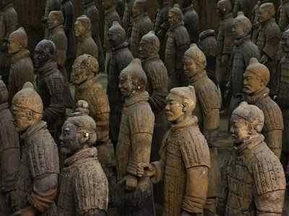
Why do we care about war?
Cross-culturally, warfare has been one of the central tasks of humans. Often a determining factor in settlement patterns, social relationships, identity, and so forth. Lots of different approaches to war…
Notes:
Terracotta Warrior Statues in Qin Shi Huangdi Tomb (China), Aztec Eagle Warrior (Mexico), Maori Warrior (New Zealand)

Slide 4
20th Century
Boxer Rebellion (Chinese peasants vs. British)
Boer War (British vs. Dutch South Africans)
Russio-Japanese War
Mexican Revolution
World War I
Russian Revolution/Civil War
World War II
Chinese Civil War
French-Algerian War
Korea
Vietnam (French and American)
Six-Day War
Iran-Iraq War
Afghanistan (Russian Invasion)
Notes:
Since 1914, we have had 100 to 200 million people.

Slide 5
Death Rates from War Lower than at Any Time in the Past
100,000,000 to 200,000,000 people of the 10,000,000,000 people who lived. 1% to 2% death rate.
In contrast, estimates from many pre-state societies: 20% to 30%.
Hobbes vs. Rousseau…

Slide 6
Warfare before Agriculture
Tit-for-tat warfare most common, although massacres do occur.
Feuds, typically over personal issues or accusations of sorcery.
Can be “ritual,” occurring at specific times and for specific durations.

Slide 7
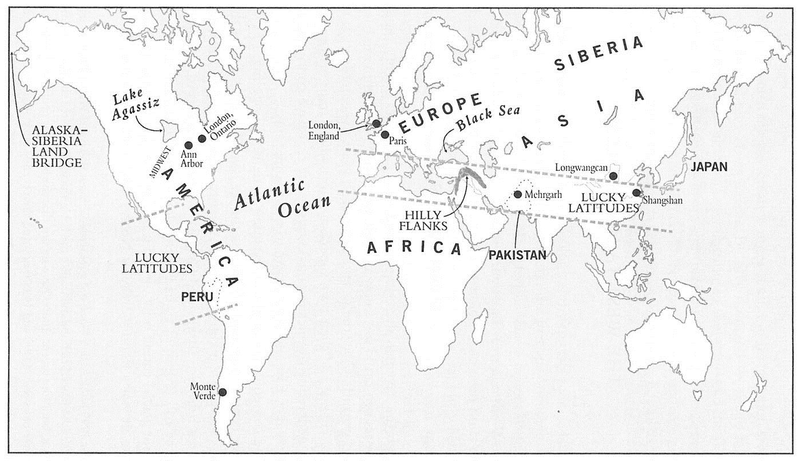
Agriculture
Starting around 10,000 BP in the “Lucky Latitudes”.
Population explosion.
Greater packing of landscape.
Defeated H-G can move away.
Defeated agriculturalists can’t.
Massacres, but also the start of incorporating losers into larger societies.

Slide 8
