Slide 1
Goals. Students will be able to:
Explain Ember and Ember’s cross-cultural analysis of the factors that influence the frequency and intensity of warfare.

Slide 2
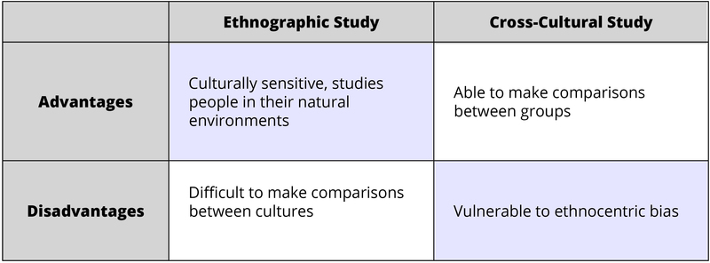
Cross Cultural Research
Cultures vary. We want to know how and why. Comparing cultures, and figuring out how they are similar and different gives us insights into causal factors.
Are patrilocal communities more likely to fight each other than matrilocal communities?
Are women typically killed if captured in warfare?

Slide 3
Ember and Ember
Known for compiling extensive cross-cultural databases for evaluating variables that correspond to certain cultural traits

Slide 4
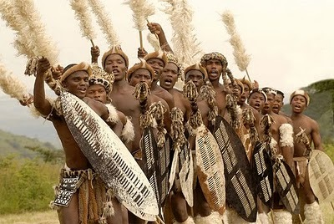
Warfare: When and Why?
186 cultures. Eliminated “pacified” societies in most cases.
Warfare present in all of them, but intensity varies
Wants to evaluate previous theories for the causes of warfare, and test for environmental/cultural correlates for warfare.

Slide 5
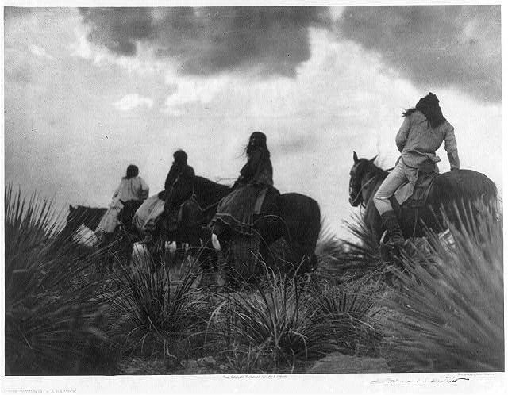
Hypothesis 1: Resource Scarcity and War
Common and common-sense explanation. People fight for resources when they don’t have enough.
Raiding: for example, Apache (hunters-gatherers) seasonally raided the O’odham (agriculturalists) and settlers to acquire goods such as food and blankets, and for children for slaves.

Slide 6
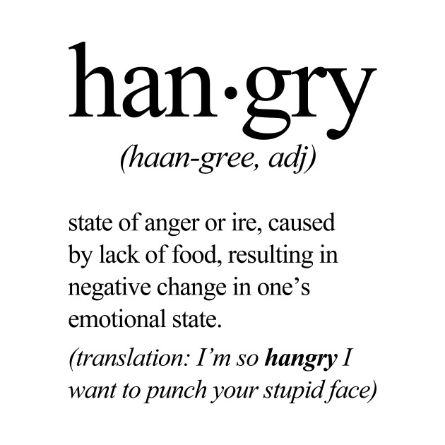
Resource Scarcity and War (cont.)
Also could cause warfare because people are “hangry”

Slide 7
Hypothesis 2: War Caused by Psychological Structures
Perhaps childhood rearing practices cause aggression, which leads to warfare. “Frustrating socialization” caused by punishment and/or low need satisfaction.
Previous studies indicated:
punishment DOES NOT correspond to increased warfare but that socialization for mistrust of others might.
socialization for aggression seems to be a result of warfare, not a cause.

Slide 8
1992 study results
Warfare in pre-Industrial societies tended to be among non-specialist warriors at the community level.
Frequency of warfare ranged from less than once every 10 years to “constant,” occurring any time of the year on a chronic basis.
Measuring intensity of warfare, political scale of warfare, child rearing strategies, and resource availability (at both long-term and short-term scales)

Slide 9
1992 study results
Statistical analysis indicates increased warfare when:
threat of natural disasters and famine (for non-state societies).
chronic resource short fall (weakly correlated but only for non-state societies).
unpredictable resource availability (i.e., threat but not actual resource shortfall).
children socialized for mistrust.
Inconsistent with Hypothesis 1 because threatened, as opposed to actual, short fall is most strongly correlated, BUT victors do generally take some sort of resource from losers.

Slide 10
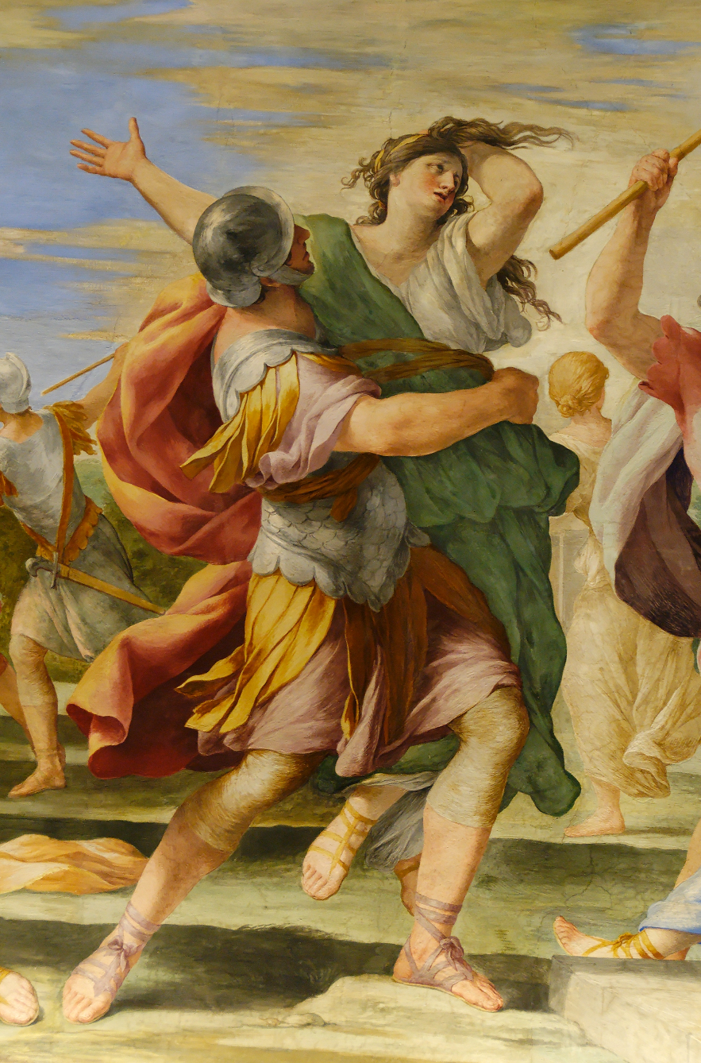
1992 study results (cont.)
Statistical analysis indicates:
unlikely warfare is typically to capture women for mates (the Sabine Women hypothesis)

Slide 11
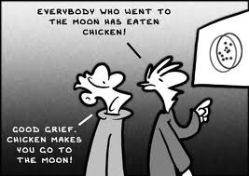
Bottom Line:
Two significant predictors, arranged in order of significance:
Threat of natural disaster (fear of nature/future)
Socialization of mistrust (fear of others)
People thus generally fight over “future” problems, not current conditions.
Can adjust to good times. Can adjust to bad times. Can’t adjust if they don’t know what to expect.
Mistrust of others also increases with unpredictability.
Remember, correlation doesn’t equal causation!

Slide 12
