Slide 1
Goals. Students will be able to:
Define key terms such as religion, magic, animism, shaman, priest, prophets, and ancestor worship.
Provide case studies of the importance and operation of religion.

Slide 2
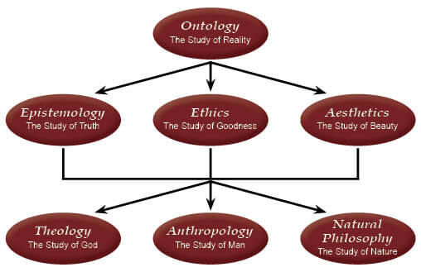
Worldview: A worldview is the collective body of ideas that members of a culture generally share concerning the ultimate shape and substance of their reality.
Politics
Gender and age arrangements
Class/Caste
BUT also (and perhaps especially) cosmology and religion. Many societies do not differentiate between religion and other aspects of life

Slide 3
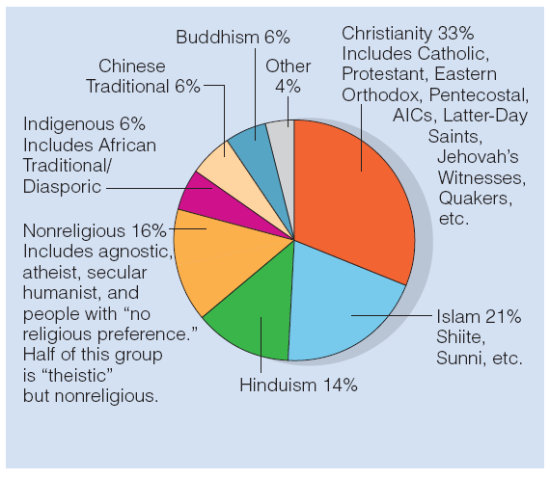
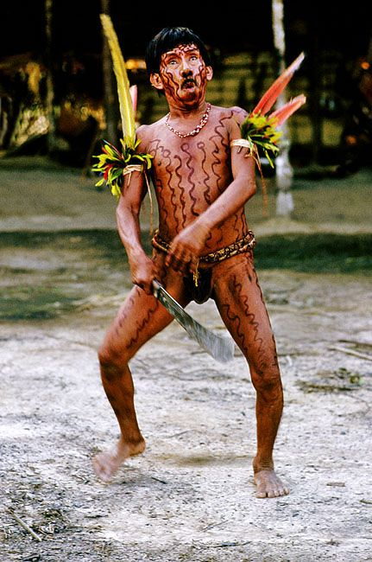
Major Religions of the World
Anthropology can give insights into any of these religions, but often the only way to look at the “indigenous, traditional” religions. Up until recently (1600) these were dominant.

Slide 4
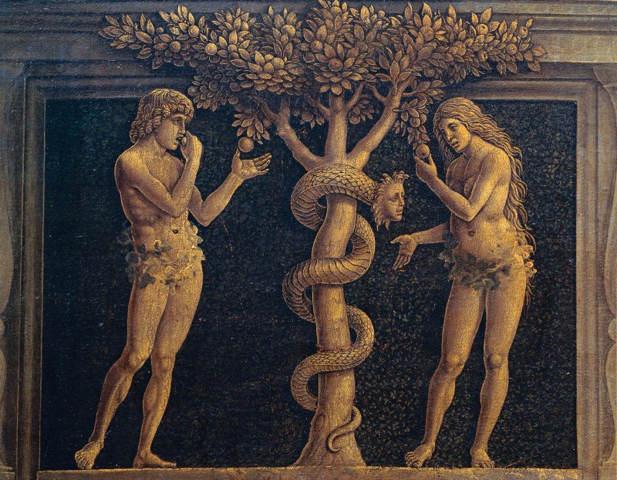
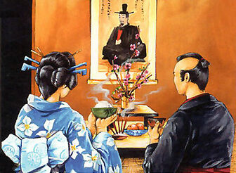
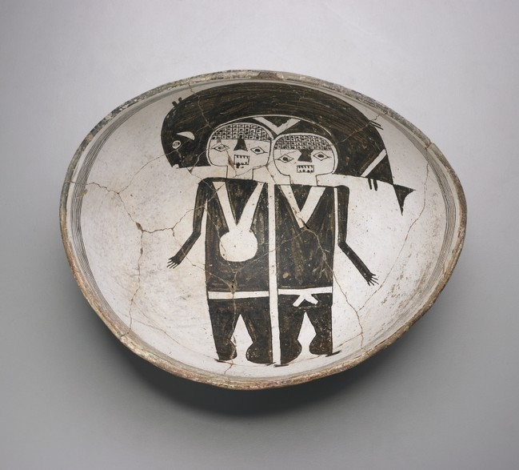
Religion: organized system of ideas about the spiritual, “supernatural” sphere. Includes ceremonial practices to influence/understand aspects of the universe otherwise beyond their control.
Myths are sacred narratives that explain the fundamentals of human existence—Who are we? Where did we and everything else come from? Why are we here? Often set cultural standards for “right” behavior.
Nearly all religions include “ancestor worship/ancestral spirits”
Can be other spirit beings/spirit forces.

Slide 5
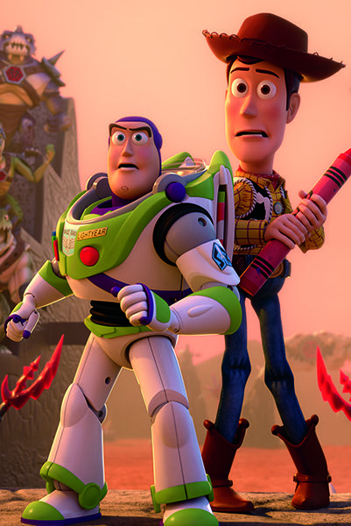
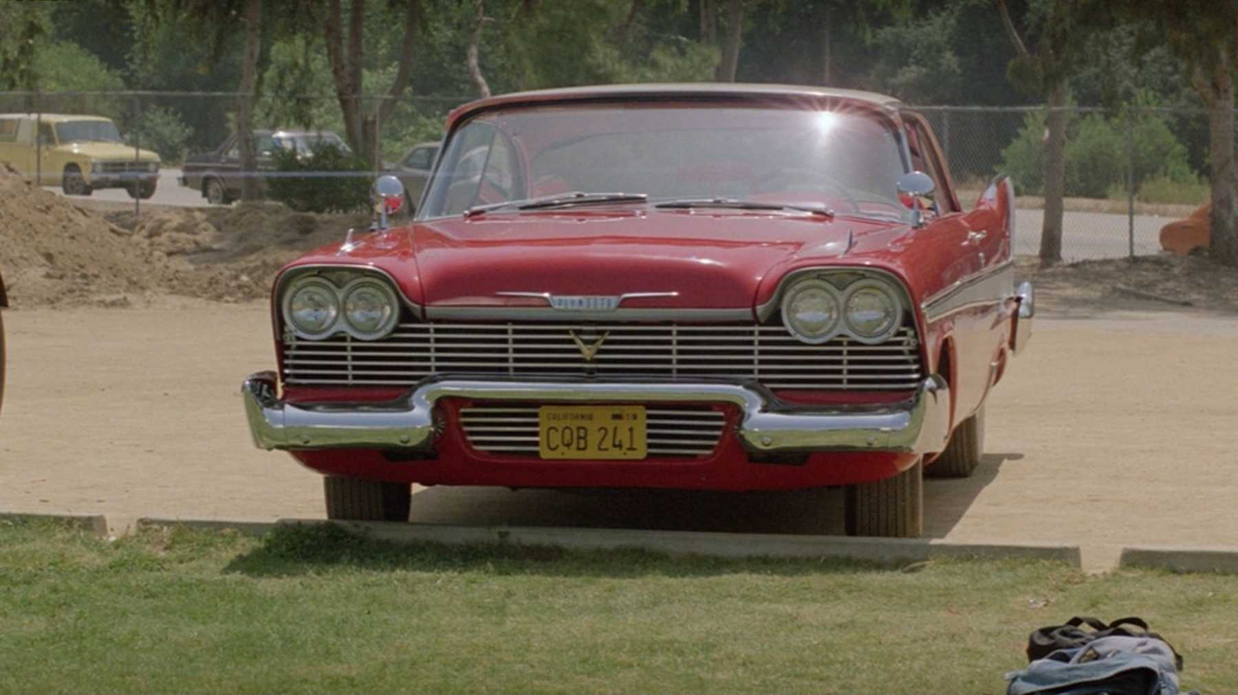
Many traditional religions focus on Animism and Animatism
Animism: Belief that nature is animated or energized by distinct personalized spirit beings.
Spirits in humans, animals, and also other natural (inanimate) features.
Animatism: Belief that nature is energized by impersonal spiritual power (mana)

Slide 6
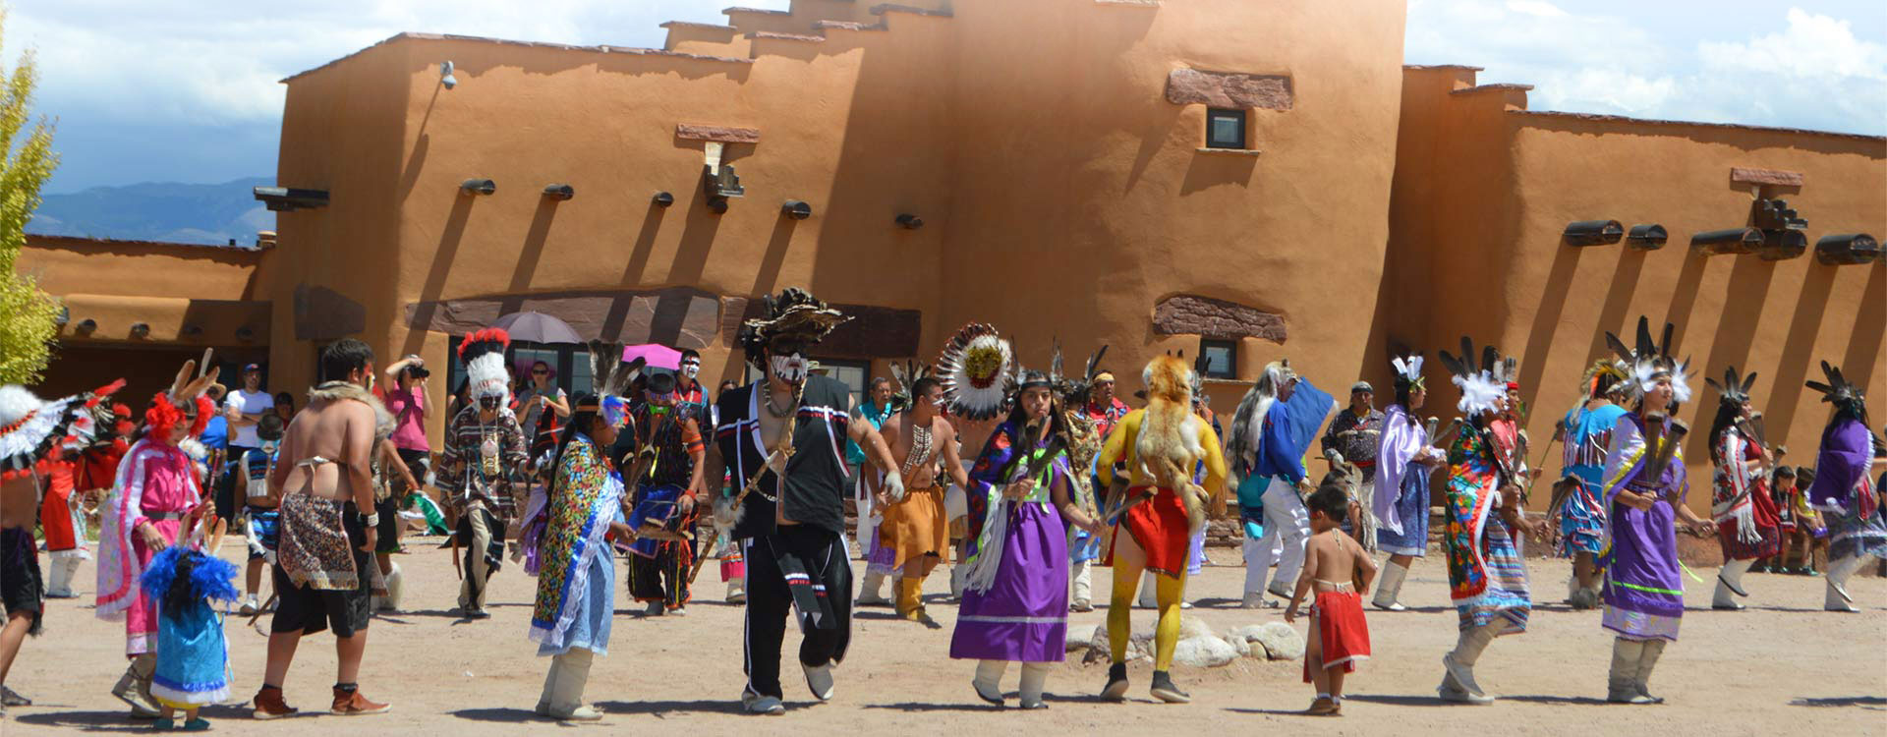
Some common aspects of religion
Divination is a magical procedure or spiritual ritual designed to learn the unknown and foretell the future
Pilgrimage is a religiously inspired journey to a site believed to be metaphysically significant. Typically requires personal sacrifices from travelers
Syncretism is the creative blending of indigenous and foreign beliefs and practices into new cultural forms.

Slide 7
Magic
Exists in all societies.
Generally has a functional quality, but not just functional. “Defense against the dark arts” Protects against bad luck—the evil eye
Functional:
Don’t walk under a ladder
Not functional: Throw salt over your left shoulder when you spill salt.

Slide 8
A Case Study from the Trobianders of Papua New Guinea
Bronislaw Malinowski (1884-1942)
Credited for developing “participant observation”
Trobriand Islanders of Papua New Guinea (1915-1918)

Slide 9
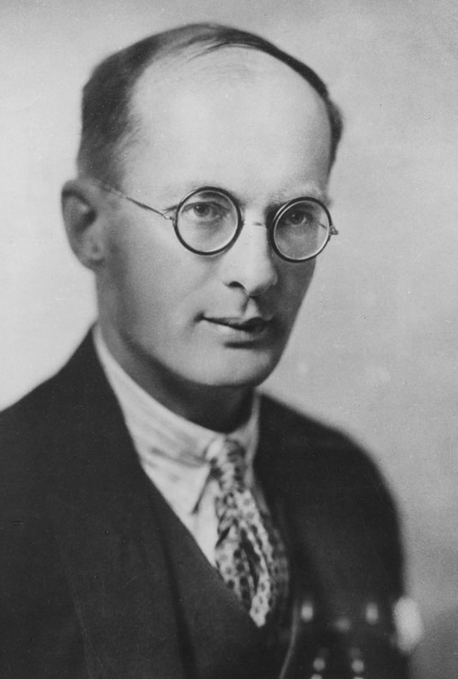
Spirits literally packed the Islanders’ landscape (including the ocean).
Sorcerers and witches could cast spells to draw upon spirits to cause illness, misfortune, and even death
Spirit could help people
Witchcraft could be countered by magic
Magic ensure “good luck” esp. for uncertain circumstances

Slide 10
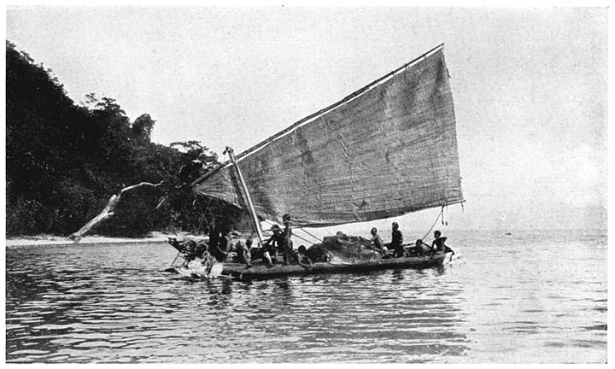
Sea was unpredictable and dangerous. Boats could not be trusted. Magic rituals were conducted to “catch luck” and counteract witchcraft.
Decorated canoes with human figures that were animistic. Their spirits would help protect the sailors.
Men would recite spells over ginger to counteract witchcraft. Witches could fly over the water to harm and cause bad luck.

Slide 11
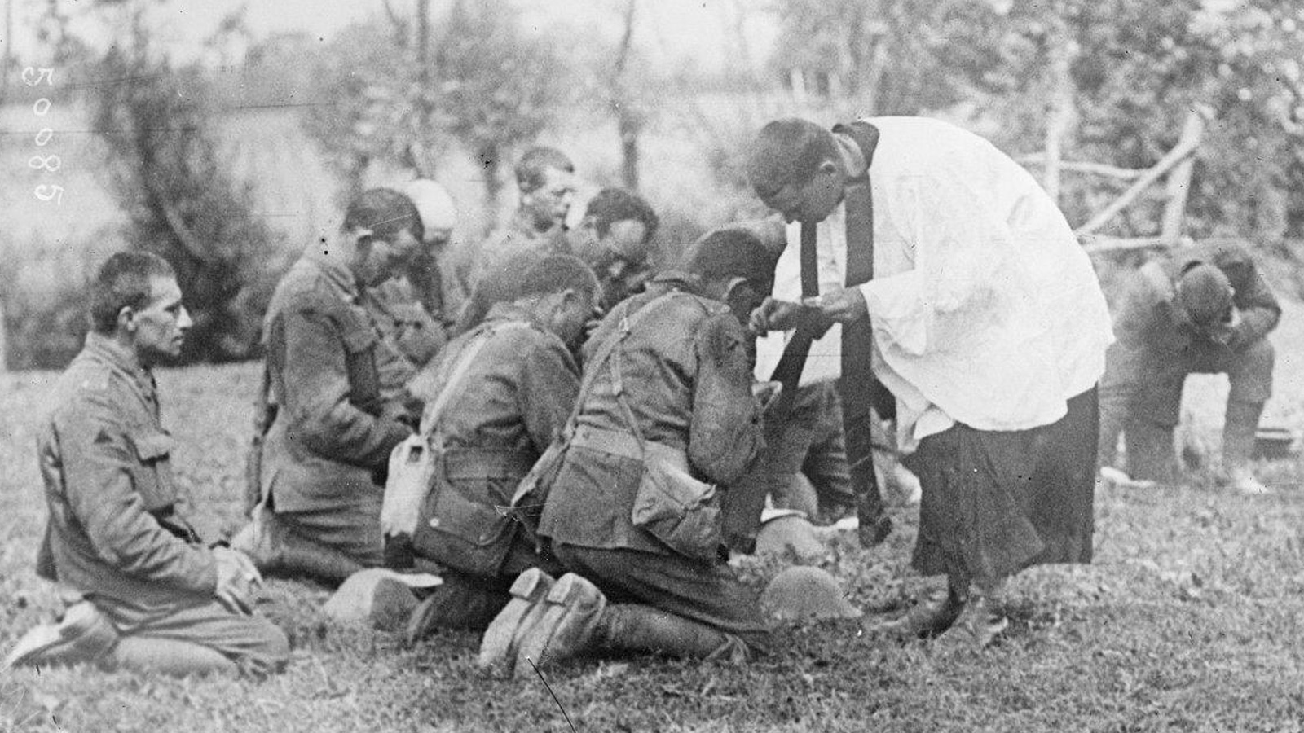
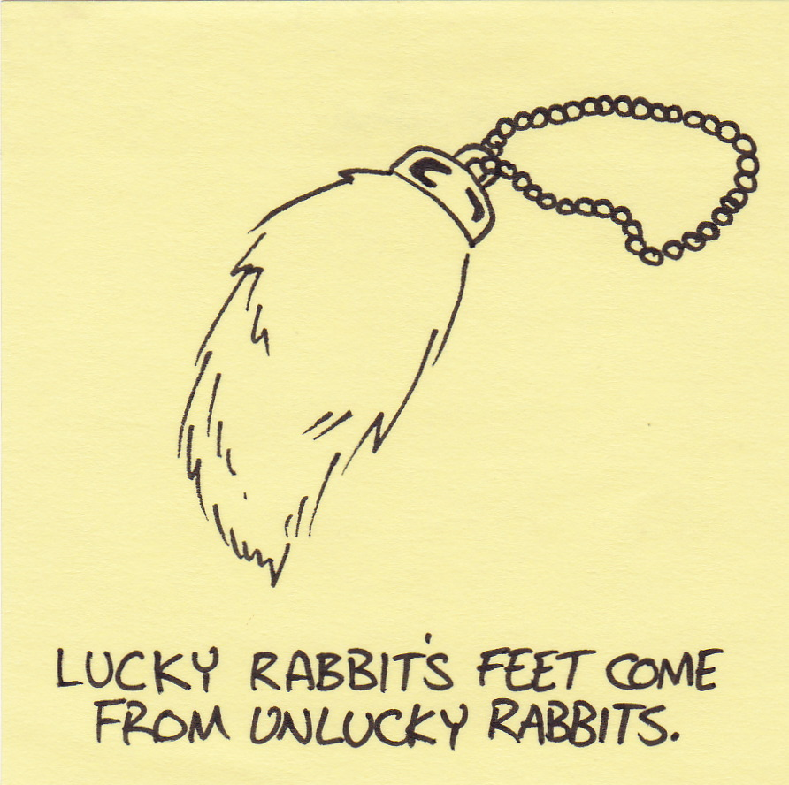
According to Malinowski:
Religion born out of tragedies
Magic/religious rules can have practical effects (avoiding pork, don’t walk under a ladder)
People rely on magic to deal with uncertainty and things outside of their direct control/knowledge. “Magic gives the individual confidence in the face of fear and provides an outlet for hostility.”

Slide 12
Shamans
Enter into “altered states of consciousness” to directly interact with the spirit world.
Contacts an ordinarily hidden reality to acquire knowledge, power, and to help others.
Different types of shamans: healers, diviners, mediums, autowriters.
Spiritual power is individual, often gained in solitude.
Power is derived through cooperation with spirits.

Slide 13
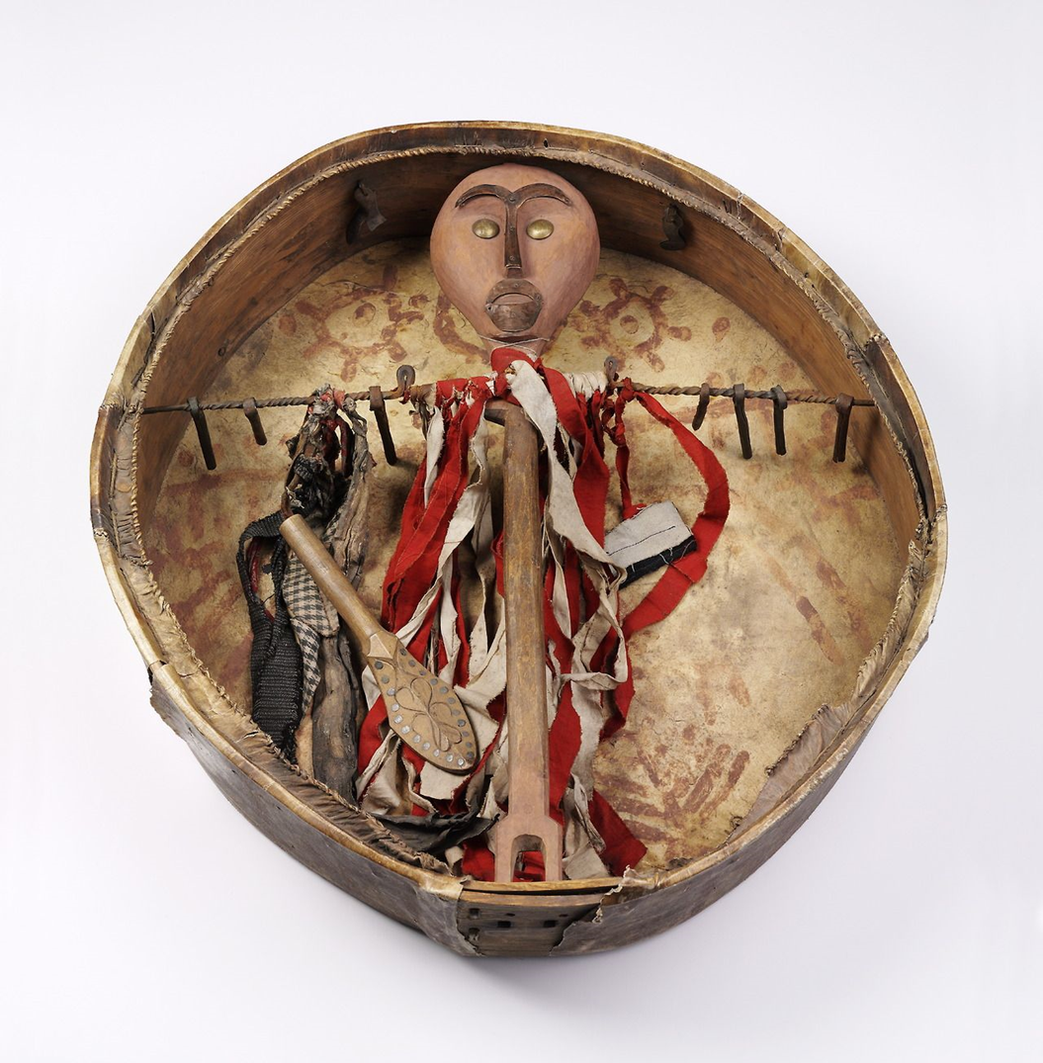
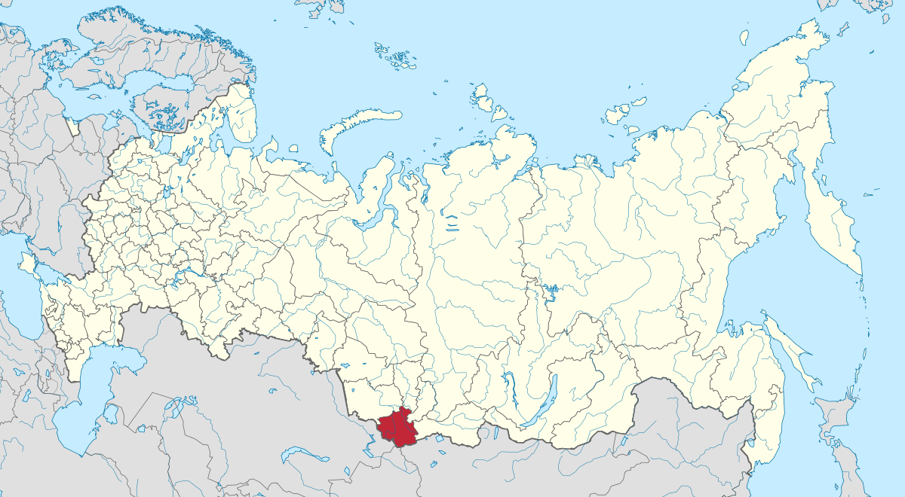
Altai shaman’s drum:
The drum is the shaman spirit double.
It is a soul of the shaman and essential to interaction with the supernatural.
A physical “reflection” of the shaman’s spirit.

Slide 14
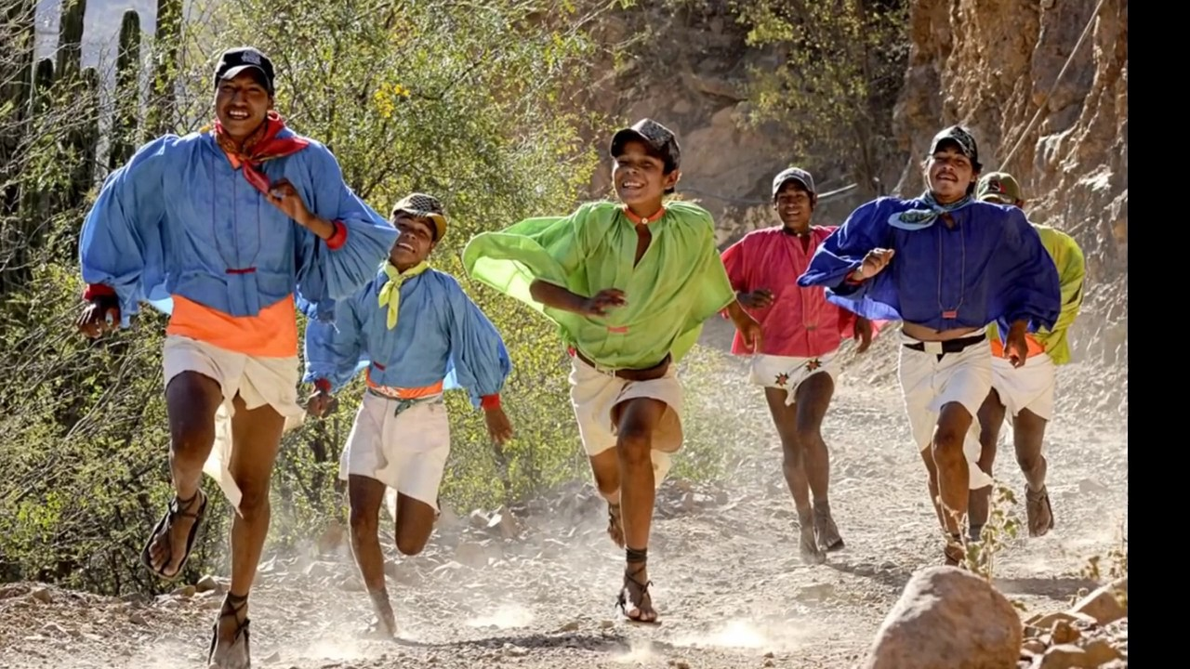
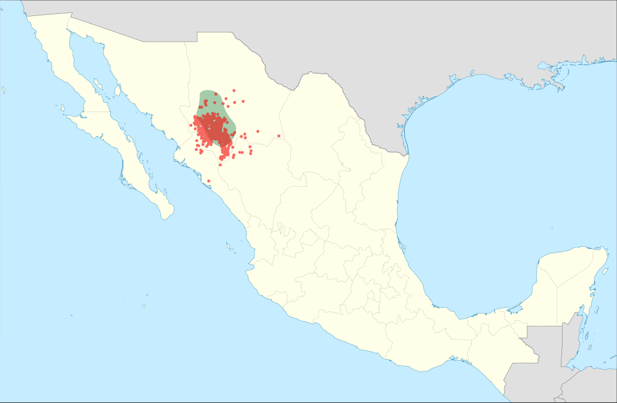
An Example
An Raramuri shaman during the Fiesta of San Pablo:
Various clients visited her: a man trying to catch cattle rustlers, a young father asking about an illness afflicting his wife, a father seeking advice dealing with his son, and so on. The shaman would either cast corn for divination or would administer a hallucinogenic to the client to gain knowledge.

Slide 15
Priests and Priestesses
A full-time religious specialists
Authorized to perform sacred rituals and mediate between fellow humans and supernatural powers, divine spirits, or deities
Keeper of sacred law and traditions
Priests do not have supernatural powers but may be granted them by deities/other beings.

Slide 16
Priests work for deities (gods). They tell the people what the gods want. Shamans work for people. They tell the spirits what to do.

Slide 17
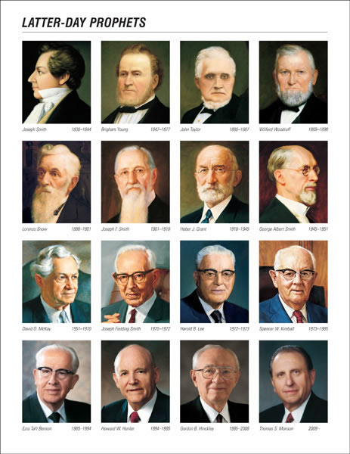
Prophets
Receives divine revelation from supernatural sources. Can call for dramatic change while the general priesthoods usually act of conservative forces to preserve tradition.

Slide 18
Wovoka (Jack Wilson)
Paiute creator of the Ghost Dance
During a typhoid outbreak during a period of considerable military expansion by the US after the Civil War
Ghost Dance:
Wovoka has a series of visions in 1889
Prophesied the ancestors would help defeat the US Calvary and unite Native Americans throughout the West in prosperity.
Jesus was being reincarnated on Earth, and would bring an end to disease and warfare.
Based on a “circular dance,” which was a common form of dancing. Dancing would help bring the perfection.
Some added “the Ghost Shirt,” a white shirt that would prevent harm to warriors.

Slide 19
